Slide 1
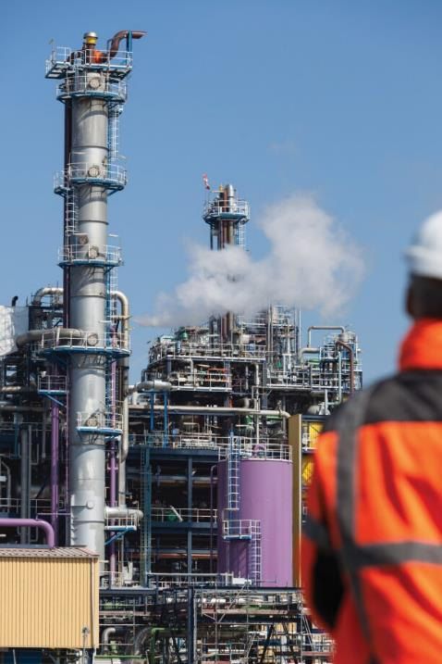
CCUS
What the Insurance Market Should Know
Louis Daspre and Joe Brennan

Slide 2
Summary of Presentation
Why CCUS? Where does it fit in to the Net Zero target?
How financially viable is it? Does it fit in to the current energy economics?
How does CCUS work? What are the processes and how do they operate?
What is carbon dioxide and how does it differ to other industrial gases?
What are the risks Insurers should know with carbon dioxide?
Case studies: CO2 releases
Accumulation of risk
Risk reduction
Notes:
Current net zero climate, the current need for CCUS.
CCS economics, comparison to other approaches
How does CCUS work – Different Carbon Capture technologies, uses and how the gas is stored
Physical properties of CO2 and comparison with other gases
Case studies, of notable incidents involving CO2 gas releases
Accumulation of risk in the supply chain
Opportunities to reduce risks

Slide 3
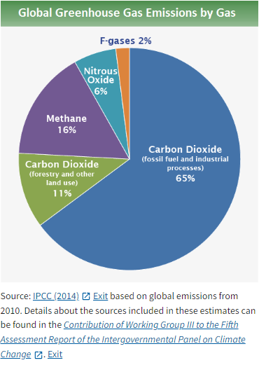
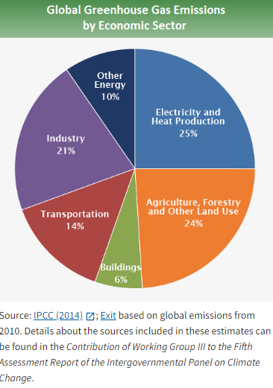
Introduction – Why CCUS?
Carbon dioxide is the biggest contributor to greenhouse gases
Power, Industry and Transportation all large producers of carbon dioxide which can be controlled
Energy transition and current generation of assets indicates that carbon sequestration is most impactful, immediate technology to address current concerns

Slide 4
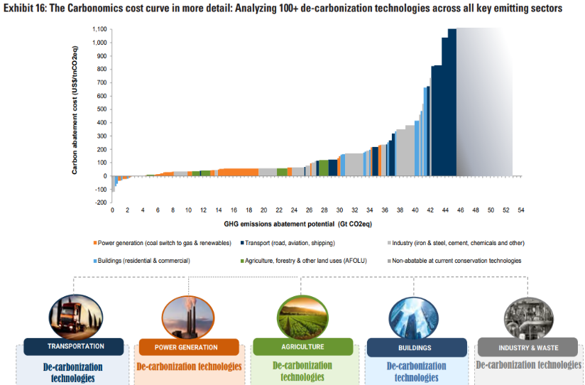
Financial Drivers of CCUS
Cost to remove n^{th} ton of carbon dioxide increases exponentially.
CCUS has its role to play within overall strategy of Net Zero
https://www.goldmansachs.com/intelligence/pages/gs-research/carbonomics-10-key-themes-from-the-inaugural-conference-f/report.pdf

Slide 5
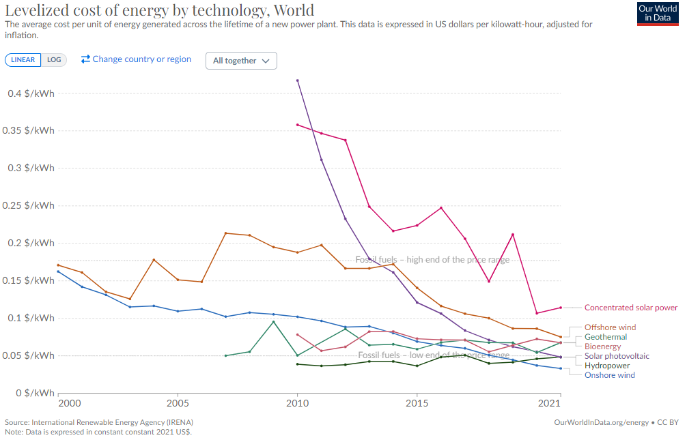
Financial Drivers of CCUS
Green Energy sources arriving at a financially competitive rate around the world
Large upfront capital requirements mean fossil fuels still financially relevant at this time

Slide 6
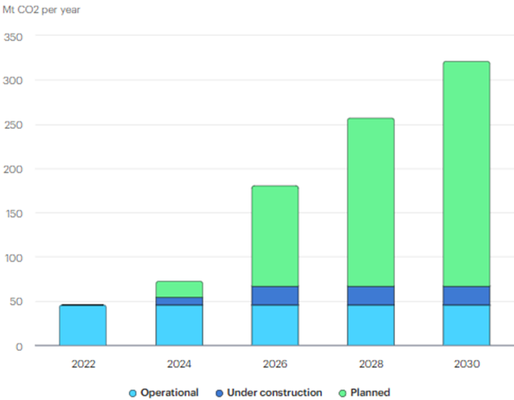
Operational and Planned Projects
All CO₂ capture, transport, storage, and utilisation projects worldwide that have been commissioned since the 1970s
Have an announced capacity of more than 100 000 t per year (or 1 000 t per year for direct air capture facilities).
Includes projects with a clear emissions reduction scope
Excludes CO₂ capture for utilisation pathways which bring low climate benefits (e.g. food and beverages), or which are part of the conventional industrial process (e.g. internal use for urea production), as well as use of naturally occurring CO2 for enhanced oil recovery.
For context, the world currently emits approximately 40 Gt CO₂ per year.
IEA (2023), CCUS Projects Explorer, IEA, Paris https://www.iea.org/data-and-statistics/data-tools/ccus-projects-explorer
Notes:
For context, the world is emitting around 40 GTonnes of CO2 per year currently

Slide 7
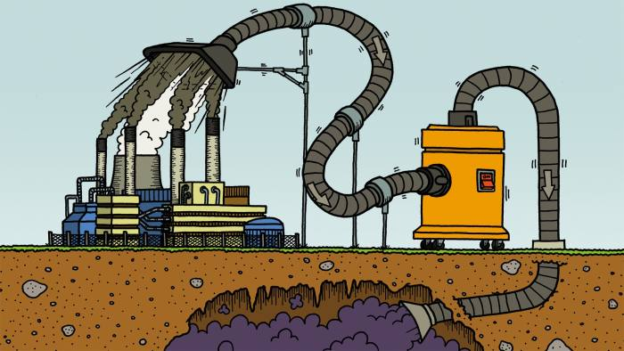
How CCUS Works
What is it and how it works, what is the technology involved?
Retrofit to existing assets?
Or integrate as part of a greener source of energy?

Slide 8
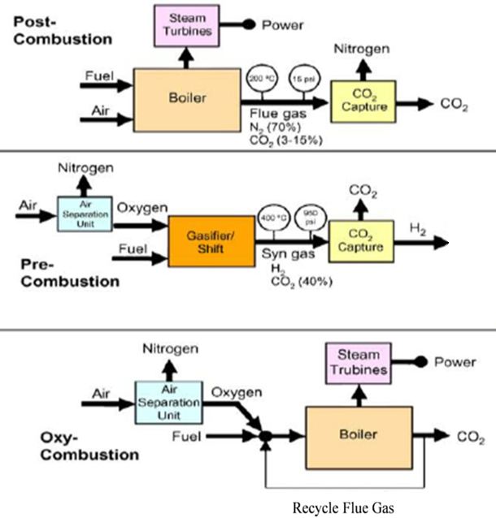
Step 1: Capture the Carbon
There are many types of CO₂ capture technology, and the technology has been in use commercially for decades.
The main capture methods are:
Post-combustion processes – separate CO₂ from combustion exhaust gasses
Pre-combustion processes – convert fossil fuel into a gaseous mixture of hydrogen and CO₂
Oxyfuel combustion processes - use oxygen rather than air for combustion of fuel

Slide 9
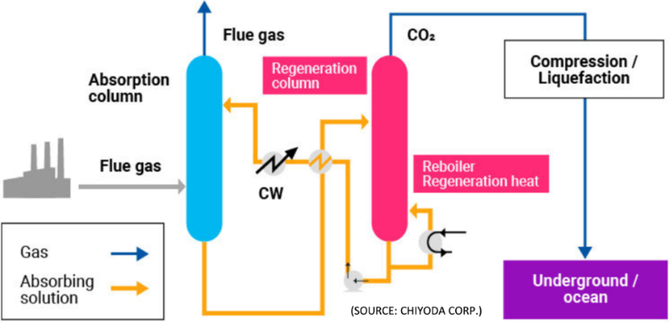
Post Combustion Capture
Typical in hydrocarbon source energy power plants
CO₂ is captured from the flue gases generated
Chemical process employed is typically absorption, with regeneration of the liquid releasing the CO₂
Underground / Subsea
Notes:
Post combustion is probably the most common process. In this method, CO2 is separated from the flue gasses that result from burning fossil fuels, by bubbling the gas through an absorber column packed with liquid solvents. Once the chemicals in the absorber column become saturated, a stream of superheated steam is passed through it. This releases the trapped CO2, which can then be transported for storage.

Slide 10
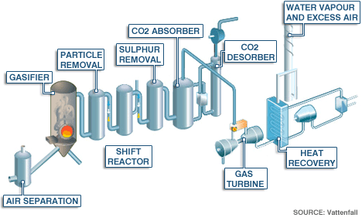
Pre-Combustion Capture
Fuel is not combusted, it is blasted into a gasifier and partially reacts with oxygen and steam to form syngas;
CO + H₂O
Further reaction with steam forms CO₂ + H₂
Notes:
Pre-combustion is carried out before burning the fossil fuel and uses coal or natural gas. The coal is gasified to produce a synthetic gas made from carbon monoxide and hydrogen. The carbon monoxide is reacted with water to produce CO2, and more hydrogen. The hydrogen can be diverted to a turbine where it is burned to produce electricity, and the CO2 capture and stored.

Slide 11
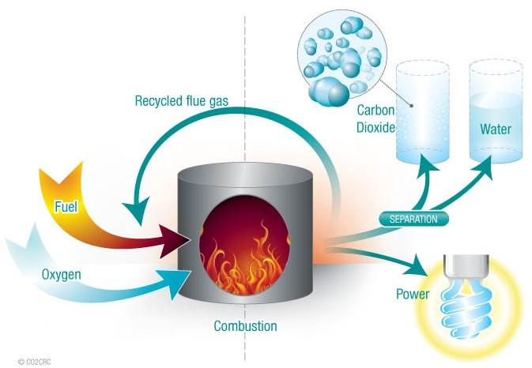
Oxyfuel Combustion
Combustion of fuel in oxygen to form CO₂ + H₂O
Notes:
When coal, oil or natural gas is burned in normal air, CO2 makes up around 3-15% of the waste gas. Separating it out is difficult and energy intensive. An alternative method is to burn the fuel in pure oxygen, so called oxyfuel combustion. By doing this, virtually all the waste gas is composed of CO2 and water vapour. Proven technology in retrofitting to existing coal plants.
This seems like a no-brainer at a high level, but in reality there are disadvantages. Producing high purity O2 is extremely energy intensive in its own right, and combustion using pure oxygen gives rise to very high temperatures that need to be managed.

Slide 12
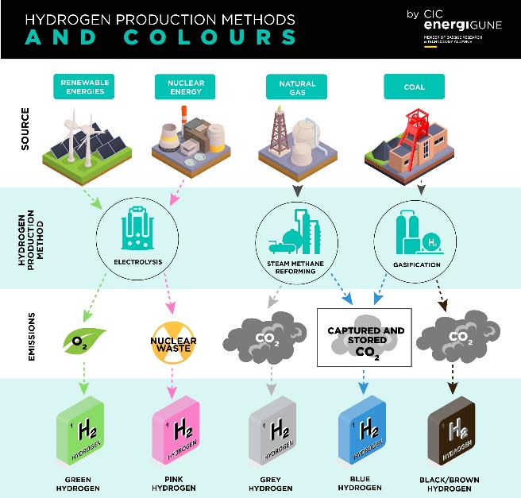
(Hydrogen)

Slide 13
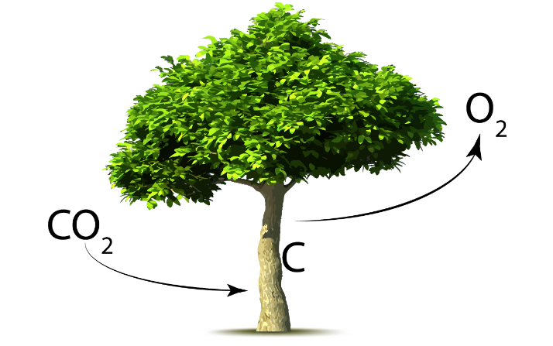
Direct Air Capture
Not all activities producing CO₂ allow removal at source (e.g. aviation)
Other processes allow capture at a later stage
Source: replant-environment.ca

Slide 14
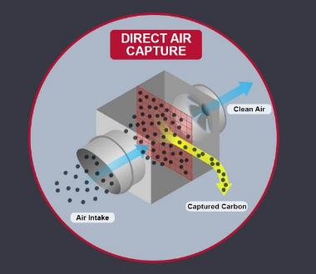
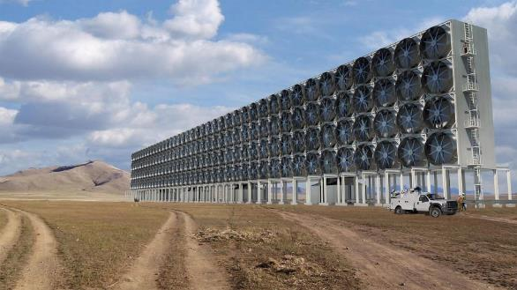
Industrial Direct Capture
Source: Frazer-Nash Consultancy
Source: c2es.ord
One of few technology options available to truly remove CO₂ from the atmosphere
CO₂ in the atmosphere is much more dilute than in a flue gas
Higher cost relative to other CO₂ capture technologies
Notes:
Let’s take a look at the mechanical systems that replicate the work of trees.
Direct Air Capture (DAC) technology achieves this by drawing in atmospheric air and then, via a series of chemical reactions, extracting the carbon dioxide from it while returning the rest of the air to the environment.
You may be thinking to yourself ‘why use direct air capture technology if it simply replicates what trees can do?’. Well, direct air capture technology is much faster, has a smaller footprint than a forest, and delivers the carbon dioxide in a pure, compressed form that can then be stored underground, or even used! However, for DAC to be considered a negative emissions technology, you would need to consider what the CO2 was being used for.
Direct air capture is a four-stage process: firstly, the ambient air is directed towards the sorbent used to adsorb or absorb the carbon dioxide. This is enhanced by using large fans to pull the air through as seen in the computer image on the right. In Stage 2, the CO₂ comes into contact with a capture agent, which can be either a liquid or a solid, that captures CO2 from the air. In Stage 3, the CO2 is released from the capture agent into a storage facility. Finally, the high-purity CO₂ is compressed, before transportation to storage or for re-use.
This sounds great doesn’t it, so why don’t we get building! Well, CO2 in the atmosphere is diluted and not as concentrated as it is in a flue gas, so it simply isn’t as effective as it first appears. Furthermore, it is one of the more expensive CO2 capture technologies.

Slide 15
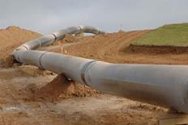
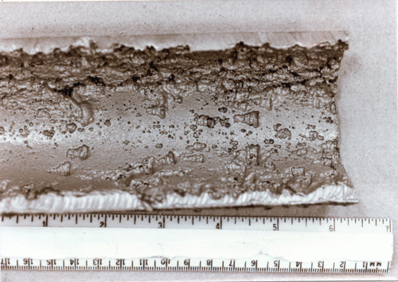
Step 2: Transportation
Once the CO₂ has been captured, it is compressed into liquid state and transported by ship or pipeline.
Millions of tonnes of CO₂ are already transported over thousands of km of pipeline, both onshore and offshore.
Source: worldpipelines.com
Source: Pipeline Observer
Source: allseas.com
IMPORTANT – dry CO₂ is not corrosive to pipelines. However, where the CO₂ contains moisture, it must be removed from the CO₂ stream to prevent corrosion.
Notes:
The transportation of captured CO2 is a key step in the CCS process, even though it is not included in the CCS acronym.
Once captured, the CO2 is compressed using existing, tried and tested technology, into a liquid known as ‘supercritical CO2’, ready for transportation by ship or pipeline. The transportation of CO2 by pipeline is well established, with millions of tons of CO2 already being transported safely over thousands of kms. The large-scale transportation of CO₂ by ship is in its infancy and has similarities to the shipping of liquefied natural gas (or LNG). 2024 will be the first year of CO2 shipping via the K Line ships in the Northern lights project.
However, it is important to understand that CO2 is an acid gas, which reacts with water to form carbonic acid. Carbonic acid is very corrosive to carbon steels. This means that CO2 transported through carbon steel pipelines needs to be dry. The use of stainless steel for any components in contact with wet CO2 takes care of this problem, but it certainly wouldn’t be cost effective to install stainless steel pipe across thousands of kms.
With the future of CO2 storage being under the sea, we are likely to see an increase in the number of subsea pipelines associated with CCS. Aside from the requirement for dry C02, the engineering know how already exists, and these pipelines will simple be a continuation of what we are already seeing in the oil and gas world.

Slide 16
Step 3: Storage of Captured Carbon
Notes:
And now to storage. Where can you store CO₂?
The most well-developed approach to storing CO₂ is injecting it underground into naturally occurring, porous rock formations such as former natural gas or oil reservoirs, coal beds that can’t be mined, or saline aquifers. These are deep geological formations with deposits of very salty water present in the rock’s pores, and are most commonly found under the sea. The North Sea and the area off the US Gulf Coast contain many saline aquifers.
How do we ensure the injected C02 stays underground?
The primary way underground reservoirs store CO₂ is through the solid impermeable rock that typically surrounds them. Once CO₂ is injected into a reservoir, it slowly moves upwards through the reservoir until it meets this layer of impermeable rock, which acts as a barrier that the CO₂ can’t pass through. This is what’s referred to as ‘structural storage’ and is the same mechanism that has kept oil and gas locked underground for millions of years. Over time, the CO₂ trapped in reservoirs will often begin to chemically react with the minerals of the surrounding rock. The elements bind to create solid, chalky minerals, essentially locking the CO₂ into the rock in a process called ‘mineral storage’.
In the case of saline aquifers, as well as structural and mineral storage, the CO₂ can dissolve into the salty water in a process called ‘dissolution storage’. Here, the dissolved CO₂ slowly descends to the bottom of the aquifer.
In theory, these processes work to store CO₂ indefinitely. While there remains some possibility of CO₂ leakage from a site, research suggests it will be minimal. Many studies have been conducted into the leakage of CO2 from geological storage, with most suggesting that more than 98% of injected CO₂ will remain safely stored for over 10,000 years.

Slide 17
Carbon Capture Utilisation and Storage (CCUS)
CO₂ is a useful and valuable commodity
Current common uses for CO₂ include:
Fertilizer industry
Enhanced oil recovery (storage)
Food and beverage production
Fire suppression
Developing uses for CO₂ include:
Fuels
Chemicals
Building materials
Scaling up the usage of CO₂ is limited by economics rather than technology.
Notes:
The main objective of this presentation was to give an overview of Carbon capture and Storage, but you may also have heard about Carbon Capture Utilisation and Storage, so called CCUS. I think it is worth touching on the utilisation element.
When thinking about CO2 and its role in global warming, it is easy for forget that Co2 is actually a useful commodity. This slide provides a high level summary of some existing and developing uses for CO2. And let’s not forget that without CO2, we wouldn’t be able to have bubbles in the beer that so many of us enjoy!

Slide 18
CO₂ – What’s the big deal?
Beer and fizzy drinks
Plants love it
We exhale it
It can’t be that dangerous, can it?
Notes:
We’ve talked about the different ways that CO2 is captured, and why it is so crucial that it is captured and stored, but what are the risks? Because on the face of it, CO2 would appear to natural gas’ benign cousin,
Afterall, its in beer and fizzy drinks
Plants loves it - we all know they absorb CO2 and convert it to oxygen for us to breath
Humans exhale it – exhaled breath consists of 4% CO2 gas.
When we are talking about CO2 in CCS, what are the risks that insurers need to know… are there any?

Slide 19
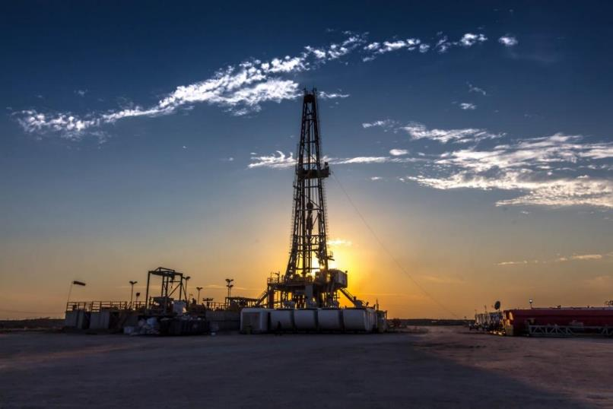
CO₂ – What’s the big deal?
Notes:
Assets like this are insured all the time, containing flammable and explosive products like oil, gas and other petrochemicals.
The Insurance industry has experience in the asset technologies, and the transported products.
Well versed on what can go wrong for these types of assets and the types of costs that can be borne by Insurers.

Slide 20
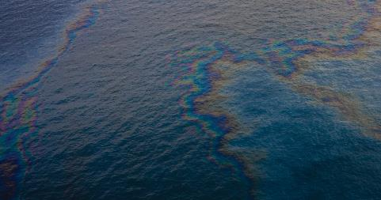
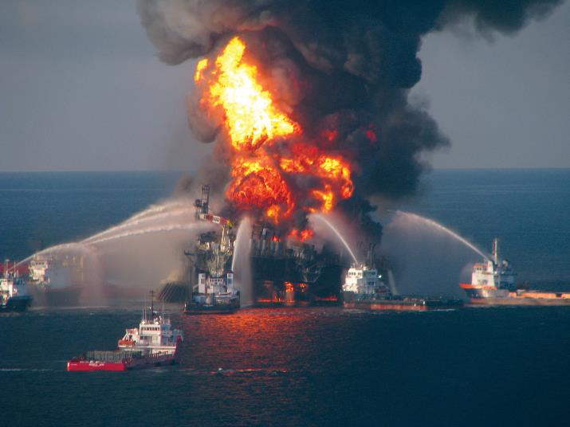
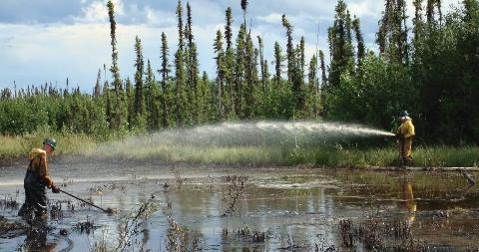
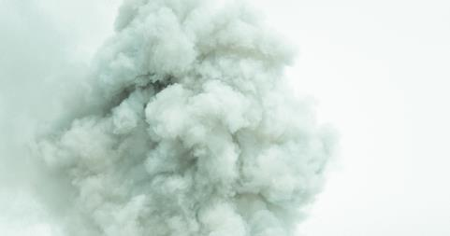
CO₂ – What’s the big deal?
Explosion and fires
Environmental liabilities
Notes:
There can be Property damage - first or third party, caused by fire and explosion, also
Environmental liabilities caused by oil spills or pollution, paid either to the government by way of fines, or to third parties, for damage caused to their property or business.

Slide 21
CO₂ – What’s the big deal?
Vs
?
Notes:
On that basis, and compared to oil and gas it would seem far less risky, after all, it is essentially exhaled air…
The next few slides attempt to dispel this myth. It’s not meant to scare or undermine Carbon Capture as a technology but rather highlight the potential hazards that may be created and how they might be different to what the insurance market (and wider society) is used to.

Slide 22
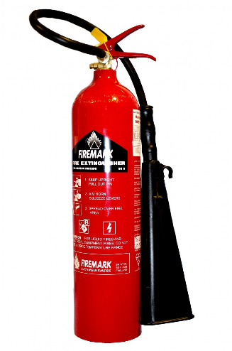
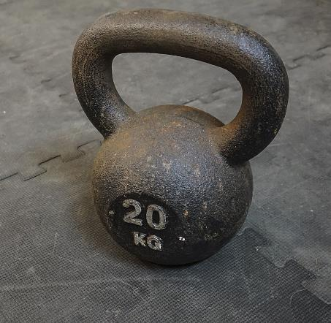
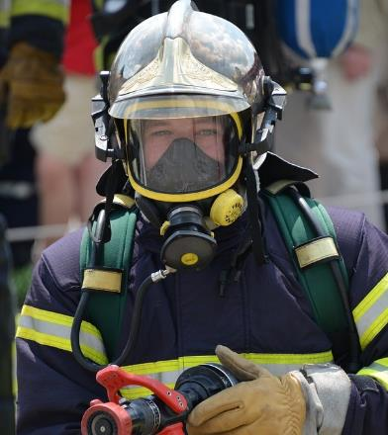
CO₂ – What’s the big deal?
Asphyxiant
Intoxicant
Heavier than air
Colourless
Odourless
Non-flammable
Notes:
Firstly, let’s look at the physical properties of carbon dioxide and how it might differ to oil and gas products.
It’s an asphyxiant, what does that mean? Well, it displaces the oxygen in the air.
It’s also an intoxicant, meaning it has a chemical effect on the brain, but not in good way. At concentrations above 5%, it can cause Disorientation, Confusion, Paranoia and Seizures.
Concentrations of more than 10% may cause convulsions, coma, and death.
Levels of more than 30% act rapidly leading to loss of consciousness in seconds.
Studies have shown that the cause of death in breathing high concentrations of CO₂ is not lack of oxygen, but CO₂ poisoning.
CO2 is around 1.5 times heavier than air, meaning it will settle in low lying areas such as basements or low-lying ground. It’s also far less easy to disperse when compared to lighter products like natural gas.
Colourless – so you can’t see it like smoke or smog.
Unlike natural gas or hydrogen sulfide, it’s odourless, which combined with being colourless, means there’s no indication if you’ve just entered an area that’s filled with CO2.
Non-flammable – used widely as a fire suppressant, so you can’t set light to it to get rid of it, and it doesn’t burn off. Additionally, it can smother internal combustion engines, causing them to cut out. This can impact other plant and machinery such as generators or compressors, or hamper emergency vehicles in the event of a release.
Based on these points, if you were to leak CO2 gas into a basement, it would fill up like a swimming pool - displacing all the air. If I was stood in that basement, I’d pass out due to suffocation, if you saw me and tried to rescue me, you’d pass out too.

Slide 23
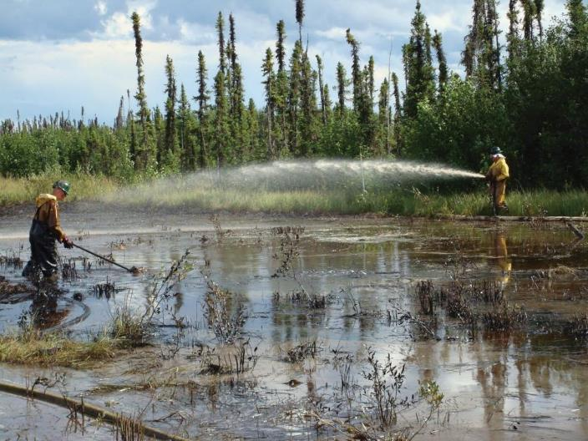
Potential Risks
Non-flammable – no fires
No oil spills
Environmental liabilities …but not as we know it.
Other risks..
Notes:
In the event of a loss involving a CO2 asset there is unlikely to be consequential damages due to fire, Afterall, it’s non-flammable, so more likely to extinguish fires than create them.
It is unlikely that there will be extensive pollution clean-up costs or liabilities akin to that of an oil spill.
Environmental liabilities are more likely to be penalty charges, either a payment to the government for releasing to the sea and atmosphere, or to the company that is paying the operator for the CO2 to be stored.
However, CO2 does have other inherent risks that the market should be aware of, and there has been CO2 releases in the past.

Slide 24
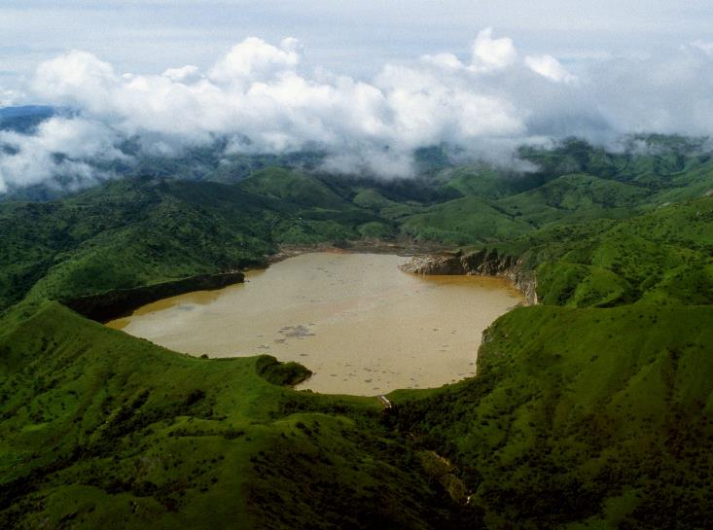
CO₂ Releases
Lake Nyos, Cameroon
Dormant volcano
Crater lake
CO₂ seeps into lake
Dissolved at bottom of lake due to water pressure
CO₂
Notes:
Innocuous looking lake is Lake Nyos in Cameroon, which sits in the crater of a dormant volcano.
Over time, volcanic gases, including CO2, seep upwards through the rock and into the lake water.
Under normal conditions of equilibrium, the CO2 is held in a dissolved form at the base of the lake, much like the bubbles in an unopened bottle of coke.

Slide 25
CO₂ Releases
Lake Nyos, Cameroon
Limnic eruption
Trapped CO₂ release
CO₂ flowed down mountain
50 metre deep cloud
Travelled 25 km
Reached speeds of 50km/h
CO₂
CO₂
Notes:
On the night of 21st August 1986, the lake suffered a Limnic Eruption whereby the equilibrium was disturbed, and caused the trapped CO2 gas to escape – effectively removing the cap from a shaken bottle of coke.
CO2 erupted from the lake, and because it’s heavier than air it silently cascaded down the side of the mountain into the valleys below.
Estimated that the 50m deep cloud travelled for 25 kilometers and reached speeds of 50km/h.

Slide 26
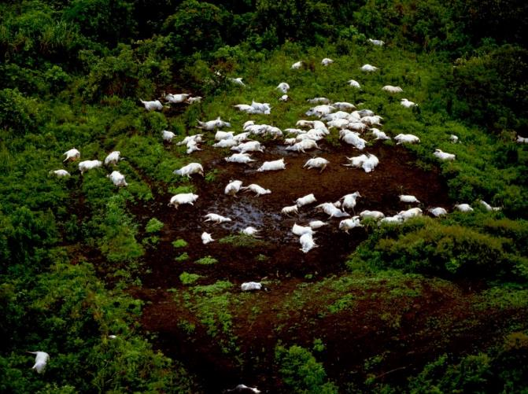
CO₂ Releases
Lake Nyos, Cameroon
Killed 1,700 people
3,000 livestock
Notes:
For the few survivors that awoke, they woke up to find themselves surrounded by silence and death. There was no bird song, or the sound of insects which is synonymous with this part of the world.
Chickens were dead in the streets, livestock dead in the fields, dead birds littered the area having dropped from the sky.
1,700 people and over 3,000 livestock died.
Although a naturally occurring disaster, I think it illustrates the deadly devastation that the CO2 gas release can have.

Slide 27
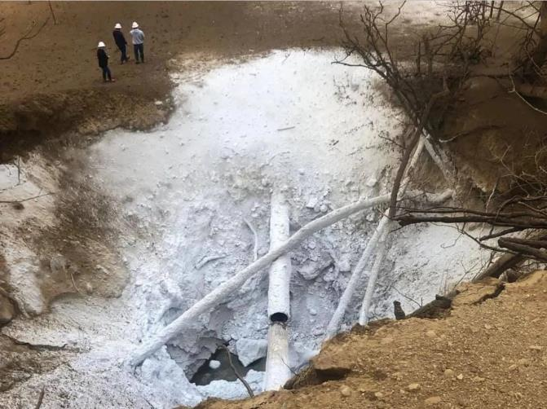
CO₂ Releases
Satartia, Mississippi
CO₂ pipeline for EOR
Local area enveloped
Evacuation hampered
Lasting health conditions
Notes:
More recently, in 2020, another CO2 release occurred, this time in the USA, in a place called Satartia, Mississippi.
However, this release wasn’t naturally occurring, it was from a 24-inch CO2 pipeline used by a local oil company for enhanced oil recovery – a way of injecting the gas into oil reservoirs to flush out more oil.
The pipeline was built through hilly, rugged terrain. Saturated with rain over two months, soil around the pipeline slid, causing a pipe weld to break and releasing an explosion of ice and carbon dioxide.
Local area enveloped with CO2 gas. When this incident occurred, panicked residents were gasping for breath and had no idea what to do.
When they tried to evacuate in their cars, the engines cut out – smothered by CO2 gas. They had nowhere to go, all they could do, was wait. None of the local sheriff’s deputies or volunteer firefighters had any emergency training in CO2 leaks, neither did staff at two of the area’s hospitals.
This incident occurred in modern times, in a developed country, however there were no provisions, no alarms, no evacuation procedures and although fortunately no one died, residents were left with lasting health conditions. It’s quite fortunate that this event happened in such a remote place, as it probably would have been more serious if it had occurred in a more densely populated area.

Slide 28
Risk Accumulation
CO₂
CO₂
CO₂ Production
Transportation
Storage
CO₂
Utilisation
Notes:
So, we’ve had the disaster stories on what can go wrong in the event of a release, but what about the business interruption, or contingent business interruption side of things. Here’s a simplified diagram representing the CO2 supply chain, and it shows that CO2 can be treated both as a waste product or feedstock depending on where you sit. On the left we have the CO2 producer, which may be a power station, cement plant or other CO2 intensive industry.
In order to reduce the amount of CO2 that it releases to the atmosphere (and likely reduce taxes or penalty charges), it will pay the transportation company – a pipeline co or shipping co
and the storage company for disposal / storage.
As previously mentioned, it is also possible to utilize CO2 for other purposes and the producer may also sell the gas to be utilized in agriculture for fertilizers for example.
As you can see, the supply chain is very interdependent, so if one of these parties suffers a loss – what are the potential impacts to the other parties in the chain?

Slide 29
Risk Accumulation
CO₂
CO₂
CO₂ Production
Transportation
Storage
CO₂
Utilisation
Notes:
If the fertilizer company suffers a loss.
Producer now unable to sell CO2 to the fertilizer company, losing revenue as a result.
Not only is the producer out of pocket because of this, but the producer also now needs dispose of more CO2 and will have to pay additional transportation and storage costs for the CO2 that would have been utilized.

Slide 30
Risk Accumulation
CO₂
CO₂
CO₂ Production
Transportation
Storage
CO₂
Utilisation
Notes:
If the CO2 producer suffers a loss to the extent that they cease production, they no longer have to dispose of CO2 which can be considered a cost saving.
However, neither the transportation co or the storage co will have CO2 coming their way so both have their revenue cut or reduced.
Also, the fertilizer co now has no regular source of CO2
and may need to source elsewhere at an additional cost.

Slide 31
Risk Accumulation
CO₂
CO₂
CO₂ Production
Transportation
Storage
CO₂
Utilisation
Notes:
If either the transportation co or the storage company have a loss that interrupts their business.
Then the CO2 producer will have nowhere to store the CO2,
and may have to vent this CO2 to the atmosphere. Although saving CO2 storage fees, it’s likely to incur large penalties or fines from the government.
These are all simplified scenarios, in reality it’s likely to be more complex and the forensic accountants in the room will have the pleasure of grappling with these complexities.
But it’s important that all stakeholders - Insurers, brokers and Insureds, are aware of the potential exposures so that they can be understood and accounted for accordingly.

Slide 32
Risk Reduction
CO₂ Release Prevention
Pipeline routing/burial
Water content
Design codes/regulations
CO₂ Release Mitigation
Pipeline routing - people
Emergency procedures
Notes:
To reduce the risk we can either make efforts to prevent the CO2 release, or make efforts to mitigate its effects. To prevent its release, we should consider:
Pipeline routing, this could influence the risk as burial can provide an additional barrier against release, it will also make it less likely to be damaged by a direct collision. But in light of the incident in Satartia, Mississippi, it would also be wise to consider the ground conditions of the route and if it is prone to landslides or landslips. There are also plans to utilize existing infrastructure such as natural gas pipelines, this may bring its own risks as a good design for a gas pipeline could be a bad design for a CO2 pipeline.
As previously mentioned, if there is moisture present in the pipeline, it will combine with the CO2 to form carbonic acid which can corrode the pipeline and lead to ruptures, therefore it is critical that the gas is dry.
Any machinery or instrumentation breakdown, or a defect that introduces moisture into the pipeline could result in either pipeline downtime, while it is dried and checked or, at worse, result in a catastrophic failure. We’ve probably all seen claims where minor commissioning errors have introduced debris, corrosion or contamination into a piping system and led to large claims. Because of this inherent susceptibility to moisture, this aspect should be consideration.
Design codes and regulations. This will depend on the location of the pipeline and the associated legislation. Some countries may have zero experience or regulations for CO2 pipelines, other countries may have experience and regulations, but they are for CO2 pipelines used for enhanced oil recovery, which are at a higher concentration and pressure than that required for CCS. Because pipelines for CCS may be at a slightly lower pressure and concentration, they may fall outside current regulations in some countries.
Pipeline routing, this time as a mitigation in the event of a release. Does the pipeline pass near populated areas? As CO2 is heavier than air, it will collect in low areas, therefore the topography of the areas could be an additional risk factor when combined with pipeline proximity to densely populated areas. Routing will also depend on the location of the industrial clusters that produce the carbon dioxide. In the UK these clusters tend to be close to the coast and to the offshore fields where it will be stored, which minimizes the number of pipelines on land. However, in the US, a large amount of the captured CO2 will come from in-land industrial hubs which will rely on an extensive network of land-based pipelines, to transport it to the storage locations. It is also likely to be a key consideration when repurposing existing natural gas pipeline.
Finally, what are the emergency procedures in the event of a release, such as emergency shut offs, notifications, CO2 detectors, evacuation protocols etc. All of which could be a key safety net in the unlikely event of a release.

Slide 33
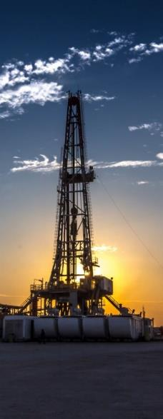
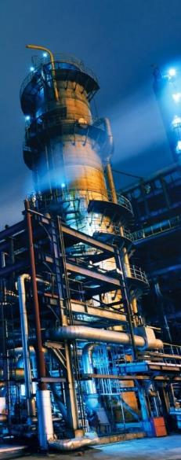
Conclusion
Existing technologies
Track record
Knowledge sharing
Risk awareness
Any questions?
For more information including key contacts visit
www.charlestaylor.com/naturalresources
Notes:
So, we’ve scared you with the disaster stories of all that can go wrong with CCS, but it isn’t all bad news.
CCS technology already exists – CO2 capture technology has been used since 1920s for reducing the CO2 content of natural gas or methane. In the 1970s oil companies started injecting CO2 below ground for enhanced oil recovery.
In 1996, Equinor’s Offshore Sleipnir facility was the first to do it purely for storage and not for enhanced oil recovery. It removes CO2 from produced gas and injects it into a separate underground formation.
Vast amount of experience and knowledge out their, but it’s unlikely to be all in one place, it’s important that knowledge and experience is shared between the offshore, onshore and shipping sectors to ensure the risks are fully understood.
Although it’s a combination of existing technologies, there is always a risk factor when tech is scaled up and utilized in new areas, environments or for new purposes, particularly, where there may not be same levels of experience, expertise or regulation.
Conscious we’ve bombarded you with information, but I think if there’s one point to take away, it’s that although not flammable, CO2 isn't a benign gas and does present its own quite distinct risks which can be underestimated but could have severe consequences.

Slide 34
Louis Daspre MEng CEng MIChemE Cert.CII Cert.CILA
Senior Adjuster
Dubai
Email: LouisFlorent.Daspre@CharlesTaylor.com
Joe Brennan MEng CEng MICE MEI Cert.CII Cert.CILA
Senior Engineering Adjuster
London
Email: Joe.Brennan@CharlesTaylor.com

