Slide 1
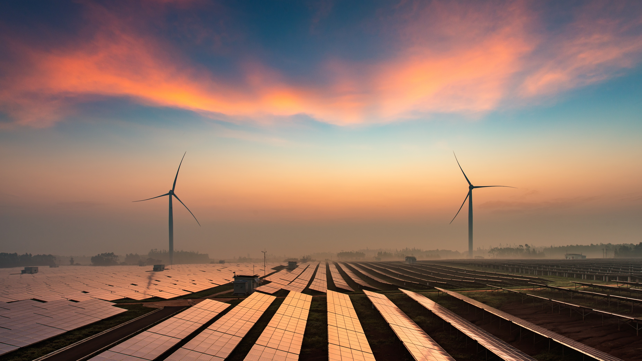
Energy Financing –
New Models to Support the Transition
1 November 2023
Lee Swain & Edward Secchi

Slide 2
Agenda
Energy Transition
Project Financing
Industry Developments
Role of Insurance

Slide 3
Energy Transition

Slide 4
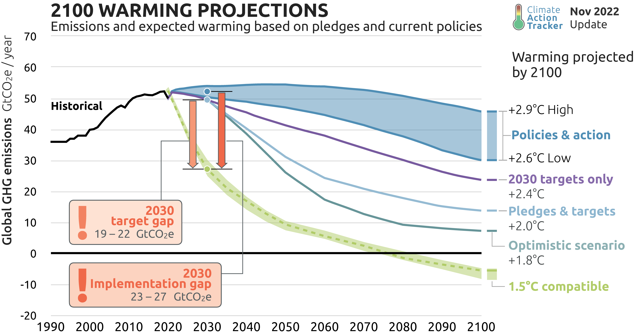
Why Needed?

Slide 5
Changes Needed
Increase Annual electricity production 4x to 90k – 130k TWh
Wind capacity from ~900 GW to 13,000-15,000 GW
Solar capacity from ~1,000 GW to 30,000 GW
Battery storage to increase from <1 TWh today to 11 TWh
Grid modernisation and expansion
Risk mitigation
Increased investment, green finance and support for start-ups

Slide 6
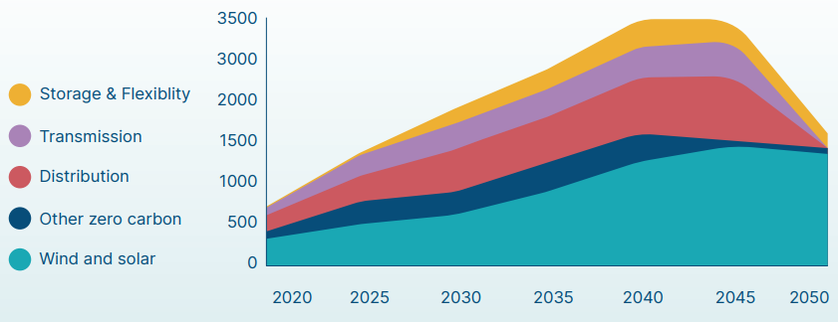
Investment Needed
*USD Billion

Slide 7
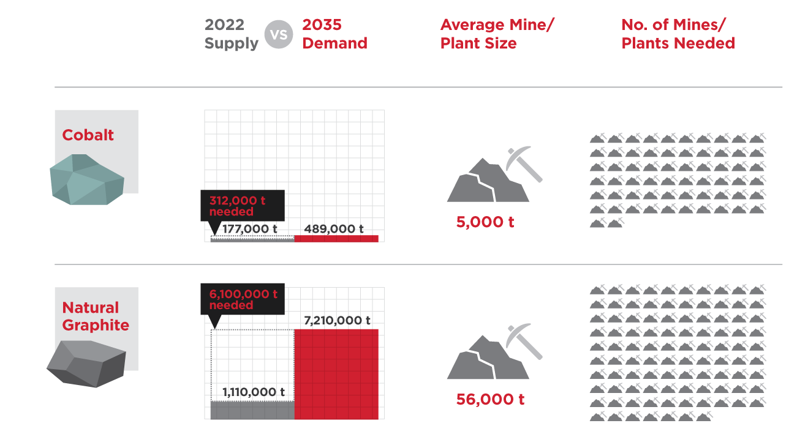
Investment Needed
Notes:
.

Slide 8
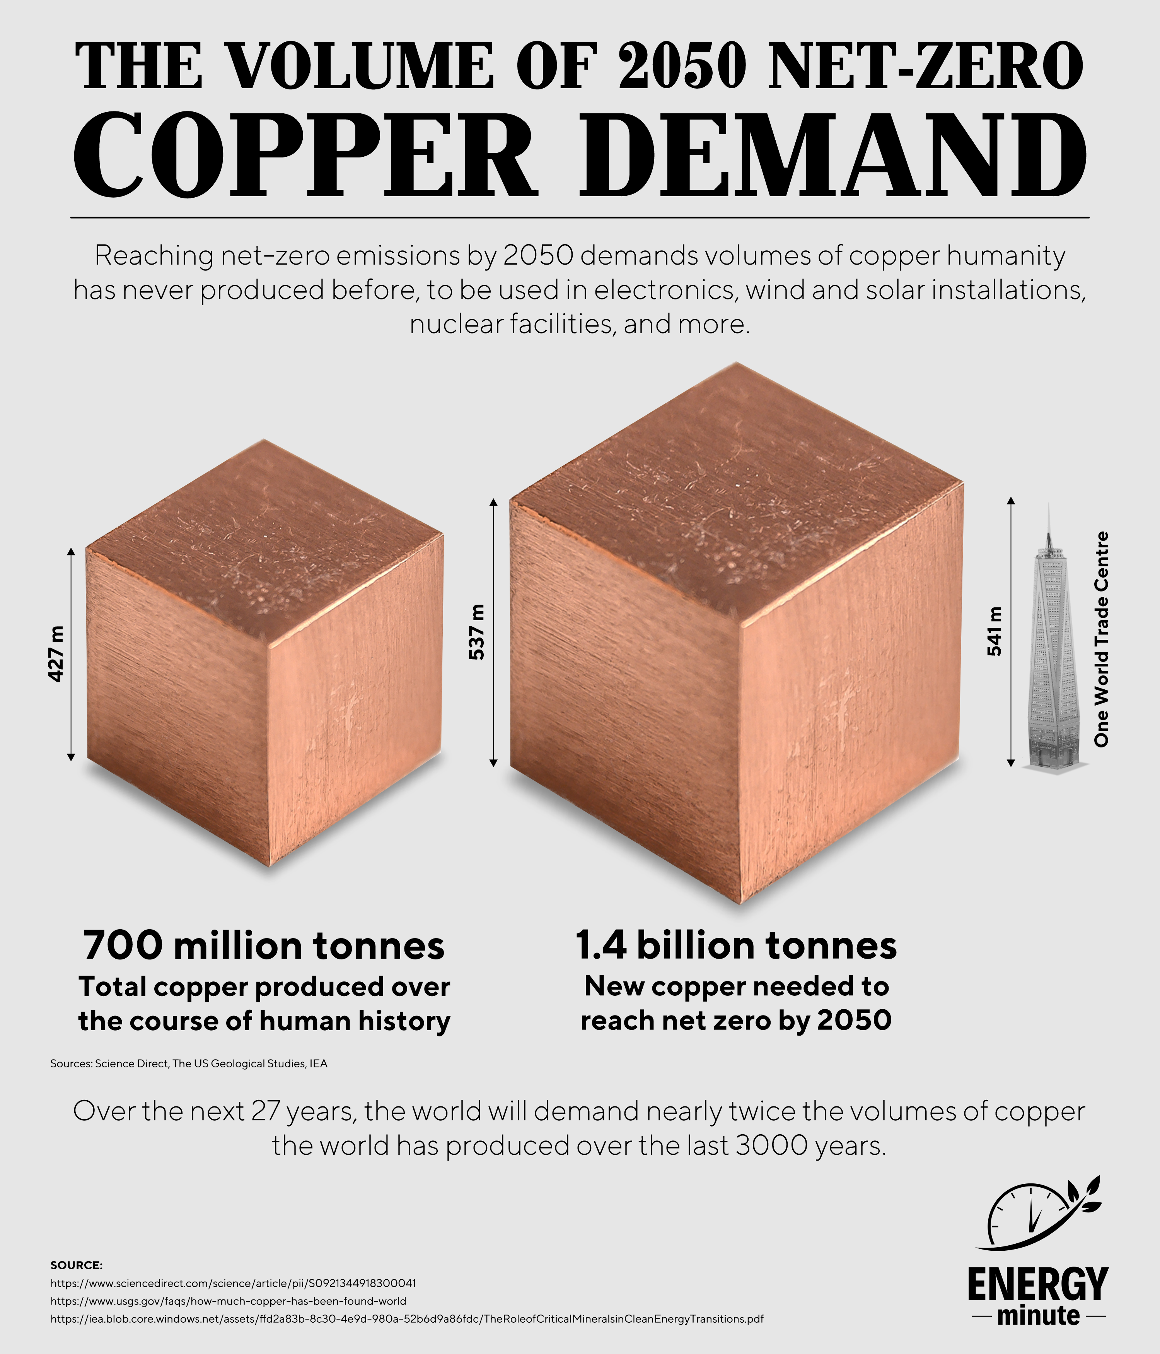
Investment Needed
Notes:
.

Slide 9
Project Financing

Slide 10
Project Financing
Securing funding for a project of large capital expenditures and long-term commitments
Commonly used in the energy industry
Different from traditional corporate financing
Usually non-recourse - lender has no claim on the assets or future earnings if the project fails
Notes:
, as lenders evaluate the project's cash flow potential rather than the borrower's creditworthiness

Slide 11
The Key Steps to Project Financing
Project Development and Feasibility Study
Legal and Regulatory Framework
Project Structure
Consortium Formation
Financial Modelling
Equity Investment
Debt Financing
Government Support and Incentives
Offtake Agreements
Notes:
Project Development and Feasibility Study:
Define the project's scope, including the type and size of the power plant.
Conduct a feasibility study to assess the technical, economic, and environmental viability.
Determine the plant's capacity, location, and expected output.
Legal and Regulatory Framework:
Understand the legal and regulatory requirements for power generation in the chosen location.
Obtain the necessary permits, licenses, and environmental approvals.
Project Structure:
Choose an appropriate project structure, such as Build-Own-Operate (BOO), Build-Operate-Transfer (BOT), or Public-Private Partnership (PPP).
Consortium Formation:
Form a consortium or partnership with other investors, including equity investors, lenders, and potentially the government.
Financial Modeling:
Develop detailed financial models to estimate project costs, revenues, and cash flows.
Assess risk factors and conduct sensitivity analysis.
Equity Investment:
Raise equity capital from project sponsors and investors.
Determine the equity contribution required for the project.
Debt Financing:
Secure debt financing through loans from banks, financial institutions, or bond issuance.
Evaluate the terms, interest rates, and repayment schedules for the debt.
Government Support and Incentives:
Explore government incentives, grants, tax breaks, or subsidies available for power plant projects.
Ensure compliance with government policies and regulations.
Offtake Agreements:
Negotiate power purchase agreements (PPAs) with utilities or other buyers to secure a long-term revenue stream.
Establish terms for energy sales, pricing, and contract duration.

Slide 12
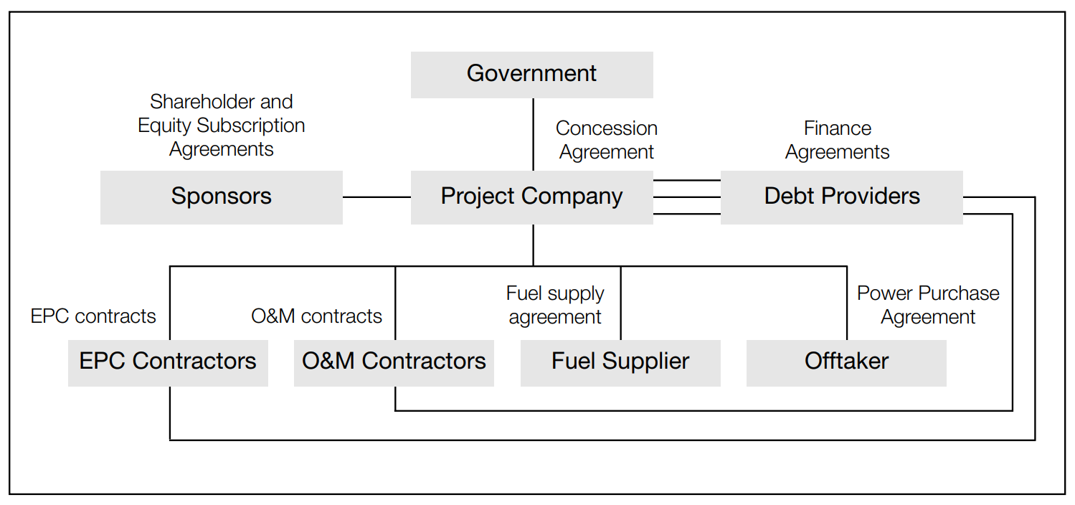
Typical Contractual Structure / Key Players
Notes:
Sponsors:
Entities or individuals who own the project and invest equity, expecting a return from its operation.
Combines equity (share subscription) and debt (equity loans) to finance the project.
Government:
Affords concessions to sponsors for project construction and operation through concession agreements.
Involvement can provide vital support and incentives, although not always required, as seen in merchant power plants.
Funders:
Provide substantial debt funding to support project development and operation.
May include multilateral financiers (e.g., EIB, EBRD, IFC), governmental entities, and commercial funders.
Project Company:
Acts as a special purpose vehicle for the project and requires various subcontractors and experts.
Construction companies (often working under turnkey or EPC contracts) and operators responsible for project operation and maintenance.
Offtaker:
Vital in traditional project-financed power projects.
Enters into a power purchase agreement with the project company, ensuring the sale of electricity generated by the project.
Long-term offtake agreements are attractive to funders to provide revenue stability.

Slide 13
Typical Assessment Criteria
Capital costs
Market / demand analysis
Cash flows
Profitability
Payback period
Return on investment
All focused around the economic viability of the project

Slide 14
Typical Financing
Fossil Fuel Power Plants
Large, established banks and financial institutions
Long-Term Power Purchase Agreements (PPAs)
Fossil Fuel Subsidies
Single-Sourced Fuel Supply
Centralized Generation
Notes:
Fossil Fuel Power Plants
Large, established banks and financial institutions heavily used
Traditional projects predominantly focused on coal, natural gas, and oil-based power generation.
Financing relied heavily on large, established banks and financial institutions.
Long-Term Power Purchase Agreements (PPAs):
Long-term PPAs with fixed prices were common, offering revenue stability for project financing.
Often involved government-backed utilities as off-takers.
Government Subsidies and Incentives:
Many traditional power projects received subsidies and tax incentives, often favoring fossil fuels.
Government backing and support were essential for project viability.
Single-Sourced Fuel Supply:
Projects were heavily dependent on a single source of fuel supply, such as coal mines or natural gas pipelines.
Fuel price fluctuations were a key risk.
Centralized Generation:
Most projects were centralized, with large power plants connected to the grid.
Investment in transmission and distribution infrastructure was critical.

Slide 15
Developments

Slide 16
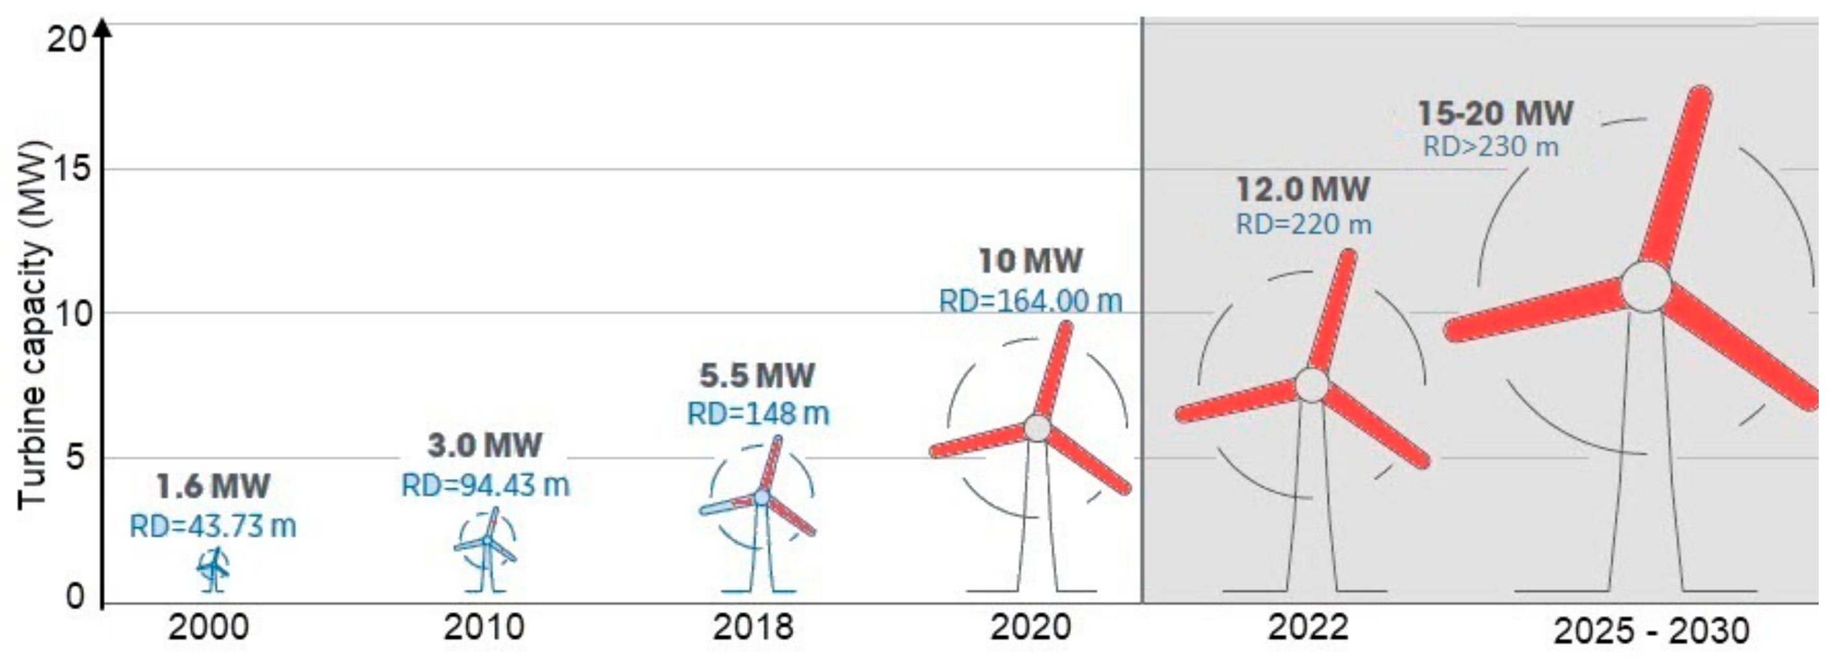
Wind Power Development
Notes:
Battery Storage
~28 GW at the end of 2022, with around 11 GW of storage capacity added in 2022 alone1.
The patenting activity in batteries and other electricity storage technologies grew at an average annual rate of 14% worldwide between 2005 and 2018, four times faster than the average of all technology fields2.
The IEA projects that the global battery storage capability will increase from 9.4 GWh in 2020 to 81.9 GWh in 2026, with China, the United States, and India accounting for more than 60% of the total3.
Sungrow, a leading provider of battery energy storage solutions, expects that liquid-cooled battery energy storage will start to dominate the market in 2022, with a market share of over 50%4.
MIT Technology Review predicts that new battery chemistries for electric vehicles will emerge in 2023, such as lithium-sulfur, lithium-air, or zinc-air, which could offer higher capacity, lower cost, longer cycle life, and better sustainability than lithium-ion batteries5.

Slide 17
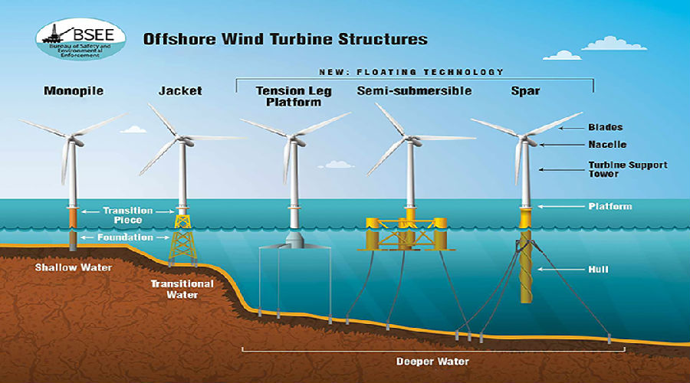
Wind Power Development
Notes:
Battery Storage
~28 GW at the end of 2022, with around 11 GW of storage capacity added in 2022 alone1.
The patenting activity in batteries and other electricity storage technologies grew at an average annual rate of 14% worldwide between 2005 and 2018, four times faster than the average of all technology fields2.
The IEA projects that the global battery storage capability will increase from 9.4 GWh in 2020 to 81.9 GWh in 2026, with China, the United States, and India accounting for more than 60% of the total3.
Sungrow, a leading provider of battery energy storage solutions, expects that liquid-cooled battery energy storage will start to dominate the market in 2022, with a market share of over 50%4.
MIT Technology Review predicts that new battery chemistries for electric vehicles will emerge in 2023, such as lithium-sulfur, lithium-air, or zinc-air, which could offer higher capacity, lower cost, longer cycle life, and better sustainability than lithium-ion batteries5.

Slide 18
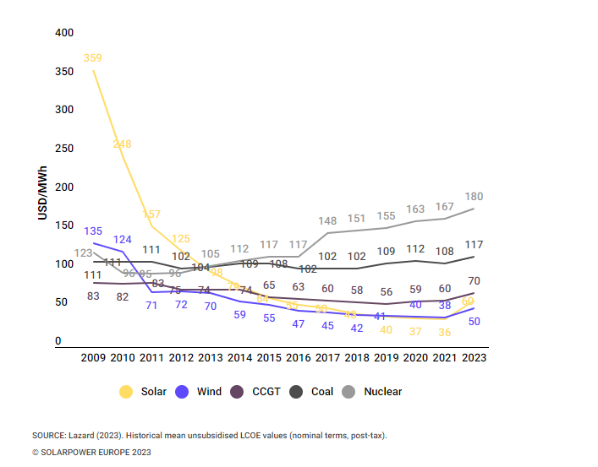
Solar Power Developments
Notes:
Battery Storage
~28 GW at the end of 2022, with around 11 GW of storage capacity added in 2022 alone1.
The patenting activity in batteries and other electricity storage technologies grew at an average annual rate of 14% worldwide between 2005 and 2018, four times faster than the average of all technology fields2.
The IEA projects that the global battery storage capability will increase from 9.4 GWh in 2020 to 81.9 GWh in 2026, with China, the United States, and India accounting for more than 60% of the total3.
Sungrow, a leading provider of battery energy storage solutions, expects that liquid-cooled battery energy storage will start to dominate the market in 2022, with a market share of over 50%4.
MIT Technology Review predicts that new battery chemistries for electric vehicles will emerge in 2023, such as lithium-sulfur, lithium-air, or zinc-air, which could offer higher capacity, lower cost, longer cycle life, and better sustainability than lithium-ion batteries5.

Slide 19
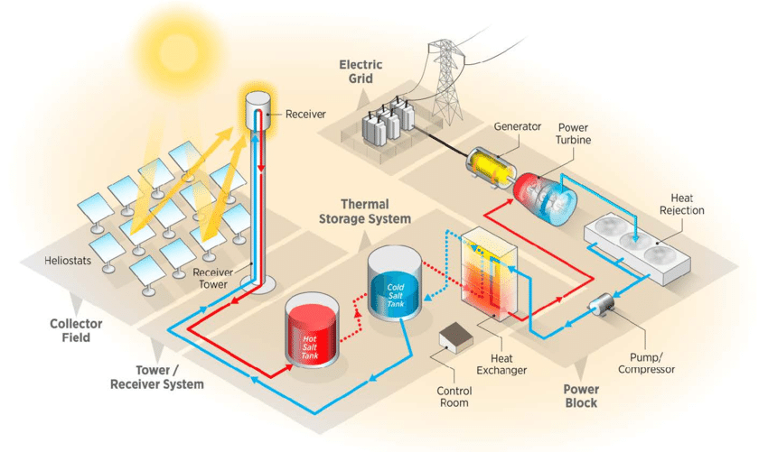
Solar Power Developments
Notes:
Battery Storage
~28 GW at the end of 2022, with around 11 GW of storage capacity added in 2022 alone1.
The patenting activity in batteries and other electricity storage technologies grew at an average annual rate of 14% worldwide between 2005 and 2018, four times faster than the average of all technology fields2.
The IEA projects that the global battery storage capability will increase from 9.4 GWh in 2020 to 81.9 GWh in 2026, with China, the United States, and India accounting for more than 60% of the total3.
Sungrow, a leading provider of battery energy storage solutions, expects that liquid-cooled battery energy storage will start to dominate the market in 2022, with a market share of over 50%4.
MIT Technology Review predicts that new battery chemistries for electric vehicles will emerge in 2023, such as lithium-sulfur, lithium-air, or zinc-air, which could offer higher capacity, lower cost, longer cycle life, and better sustainability than lithium-ion batteries5.

Slide 20
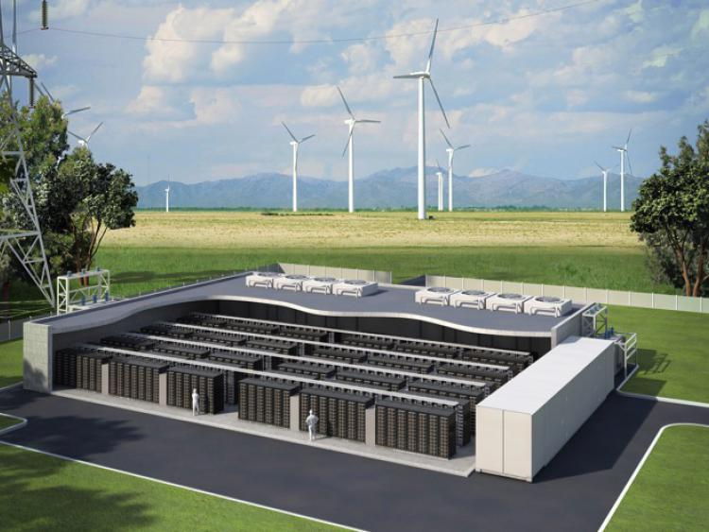
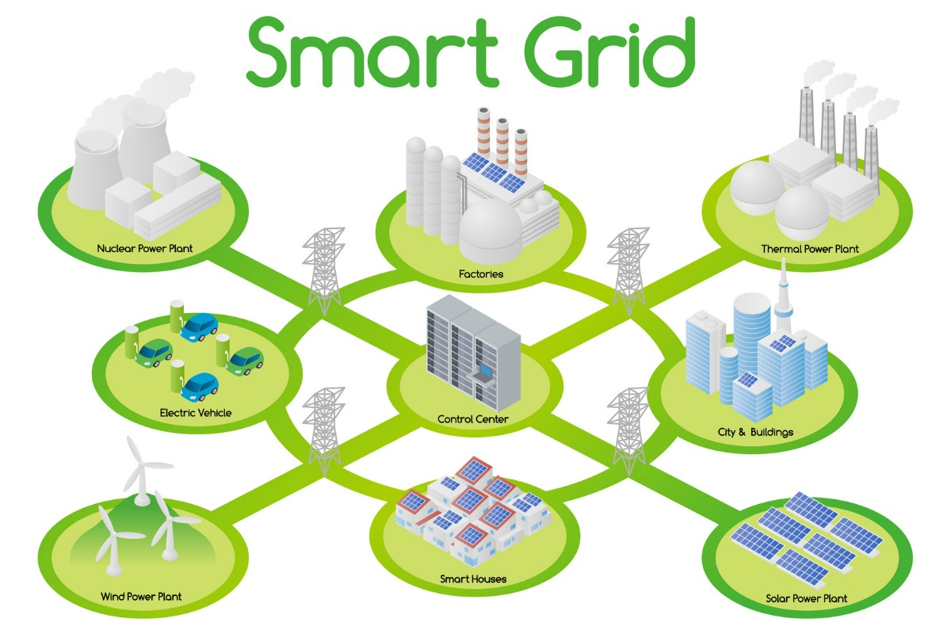
“New” Tech
Battery Storage
28 GW end 2022
90 GW in 2026
Patenting activity grew 14%
New battery Tech
Small Modular Reactor
100-300 MW
0.4 GW in 2020
7.0 GW in 2026
Not in my back yard?
Smart Grid
USD 52bn invested in 2022
Cyber security USD 6.8bn
Growing Fast Chargers
More smart meters
Notes:
Battery Storage
~28 GW at the end of 2022, with around 11 GW of storage capacity added in 2022 alone1.
The patenting activity in batteries and other electricity storage technologies grew at an average annual rate of 14% worldwide between 2005 and 2018, four times faster than the average of all technology fields2.
The IEA projects that the global battery storage capability will increase from 9.4 GWh in 2020 to 81.9 GWh in 2026, with China, the United States, and India accounting for more than 60% of the total3.
Sungrow, a leading provider of battery energy storage solutions, expects that liquid-cooled battery energy storage will start to dominate the market in 2022, with a market share of over 50%4.
MIT Technology Review predicts that new battery chemistries for electric vehicles will emerge in 2023, such as lithium-sulfur, lithium-air, or zinc-air, which could offer higher capacity, lower cost, longer cycle life, and better sustainability than lithium-ion batteries5.

Slide 21
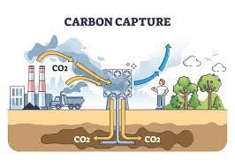
“New” Tech
Digital Twin
USD 86bn 2028
Understand issues ahead of time
Better maintenance and repairs
Significant savings
Carbon Capture
9.5 GWh in 2020 to 82.0 GWh in 2026
LCOE USD 50 to 90 / MWh
Increased number of projects being brought online
Artificial Intelligence
USD 5.3bn in 2024
Already used in the UK
Allows efficiency and flexibility
Notes:
Renewable Energy Sources
Recent years have seen a significant increase in the use of renewable energy sources such as solar, wind, and hydropower. These sources are becoming increasingly cost-competitive and are being adopted by many countries and companies around the world.
Energy Storage Solutions
The development of energy storage solutions, such as batteries and pumped hydro storage, is also having a significant impact on the power generation industry. These solutions allow for greater flexibility and reliability in the use of renewable energy sources, as well as increased grid stability.
Smart Grid Technology
The use of smart grid technology is also increasing, allowing for more efficient and effective management of power generation and distribution. This technology includes advanced metering infrastructure, demand response systems, and distribution automation.

Slide 22
New Financing
Renewable Energy Projects
Diverse Sources of Funding
Merchant and Corporate PPAs / Market-Based Pricing
Government Subsidies and Incentives
Technological Advancements
Decentralized Generation
Government Policies
Environmental and ESG Considerations
Carbon Pricing and RECs
Notes:
Renewable Energy Projects:
Emphasis on clean energy sources like wind, solar, hydro, and geothermal.
Increased investment in sustainable technologies.
Merchant and Corporate PPAs:
More projects are selling electricity directly to corporate buyers or through merchant arrangements, reducing dependence on long-term government-backed PPAs.
Market-Based Pricing:
Pricing is often market-driven and can include dynamic or variable pricing to adapt to renewable energy production fluctuations.
Diverse Sources of Funding:
Emergence of dedicated infrastructure and energy debt funds, diversifying sources of funding beyond traditional banks and financial institutions.
Energy Storage:
Integration of energy storage technologies to enhance grid stability and store excess energy for use during periods of low generation.
Decentralized Generation:
Distributed energy resources and microgrids are gaining importance, reducing the need for extensive transmission and distribution infrastructure.
Government Policies and Carbon Pricing:
Increased focus on carbon pricing mechanisms, renewable energy credits, and other incentives to support clean energy projects.
Technological Advancements:
Financing may include innovative technologies like blockchain for transparent energy transactions and smart grid solutions for efficient power distribution.
Environmental and ESG Considerations:
Environmental, Social, and Governance (ESG) criteria are becoming important factors for investors, affecting project financing decisions.
Greater emphasis on assessing climate-related risks and incorporating resilience measures into project financing.

Slide 23
New Financing
Criteria for assessment
Timeframes
Agile modelling
Modular modelling using standards
AI
New derivative products

Slide 24
The Key Steps to Project Financing
Project Development and Feasibility Study
Legal and Regulatory Framework
Project Structure
Consortium Formation
Financial Modelling
Equity Investment
Debt Financing
Government Support and Incentives
Offtake Agreements

Slide 25
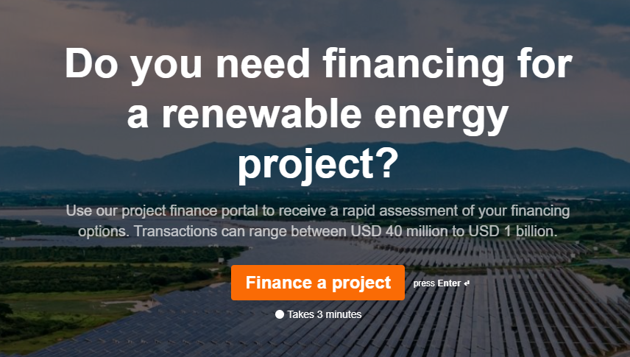
…The New Norm?

Slide 26
Opportunities
Wind and solar electricity cost-competitive against new and existing fossil fuel generation
Higher fossil fuel prices have created incentives to accelerate renewables
Increased need for energy security and reduce future consumer costs
ESG betterment
New financing and investment opportunities

Slide 27
Risks
Potential price and interest rate changes
Price fluctuations – especially apparent from late 2021 to date
Access and availability of materials required for the energy transition
Reliance on supply chain
Someone needs to take on the risk of funding

Slide 28
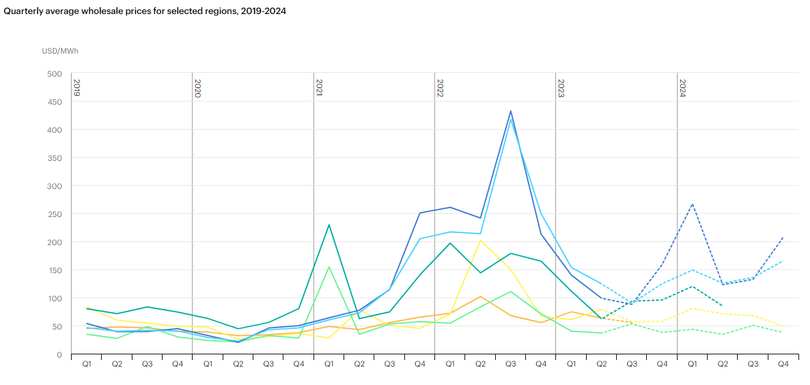
Risk / Opportunity

Slide 29
Challenges

Slide 30
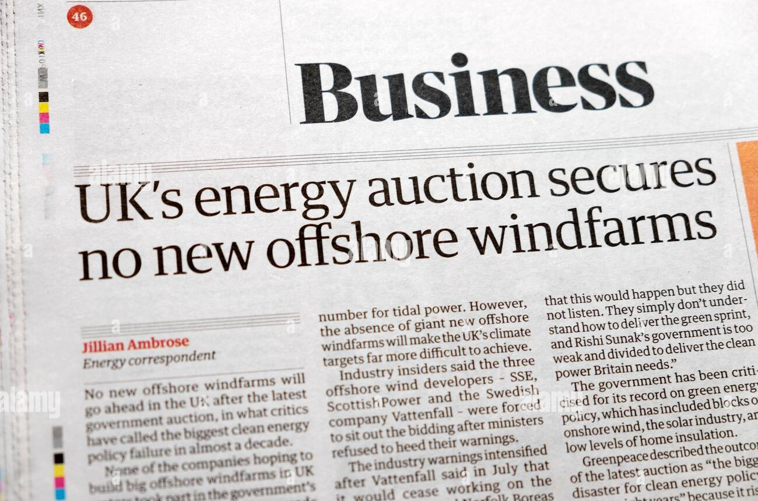
Challenges

Slide 31
Role of Insurance

Slide 32
Role of Insurance
Green Energy Policies and Endorsements
Prototype Insurance
Weather derivatives
Speed
Alignment across all parties

Slide 33
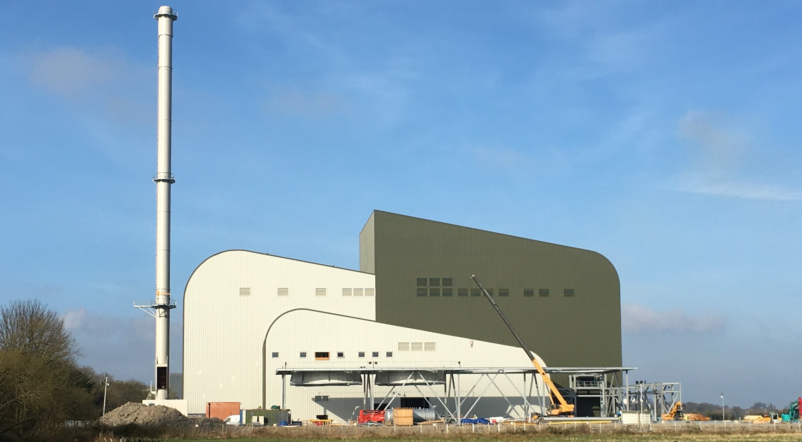
Role of Insurance - Alternative
COGEN developed 5 gasification facilities in the UK.
Investors in COGEN include Aviva Investors - an investment management company, part of the Aviva group
Marchwood Power Ltd is a JV between SSE and MEAG.
MEAG is an asset manager and 100% subsidiary of Munich Re with approximately EUR 230bn of assets under management

Slide 34
QUESTIONS

Slide 35
Lee Swain
partner | MDD london
lswain@mdd.com
+44 7714 262 850
Practice Areas
Industry Experience
Experience
Advance Loss of Profits/Delay in Start Up
Business Interruption
Catastrophe Services
Lost Profits
Physical Damages
Subrogation
Food Services
Manufacturing
Mining
Oil & Gas
Power Generation
Professional Services
Transportation
Lee is a member of the firm’s Energy team and regularly writes content and presents on the topic of power generation, oil and petrochemical.
Lee has been involved in cases that have varied widely in complexity and value, ranging from several hundred thousand pounds to losses in excess of £500 million.
Seminars
Has conducted numerous seminars and training session on many issues related to economic damage quantification.

Slide 36
Edward Secchi
Director | MDD Dubai
esecchi@mdd.com
+971 52 633 0538
Practice Areas
Industry Experience
Experience
Advance Loss of Profits/Delay in Start Up
Business Interruption
Catastrophe Services
Contingent BI & Extra Expenses
Expropriation
Lost Profits
Physical Damages
Construction
Hospitality and Tourism
Manufacturing
Maritime
Oil & Gas
Pharmaceutical
Power Generation
Ed is a member of the firm’s Energy team and regularly writes content and presents on the topic of oil and gas and power generation.
Edward has been involved in cases that have varied widely in complexity and value, ranging from several hundred thousand dollars to losses in excess of $200 million.
Seminars
Has conducted numerous seminars and training session on many issues related to economic damage quantification.

Slide 37
DISCLAIMER
This presentation contains information that is confidential and proprietary to Matson, Driscoll & Damico, LLP and may contain trade secrets. It is intended to be strictly confidential and is to be used solely for discussion purposes. No part of this presentation may be disclosed to any third party or reproduced by any means without the prior written consent of Matson, Driscoll & Damico, LLP This presentation does not constitute work product, opinion or a deliverable.
This presentation contains information in summary form and is therefore intended for general guidance only. It is not intended to be a substitute for detailed research or the exercise of professional judgment. Matson, Driscoll & Damico does not accept any responsibility for loss occasioned to any person acting or refraining from action as a result of any material in this presentation.
MDD Forensic Accountants refers to one or more of MDD International Limited, a UK private company limited by guarantee (“MDD-International”), its network of member firms, and their related entities. MDD International and each of its member firms are legally separate and independent entities. MDD International does not itself engage in the provision of services to clients.
© 2023 Matson, Driscoll & Damico, LLP. All rights reserved.

Slide 38
CONTACT Presenters
Lee Swain
Edward Secchi
+44 7714 262 850
+971 52 633 0538
lswain@mdd.com
esecchi@mdd.com

