Slide 1
HOW IS INFLATION AFFECTING THE RENEWABLE INDUSTRY?
ONSHORE ENERGY CONFERENCE
LONDON
01 NOVEMBER 2022
George Pooley Director, Head of Renewables
Chris Reeves Head of Quantity Surveying
Introduction
Materials
Labour
Supply
Power
Impact
Contact

Slide 2
GLOBAL RISK SOLUTIONS
Dedicated Renewables sector expertise & focus:
Niche sector specialists
USP is a large team that only do renewables - global
Largest volume of losses in the space investigated – giving a strategic advantage.
Diversified market support
Dedicated sector expertise & focus on key business lines:
Renewables
Energy, Construction & Property
Specialist Liabilities
Expertise-led, multidisciplinary claims team (50 adjusters, globally)
Chartered Loss Adjusters, and
Quantity Surveyors
Engineering Consultants
Forensic Accountants
Introduction
Materials
Labour
Supply
Power
Impact
Contact

Slide 3
QS
Damage Scope
Damage Mapping
Early Cost Analysis / Loss Estimating
Reinstatement Cost Analysis
PROACTIVE
LOSS ADJUSTING:
A TEAM SPORT
Engineering
Analysis of Reinstatement Options
Period of Interruption
MITIGATION
Forensic Accounting
Early Economic Test Analysis
Virtual Business
Loss Mitigation Opportunities
Introduction
Materials
Labour
Supply
Power
Impact
Contact

Slide 4
Materials inflation
technology variances
regional differences
Labour shortages
Delay
supply chain issues - solar vs wind
Power purchase variances
SETTING THE SCENE
Introduction
Materials
Labour
Supply
Power
Impact
Contact

Slide 5
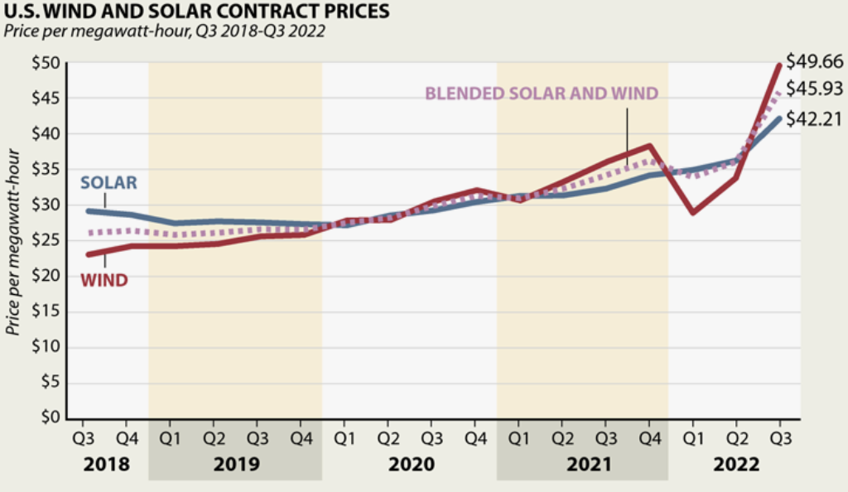
Effects of Inflation on Material Damage Claims
New build cost increase (CAPEX) | % Increase
On-shore wind | 7%
Fixed-axis (non-tracking) solar | 14%
KEY DRIVERS –
Raw Material Cost increases
Supply chain pressures (time and cost)
Production Supply & Manufacture costs (energy – Ukraine Conflict)
Q3 North America contract increases(on Q3 ‘21):
- Solar = 30%
- Wind = 37%
Source: LevTen Energy
Source: Benchmark Mineral Intelligence, ‘Lithium Price Index’
Introduction
Materials
Labour
Supply
Power
Impact
Contact

Slide 6
Material Inflation - Solar
Source: EnergyTrend | Benchmark Mineral Intelligence Price Reporting
Introduction
Materials
Labour
Supply
Power
Impact
Contact

Slide 7
Scheduled Values, Replacement Costs & Betterment
Solar PV installation Costs in USA over time
Year | US$/Watt | PV module costs (200W Panel)
2010 | c/ $2.50 | $500
2020 | c/ $0.38 | $75
2022 | c/ $0.43 (?) | $85 (?)
2023+
Conclusion:
In 2020 PV modules were 6.5 times cheaper than 2010;
a 400W panel costs $150.
Context of installed costs falling;
Technology assistances
China production
Source: National Renewable Energy Laboratory (NREL)
Introduction
Materials
Labour
Supply
Power
Impact
Contacts

Slide 8
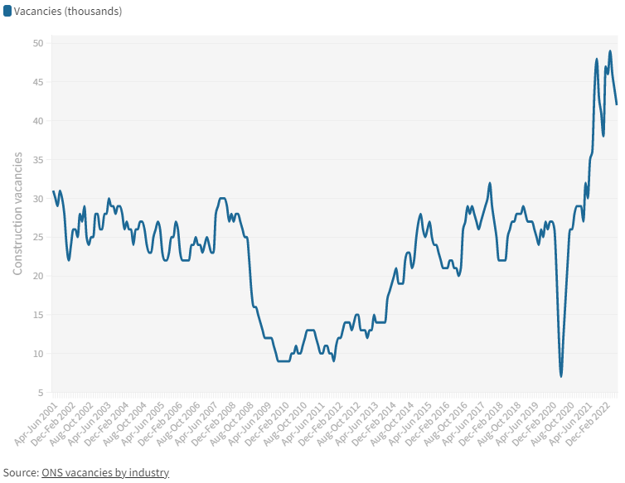
LABOUR
Ongoing skill shortages across regions + increased demand across industries = Wage Inflation
North America
Federal infrastructure bill approved $550B in infrastructure spending, requiring an estimated 3.2 million new workers. Inflation Reduction Act Aug 16th 2022
Businesses reporting labour shortages:
40% - US
58% - Canada
General Electric is laying off workers in its renewable energy operations, highlighting the impact of inflation on what might be expected to be a thriving business. The cuts are coming to GE onshore wind turbine business. Roughly 20% of U.S. workers will be affected.
MENA
Skilled expatriate labour shortage after COVID.
Inflow and outflow of skilled labour – high wages for outflow workers draws away from other regions
Europe
UK - Unemployment rate July 2022 = 3.6%, the lowest rate since May to July 1974.
55% of UK organisations facing skills shortages as the battle
Source: Virgin Media O2 Business and Censuswide digital knowledge gap facing the UK’s private and public sectors
UK Construction Vacancies 2001 – 2022 – All time high
Europe - Delivery delays and the rise in material costs forced Siemens Gamesa to cut 2,900 jobs
Inflation impact – labour hoarding to avoid shortages with next economic rebound adding to inflationary pressures
Introduction
Materials
Labour
Supply
Power
Impact
Contact

Slide 9
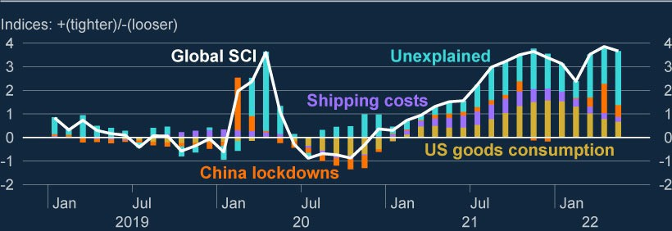
Bottlenecks in the world economy have been a key reason for high inflation among traded goods.
Global Supply Chain Pressure Index highlights.
Global Supply Chain Pressure Index September Q3 ‘22
Ukraine Conflict
COVID-19
Examples include:
Covid-related lockdowns in some key producer economies.
Increase in global demand after the pandemic.
Supply constraints in the manufacturing sector (supplier delivery times, stocks of purchases, stocks of finished goods, input prices and backlogs of work).
Sources: Global Supply Chain Pressure Index (GSCPI)
Introduction
Materials
Labour
Supply
Power
Impact
Contact

Slide 10
Energy Price Effects on Business Interruption Claims
Electricity Spot Market Prices (Italy) - €/MWh Jan 2021 to Sept 2022
Particularly relevant to sites which sell on spot market – important to confirm if fixed PPA.
Our experience is 20% of onshore energy projects sell on the spot market/merchant rate.
Often not seeing these increases reflected in adequately increased BI Sums Insured on renewal.
Additionally, the impact of ‘Upside Sharing’ mechanisms on current claims
Data from Italian Power Exchange (Gestore dei mercati energetici)
Introduction
Materials
Labour
Supply
Power
Impact
Contact

Slide 11
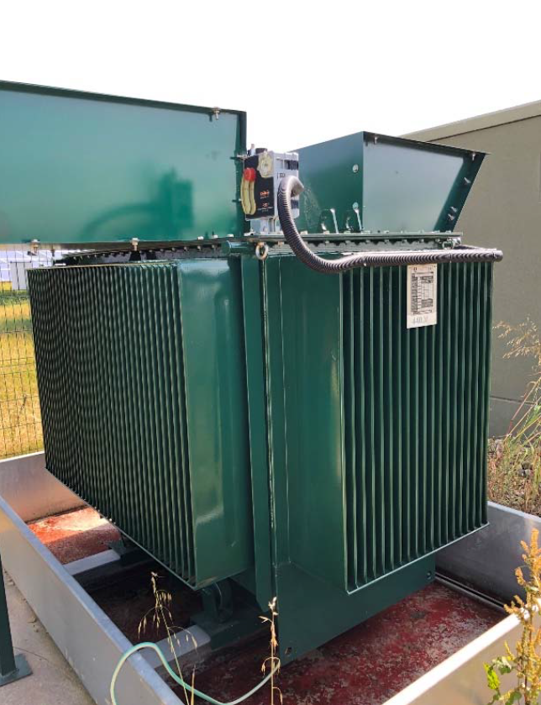
BRING IT ALL TOGETHER Supply Chain Issues Affecting Downtime
Supply chain issues, material shortages, covid-19, war in Ukraine, Brexit.
LV/MV Transformer lead times, effect on insurance claims:
Loss Mitigation Solutions:
Rental options
Spares
Refurbished options
Year | Material cost (GBP) | Downtime (weeks) | Potential Loss (GBP)
2020 | 70,000 | 12 | 100,000 | Parity - fixed PPA and merchant rate
2022 | 80,000 | 30 to 47 | 300,000 | Fixed PPA
2022 | 80,000 | 30 to 47 | 800,000 (?) | Merchant market
Introduction
Materials
Labour
Supply
Power
Impact

Slide 12
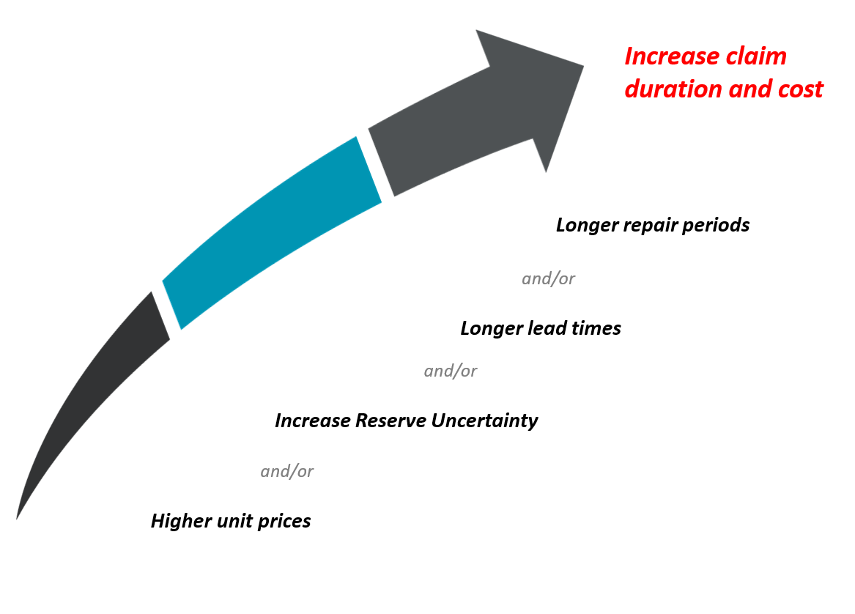
Consequences for Insurers
Introduction
Materials
Labour
Supply
Power
Impact

Slide 13
01 November 2022
THANK YOU
GLOBAL RISK SOLUTIONS

Slide 14
CONTACT
George Pooley BA (Hons) ACII
Director – Head of Renewables
Chris Reeves BA (Hons), PGDip, RICS Commercial & Civil Mediator, MCIArb, FRICS
Head of Quantity Surveying
Email
Email
gpooley@GlobalRiskSolutions.com
creeves@GlobalRiskSolutions.com
Phone
Phone
+44 (0) 7557 965 577
+44 (0) 7825 276 291
Website
Website
ccs.GlobalRiskSolutions.com
ccs.GlobalRiskSolutions.com
Office
Office
Suite 504, Dawson House, 5 Jewry Street, London, EC3N 2EX
Suite 504, Dawson House, 5 Jewry Street, London, EC3N 2EX
Introduction
Materials
Labour
Supply
Power
Impact
Contact

