Slide 1
Onshore Energy Conference London 2022
Simon Wilcock
Nuclear Risk Insurers
1st November 2022

Slide 2
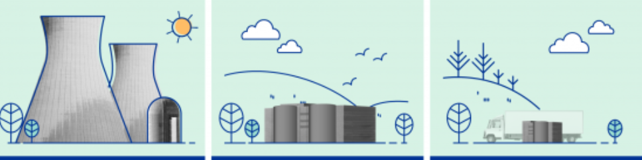

How can small* modular nuclear reactors help to combat climate change?
* Includes Microreactors
Image from https://www.iaea.org/newscenter/news/what-are-small-modular-reactors-smrs

Slide 3
What is Small Modular Reactor
Small modular reactors are advanced nuclear reactors that have a power capacity of up to 300 - 450 MWe per unit#
Small physically a fraction of the size of a conventional nuclear power reactor
Modular making it possible for systems and components to be factory-assembled and transported as a unit to a location for installation
Reactors harnessing nuclear fission to generate heat to produce energy
# https://www.iaea.org/newscenter/news/what-are-small-modular-reactors-smrs
https://www.rolls-royce-smr.com/why-rolls-royce-smr

Slide 4
How can SMRs help to combat climate change?
By low carbon production of
  On Grid or Off Grid Electrical Power
  Energy source for process heat for industry
  Firm energy source to support renewable sources variability
  Replace fossil fuel based essential power backup systems
  Replace fossil fuel based power for shipping
  Use of hybrid energy systems#
# Integrated facilities comprised of nuclear reactors, renewable energy generation and industrial processes

Slide 5
Small Modular Reactors
More than 70 commercial SMR designs being developed
Power output ranging from 1.5MW to 450MW
Temperature of Coolant 300C to 950C
Fuel enrichment up to 20% U₂₃₅
Process:
  Burners
  Breeders
  Thermal
  Fast
Coolant:
  Water
  Helium
  Sodium
  Molten Salt
  Lead
Source: https://aris.iaea.org/sites/overview.html & NRI

Slide 6
Challenges
Many of the planned technologies will fail to develop
Keep them Standard Modular Reactors
(Inter)national regulatory technical approval
National regulatory site approval & licence
Safeguards & Security
Skills shortage (OEM, contractors and operators)
Finance
Fuel Supply Constraints

Slide 7
What’s actually happening
High Temperature Gas Cooled Reactor
Shidao Bay Nuclear Power Station, China
2 x 250MWth reactors
TRISO# fuelled
Helium Cooled
Reactors critical with power raising underway
# Uranium kernels of about 0.5mm diameter are coated by three layers of pyro-carbon and one layer of silicon carbon. Coated fuel particles are dispersed in matrix graphite which is 5cm in diameter.

Slide 8
What’s actually happening
Barge Mounted SMR
Akademik Lomonosov NPP Russia
2 x 150MWth reactors
PWR reactors derived from ships reactors
Water Cooled
Provides heat and power to a remote community and industry

Slide 9
What’s actually happening
Announced Projects (some of them)
OPG Canada GE Hitachi BWR 290MWe on existing site
PacifiCorp US TerraPower NATRIUM™ Power Plant 345MWe sodium fast reactor combined with a molten salt energy storage system
Energy Northwest Xe 100 HTGC 4x 80MWe Reactor TRISO fuel
& Grant County PUD
Also developments from Rolls Royce, Urenco, NuScale, BWXT, USNC etc etc.
Plans in US, Canada, UK, China, Russia, Poland, Estonia, Romania, Czech Republic etc.
Further info at https://www.world-nuclear.org/information-library/nuclear-fuel-cycle/nuclear-power-reactors/small-nuclear-power-reactors.aspx

Slide 10
Can SMRs help to combat climate change?
Yes, there is the most positive outlook for nuclear power for decades
Significant international Government support
Regulators focused on maintaining standards but enabling industry and society
Industry is focused on managing resource constraints
Shorter build times and lower capital costs should make private investment easier and in UK Nuclear Energy (Financing) Act 2022 passed
A focus on not repeating past mistakes is key

Slide 11
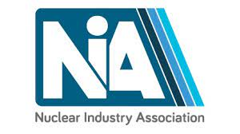
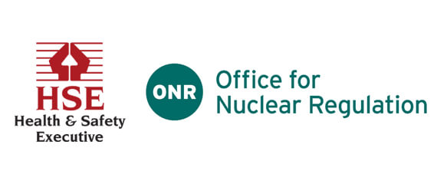
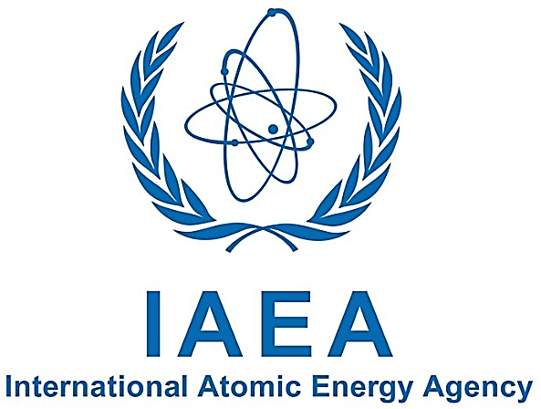






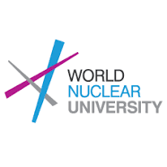
Multiple party relationships
Governments
Nuclear Insurance Pools
Operator

Slide 12
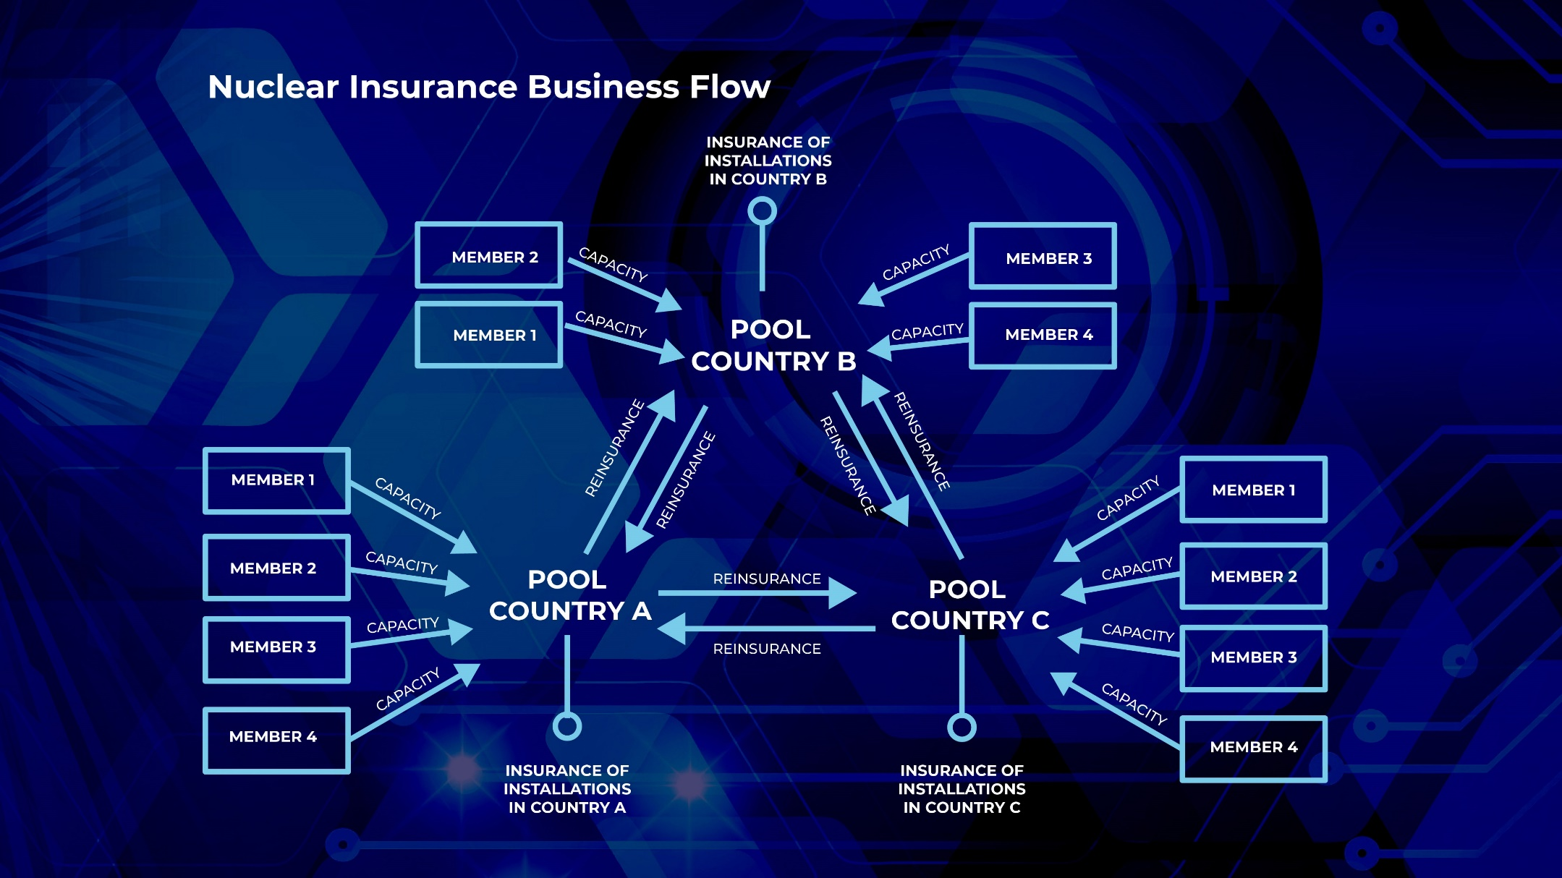
Nuclear Insurance Pools

Slide 13
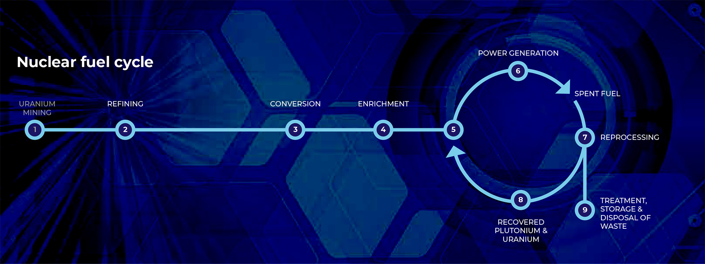
Nuclear fuel cycle

Slide 14
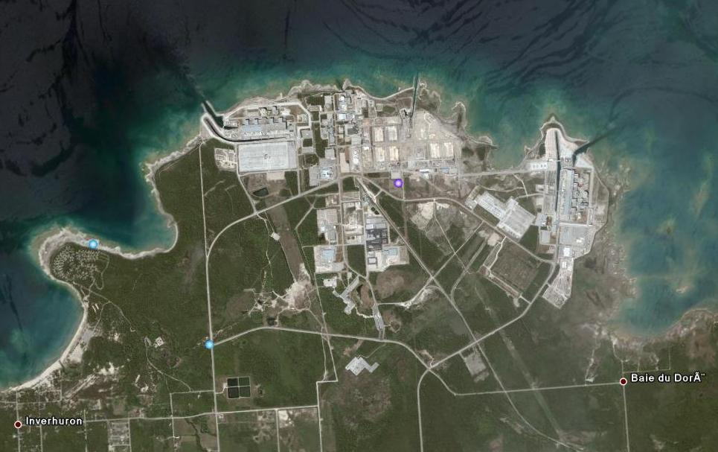
Liability & Property insurances
Onsite – assets & cash flow
Property insurance
Offsite – legal obligations to have
liability insurance

Slide 15
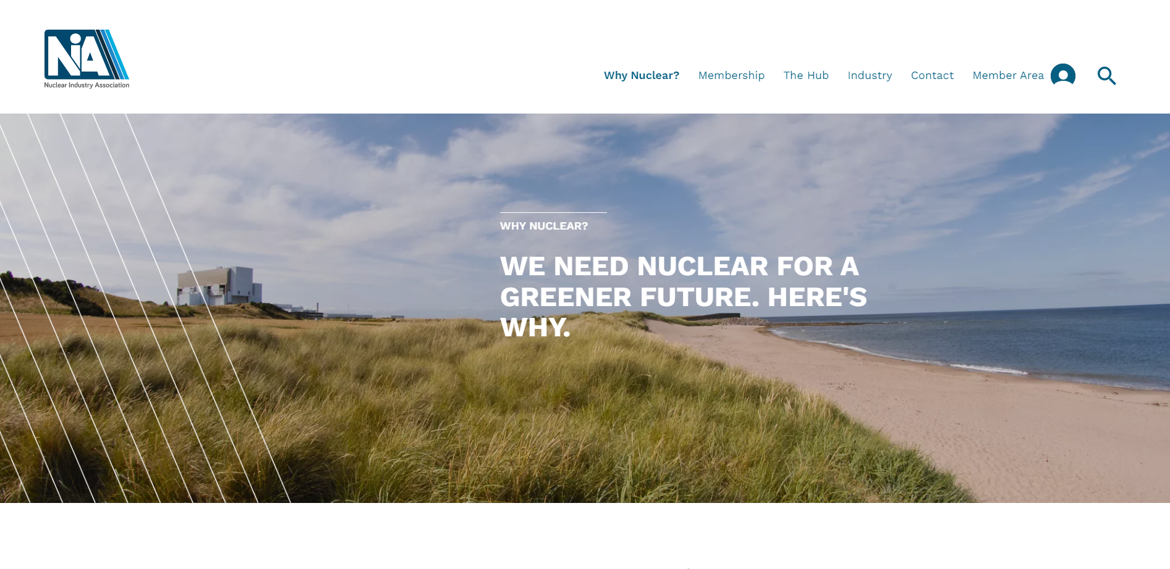
Nuclear Industry Association https://www.niauk.org/

