Slide 1
Hydrogen as a fuel for gas turbine engines
The challenges and mitigations of running gas turbines on hydrogen through the energy transition
Simon Batt
Notes:
Ceng Mechanical engineer, also FIMechE.
State the obvious – I work for Hawkins as Forensic Investigator - Prior to this, worked at RR and SE on gas turbines.
ET is a transition from fossil fuel to low carbon fuel Talking about the use of hydrogen, because ET forces changes – and brings risk.

Slide 2
Introduction
Climate change, the energy transition and hydrogen.
Risks and financial implications of running on hydrogen.
Mitigating actions for gas turbine systems.
Other alternative fuel considerations.
Notes:
1 – why we have a problem and the scale of the problem, why are gas turbines still important
2 - what are the risks of continued operation on low carbon fuels and how do we mitigate risks
3 – other alternatives to hydrogen and summary

Slide 3
Climate change, the energy transition and hydrogen

Slide 4
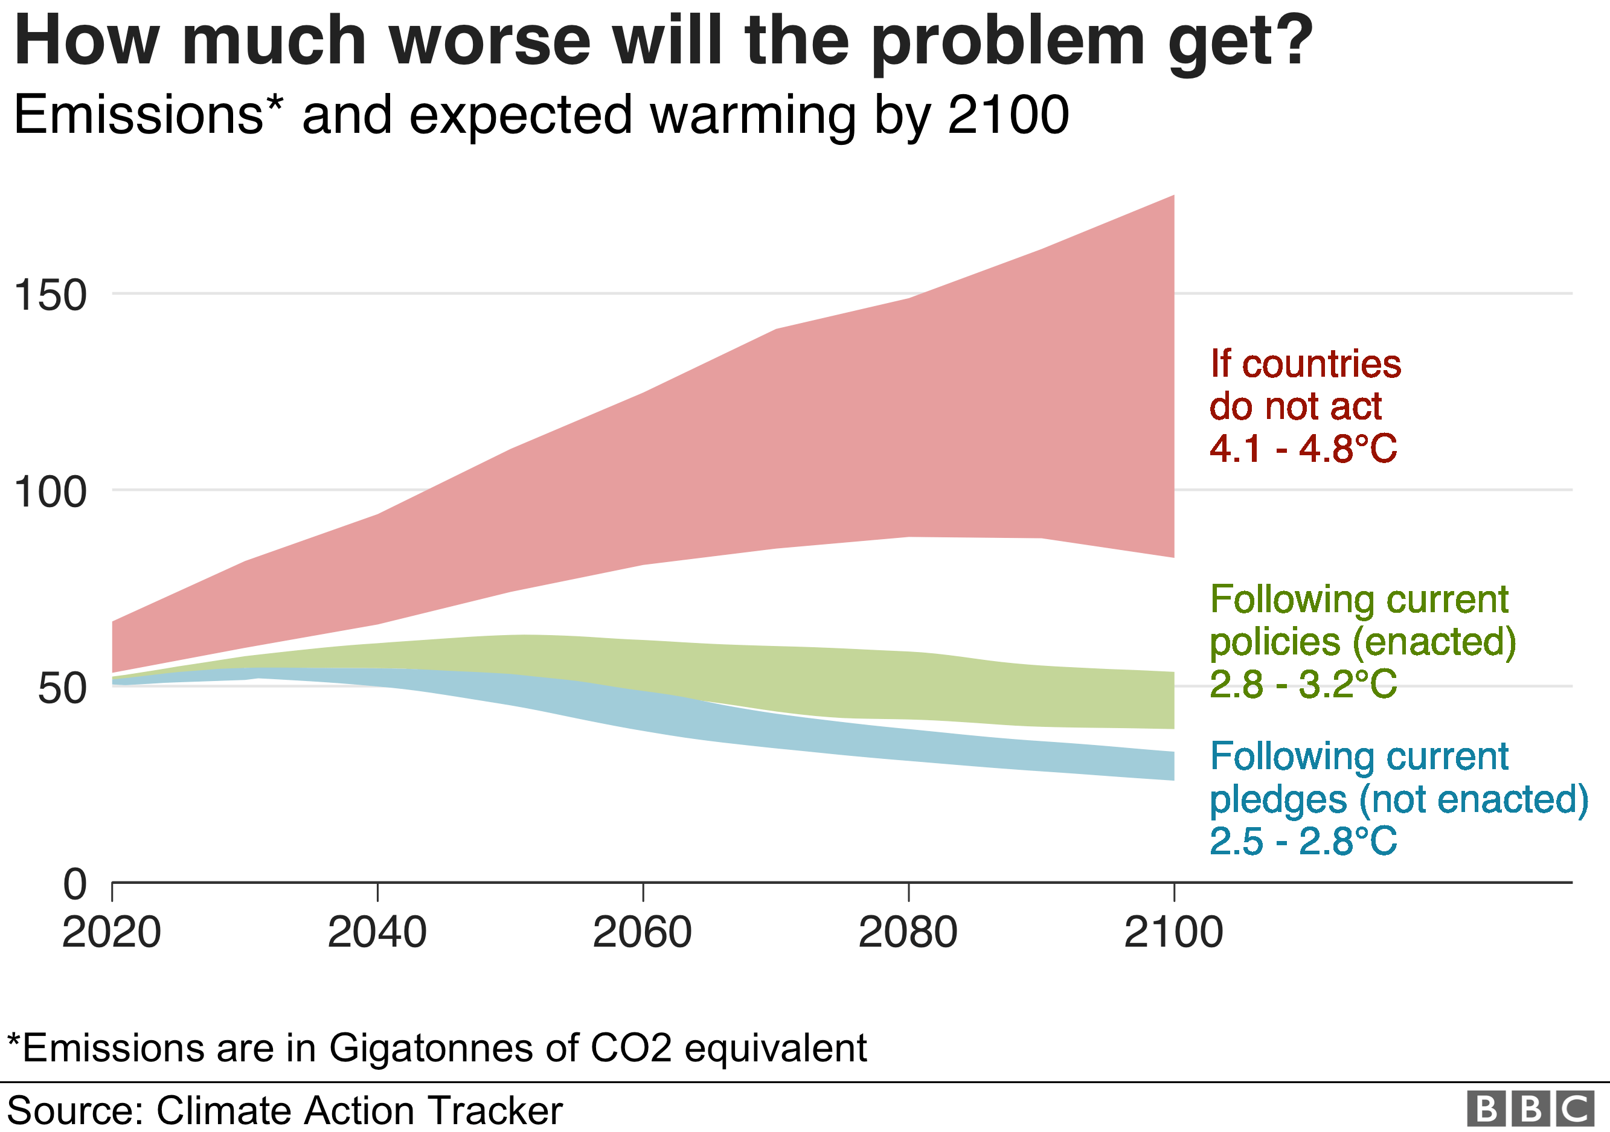
Climate change, the energy transition and hydrogen
Greenhouse gas emissions (CO₂ / CH₄ / NO) are leading to global temperature increase.
Natural disasters are having a humanitarian effect, but also financial.
UK and European governments are pledging, committing or promising to reduce emissions.
Rapid change of targets for emissions reduction and for CO₂ taxation.
Source: Chew fire station / Twitter
Notes:
Wild fire in Bristol – expect California and Australia, but it is happening in UK. Financial impact to insurance – APF natural catastrophes have an increasing impact on claims.
It all comes down to money - Carbon tax increasing rapidly, gas fuel is expensive
Adobe stock image bottom left #397407045

Slide 5
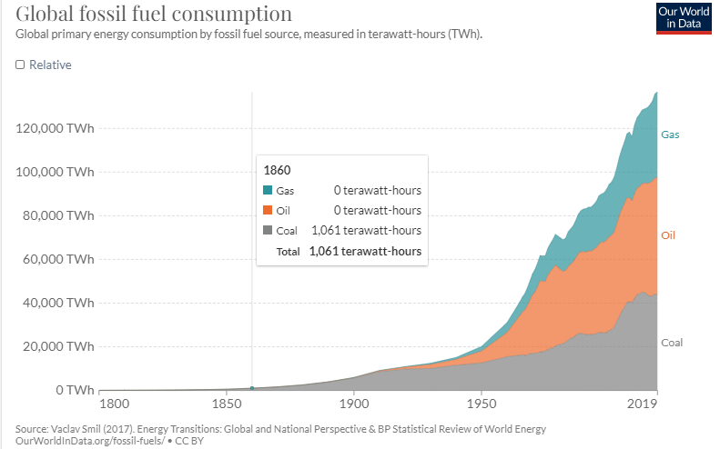
Climate change, the energy transition and hydrogen
How much oil do we consume globally per day?
1 million barrels?
10 million barrels?
100 million barrels?
Global energy demand is increasing.
Energy industry contributes approximately 25% of greenhouse gas emissions.
Fossil fuels are very convenient – energy dense and easy to store and transport.
Safe and easy to burn in combustion engines.
Notes:
Scale of problem - 100m barrels oil per day – 6,350 Olympic sized swimming pools
Global increase in energy demand – will continue – comfortable convenient and safe lives. Currently at the expense of the planet.
Challenge for alternative fuels is the cost, convenience and infrastructure.
Equipment has good track record for safety and availability on fossil fuels.

Slide 6
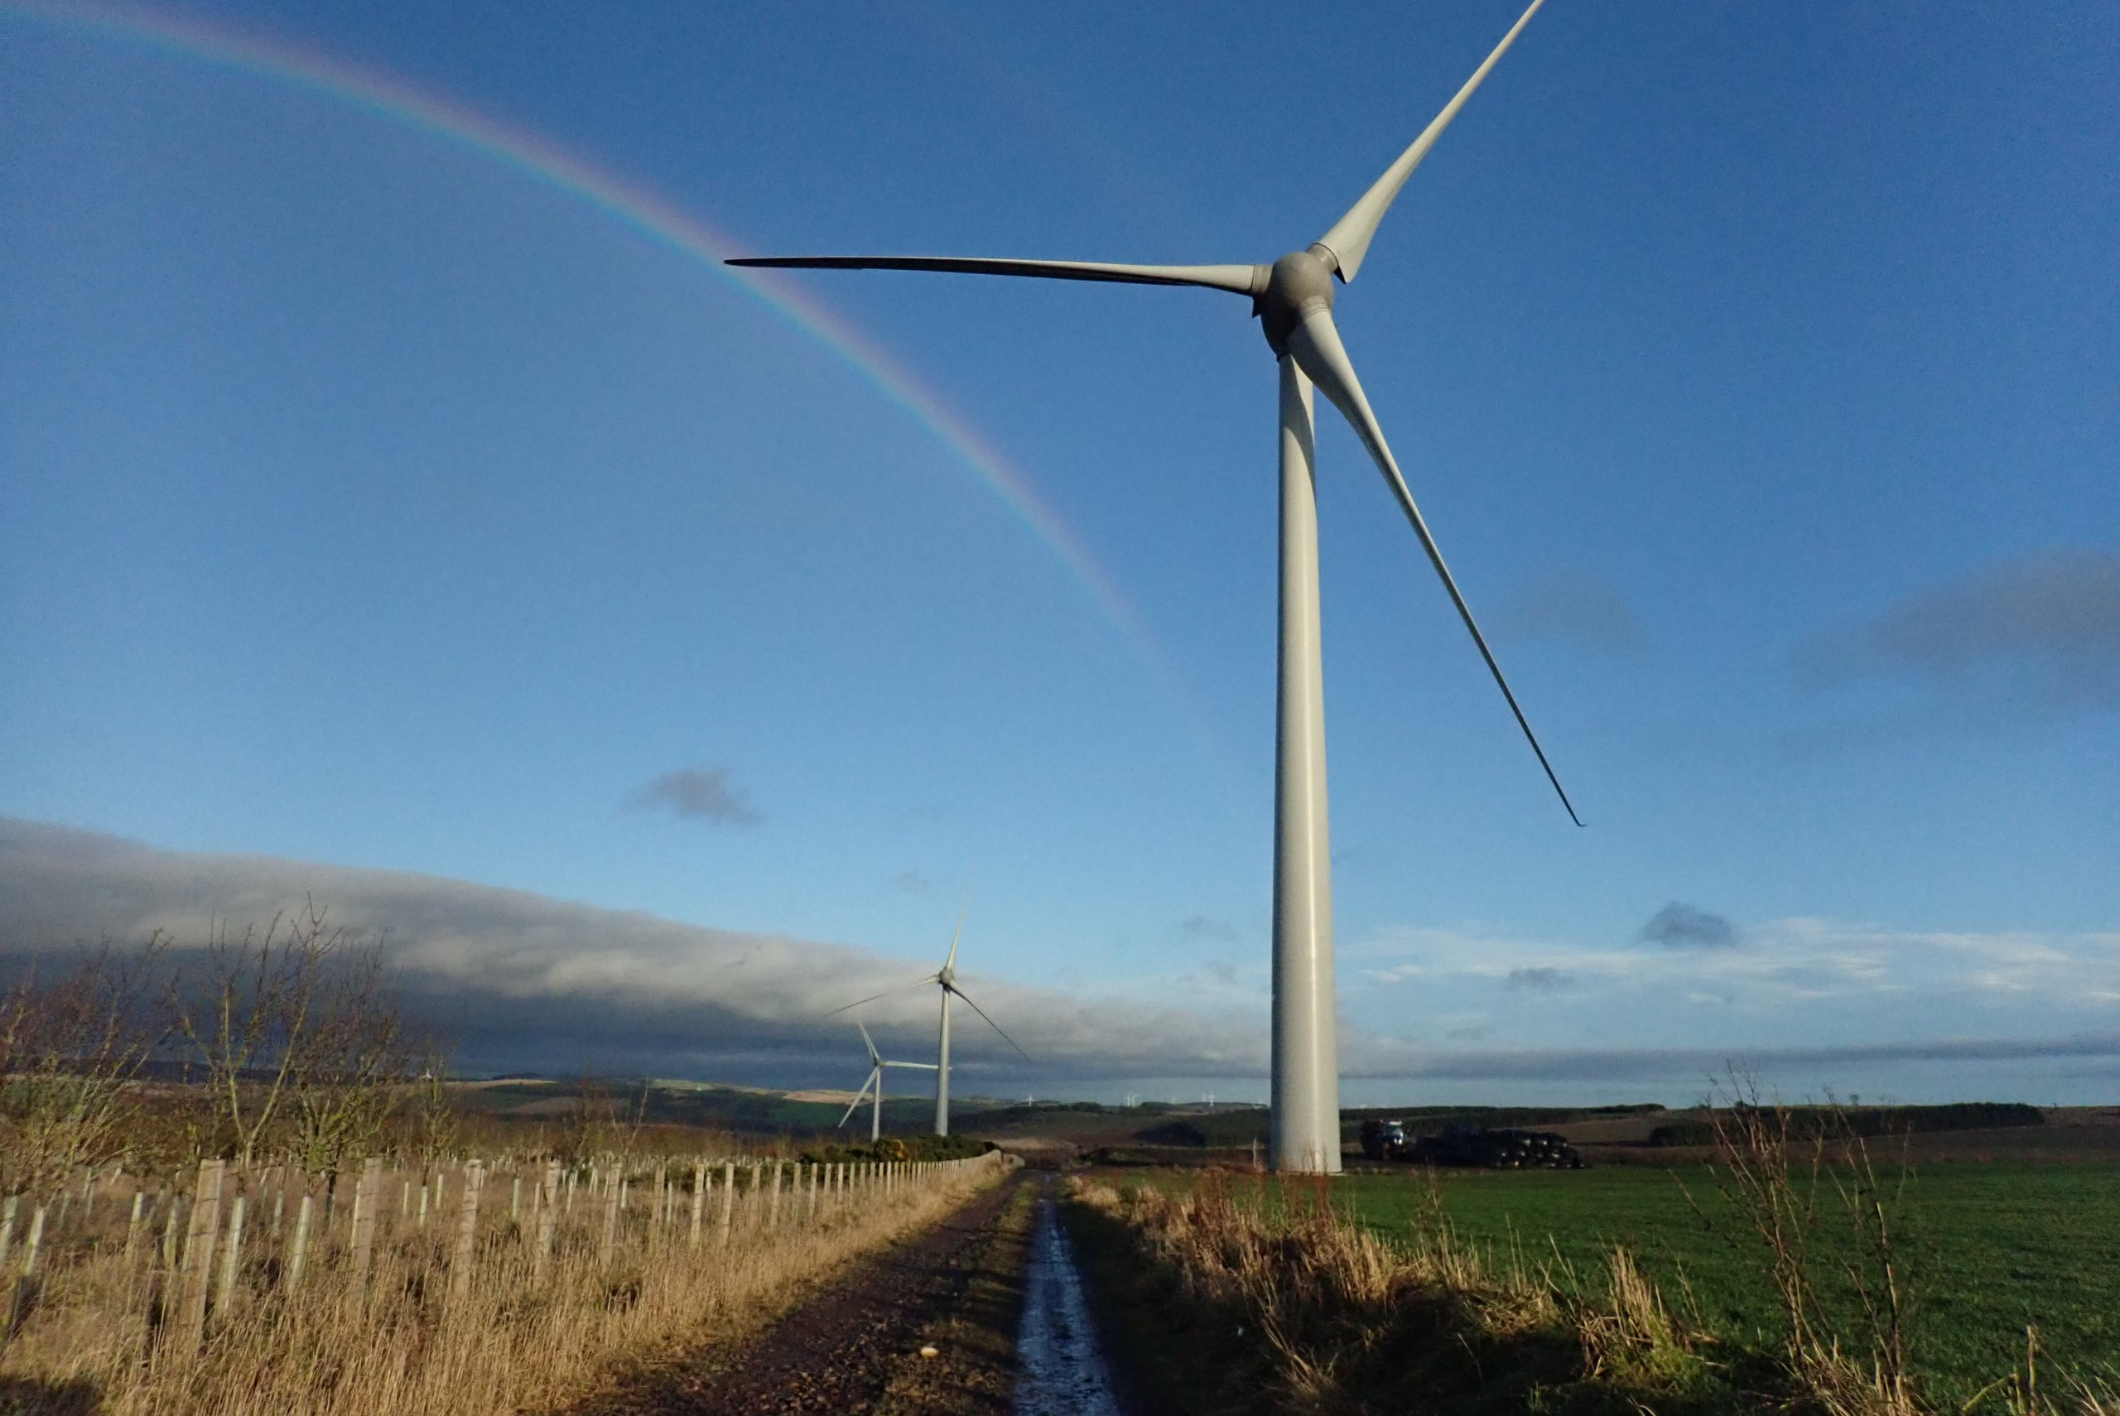
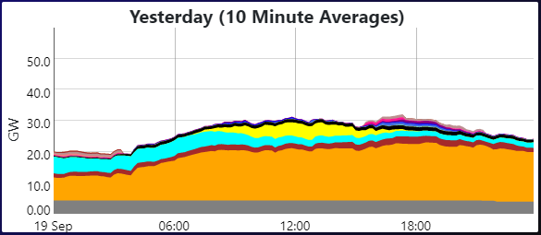
Why are gas turbines still relevant
Wind and solar power is cheap – it doesn’t make economic sense to build new gas turbine plants.
Wind and solar capacity is set to treble this decade.
However, wind and solar power is not dependable.
Existing equipment can be adapted to operate on low carbon fuels (when needed).
UK power generation on 19 September 2022
Source: gridwatch.co.uk
Notes:
100m barrels oil per day – 6,350 Olympic sized swimming pools
Global increase in energy demand – will continue – comfortable convenient and safe lives. Currently at the expense of the planet.
Challenge for alternative fuels is the cost, convenience and infrastructure.
Equipment has good track record for safety and availability on fossil fuels.

Slide 7
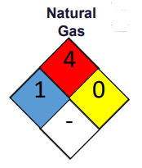
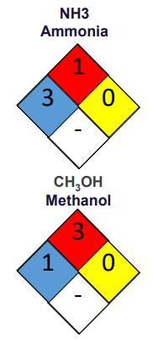
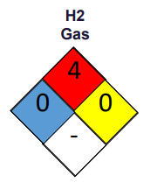
Gas turbines and hydrogen
Positive attributes of gas turbines
Fast response
Efficient
Fuel flexibility
Alternative fuels all have difference challenges:
Cost
Ease of storage and transportation
Combustion properties
Hydrogen is being actively developed for the energy transition.
Safety diamond hazard scale: 0 to 4
: Flammability
: Toxicity / health hazard
: Instability / reactivity
+
National Fire Protection Association (NFPA)
704 safety square / fire diamond
Notes:
GTs provide fast response capability – more important as renewables increase. Efficient in CC mode. Average coal plant ~33%.
GTs burn any fuel – very fuel flexible.
Each alternative fuel has own challenges
Hydrogen – just need electricity and water (lots) – and emissions are water (plus NOx)

Slide 8
Financial implications, risks and mitigations

Slide 9
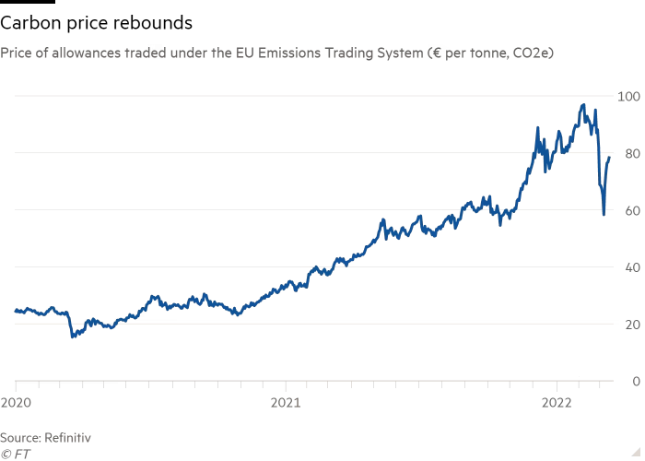
Hydrogen - financial implications
How much revenue can a single gas turbine generate in a day?
Up to £1m
More than £1m
Overhaul / repair costs in the event of a failure can also be several million pounds.
Existing equipment is well known, proven and generally reliable / available = low risk.
Development is likely to be required for operation on hydrogen = increased risk.
Operating cost and performance can be influenced by alternative fuels.
Notes:
£1m of revenue per day (think about gas and fuel bills!)
Delivery commitments and cost of repair can be significant.
Low risk to insurers as equipment is mature.
10s of millions at risk.

Slide 10
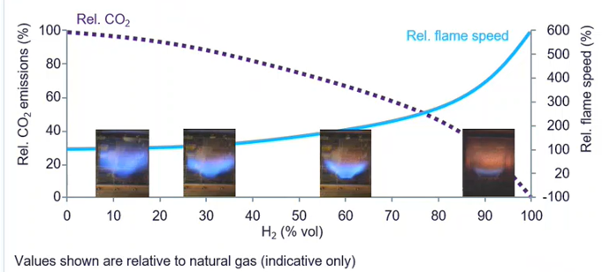
Hydrogen – operational risks for gas turbines
Combustion
Flashback – development activity required, (as existing equipment previously needed).
“Who is paying for R&D?”
Temperature – NO_{x} emissions and hot spots
Performance – shaft power
Maintenance interval
Burner sizing and backwards compatibility
Source: Siemens Energy
Notes:
Flashback – flame travels backwards to area of pre-mix: damage potential. Took ages to get DLE right – new products will be in service.
Depends on combustor type – aero combustors can tolerate.
Can you meet performance commitments and emissions – legal question?

Slide 11
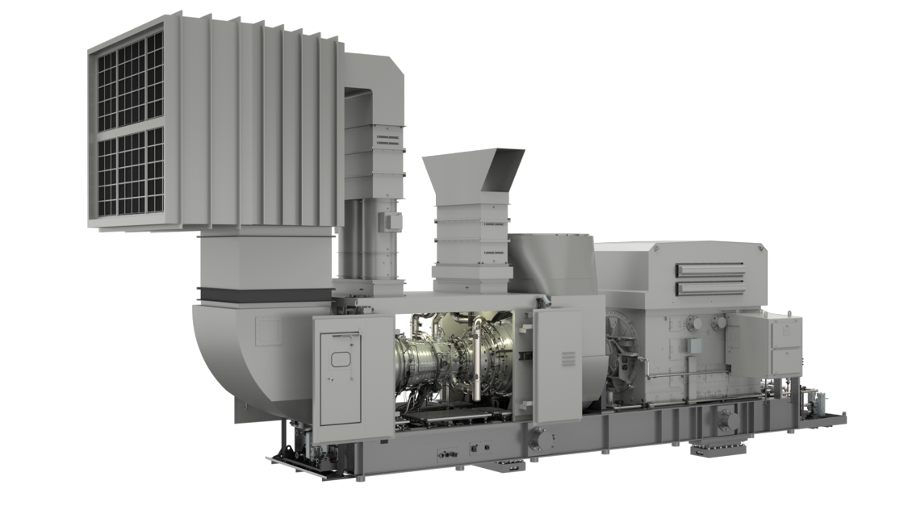
Hydrogen – operational risks for gas turbines
Package systems
Fire and gas detectors
Electrical components – group 2C
Ventilation system
Fuel system (valves, piping)
Control system
Source: Siemens Energy
Notes:
F&G detectors – specific to H2
Enclosure elec systems – sensors, connectors, actuators
Vent system – AFR range and leaking from instro, valves. Will leak more and broad flammability – less than 1% by vol – below LFL
Fuel – backwards compatibility – capacity due to hydrogen properties
Controls – transient capability, overspeed protection

Slide 12
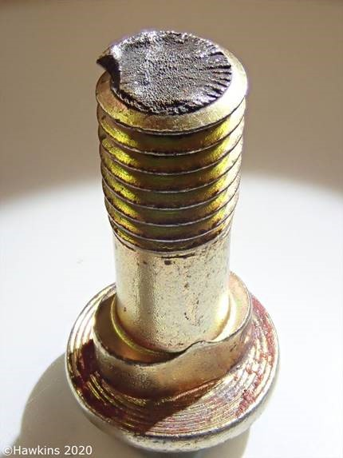
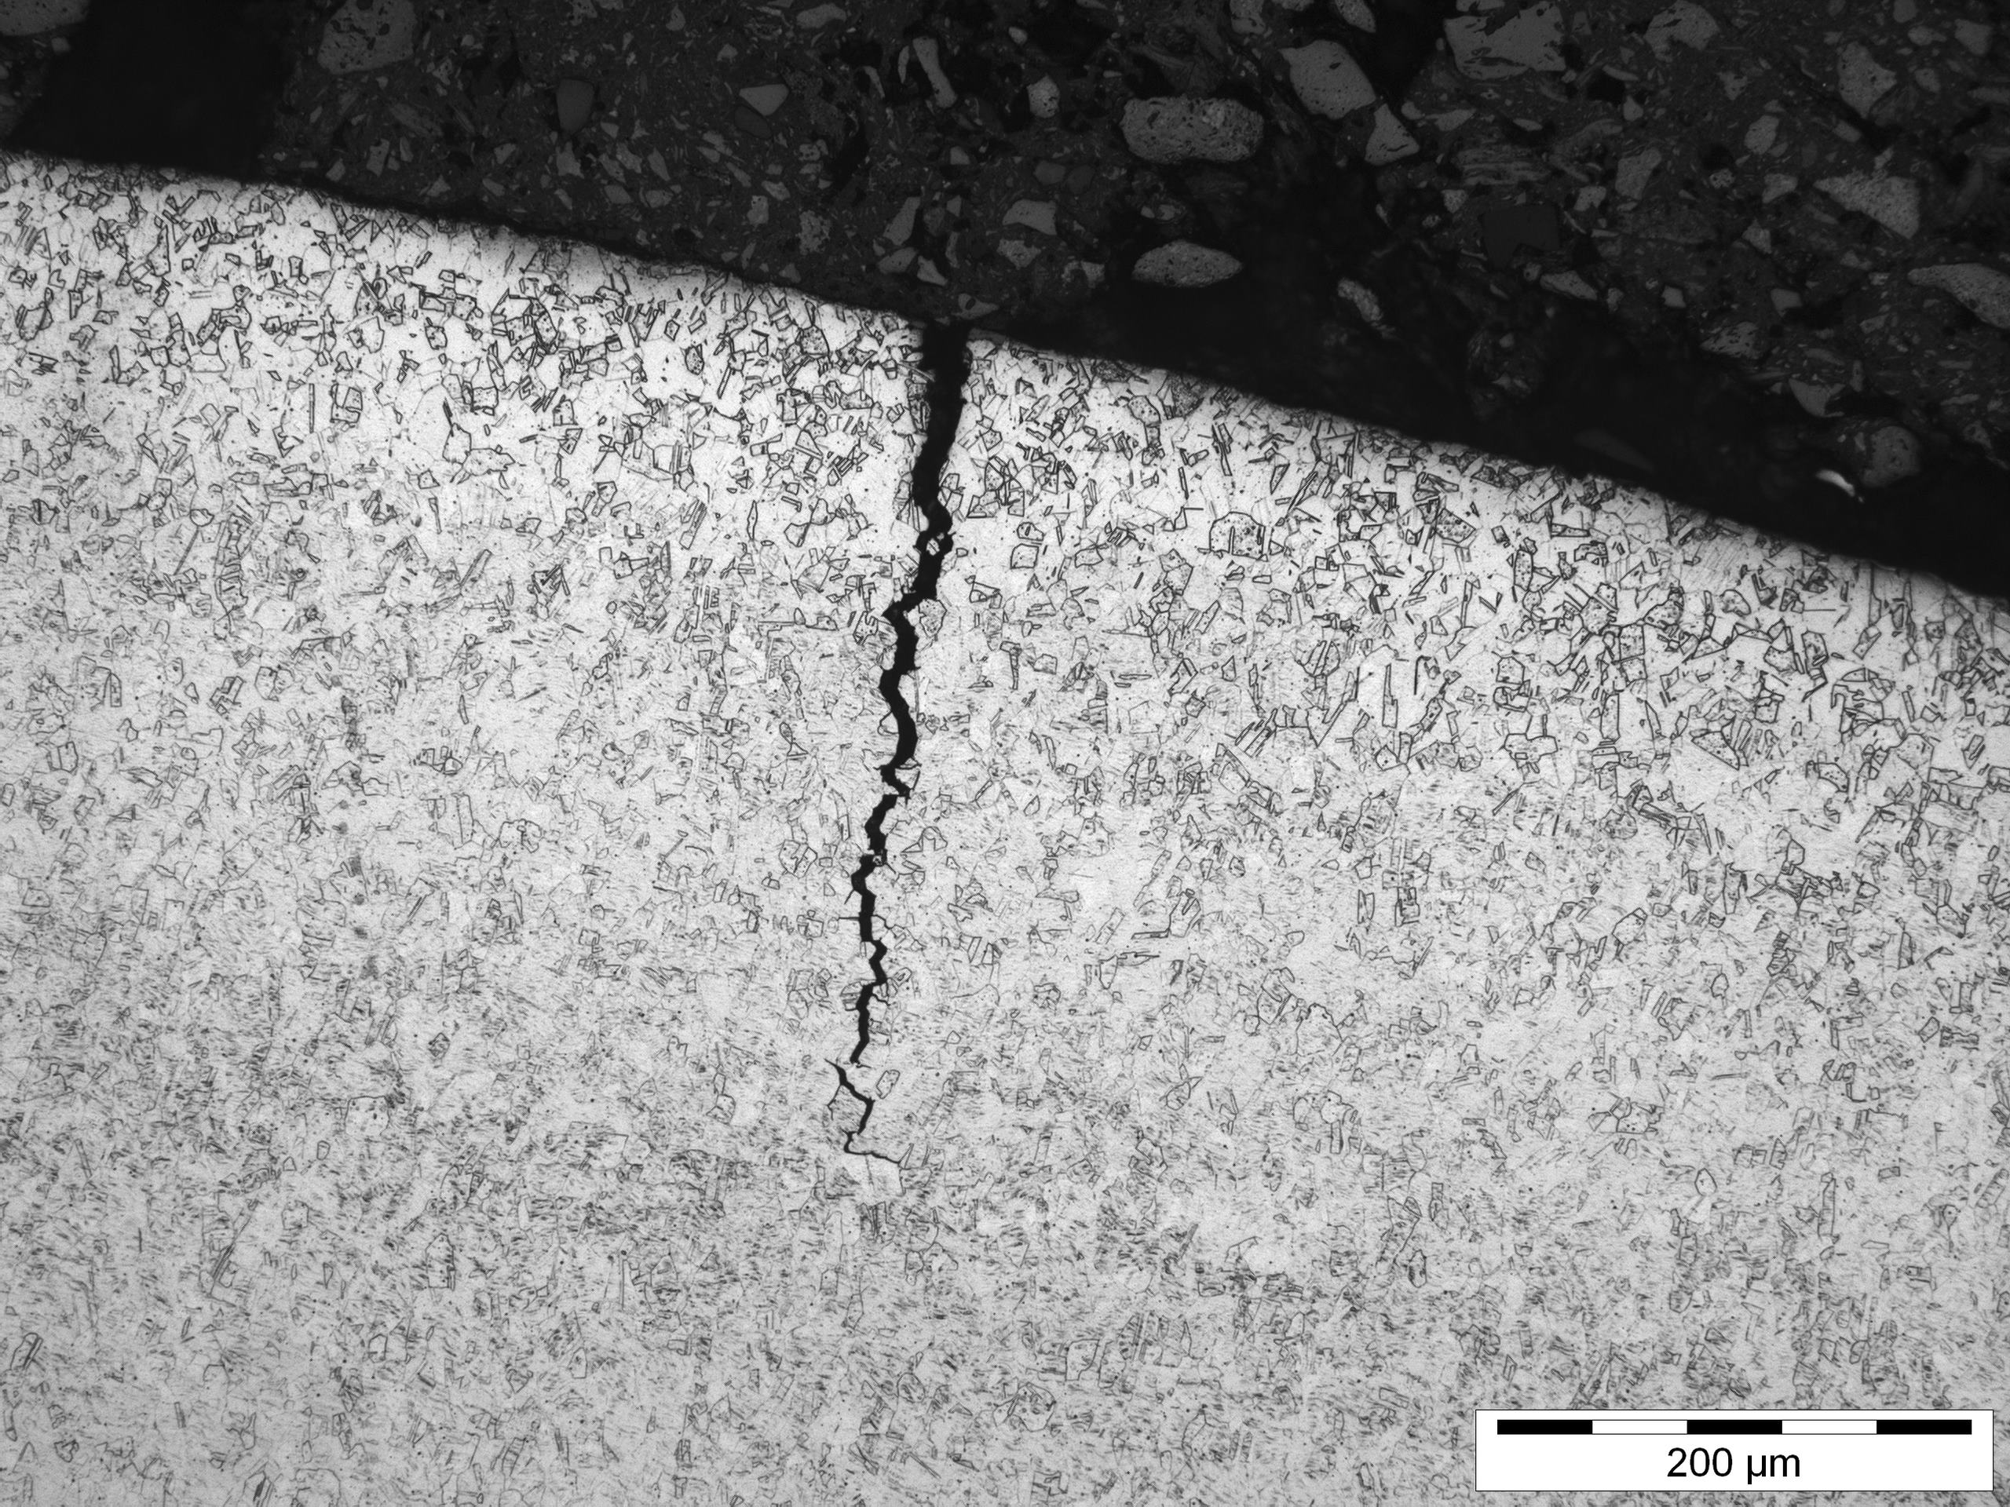
Hydrogen – operational risks for gas turbines
Hydrogen embrittlement
Sudden failure – material properties are changed, promoting crack propagation
Material specification is important
Existing defects and manufacturing processes can exacerbate the problem
Requirement is to test and validate the materials used in GT systems
H⁺
H⁺
H⁺
H⁺
H⁺
H⁺
Notes:
Scary – sudden failure that you can’t see developing.
Hydrogen affects material properties and will promote crack propagation
Needs testing and validating
316 SS – good with H2 and is used in fuel systems.
High tensile strength materials at risk (440C) – could be used in valves or pumps – where you need wear resistance
Cold operation e.g. machining, bending makes materials such as 304 more susceptible.

Slide 13
Other alternative fuels

Slide 14
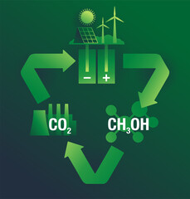
Other alternative fuels for consideration
Liquid fuels that are nearly “drop in”
Hydrotreated vegetable oil
Methanol
Each have their own challenges and requirements
System materials
Capacity
May see an increase in these fuels in the next 5 years.
Notes:
Seal materials (rubbers) – fuel system and actuation
Valve materials – lubricity
Hydrogen will take time – infrastructure – these offer a stop gap option (for liquid operators).
Image # 333596901 and 446783776

Slide 15
Summary

Slide 16
Summary
The energy transition will force operators towards alternative fuels.
Existing equipment will need to be adapted (some known, some unknown), bringing operational risk.
Financial losses of failure and / or non-availability could be in tens of millions.
Mitigating actions and a careful approach can minimise this risk and maximise revenue potential (whilst making the world a better place).
Hawkins can help advise operators and insurers make informed decisions – proactive or reactive.
Notes:
Economics, and a bit of political will
Varying degrees of adaptation required – package and combustion. Infrastructure required.
Range of experts – help with losses that have occurred, or understanding risk of insuring and minimise

Slide 17
Any Questions?
Simon Batt
07818 062042
simon.batt@hawkins.biz

