Slide 1
Onshore Assets of the Future
Adam Beardmore
01/11/2022

Slide 2
Hydrogen Production
Blue hydrogen
Carbon capture and storage
Green hydrogen
Electrolyser design
Layout
Placement
New technology development
Solid-oxide electrolysis
Methane pyrolysis
Electrified steam methane reformers
Notes:
Blue Hydrogen – established grey methods from coal gasification and SMR with CO2 then captured and stored – 8 sites globally in operation – largest at 1000 tonnes per day of H2, behaviour and storage within reservoirs and mitigating actions at early stages – practice well established but scaling poses challenges, re-use
Green Hydrogen
Alkaline – established technology – challenge is building in greater flexibility and operating range (minimum 10% load) to support renewable supply
Proton Exchange Membrane – Relatively new technology – out of the 286 MW globally operational 30% is via PEM, small scale (10 MW largest), operating hours and lifetime are lower – same at any load
Layout – overcome the high footprints of current designs future aspirations are to use stacked systems, access for maintenance and intervention, impact on fire risk,
Placement – coastal developments linked to offshore wind – exposure to flooding risks
New technology
Methane pyrolysis, solid oxide electrolysers (high efficiency but require high temperature steam as process feed, very new technology), electrified steam methane reformers

Slide 3
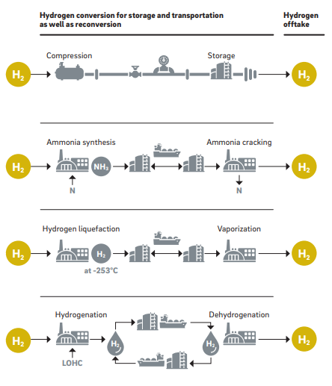
Hydrogen Networks
Pipeline
Specialist
Re-use and blending
Material impacts
End user preference
Storage
Salt cavern
Pressurized vessel
Conversion
Ammonia
Liquid hydrogen
LOHC
Notes:
Pipeline – well established method for transporting hydrogen as seen in refineries, technology gap is scale, but little issue seen, Compression has established use of piston compressors in refineries
Re-use and blending – greater technology risks, hydrogens impact on material selection, from steel embrittlement issues to valve seals, gas compressor normally based on centrifugal model, limited examples globally of their use for hydrogen but suffer challenges in rotational speed, impeller material and additional stages of compression. In blending end users on the gas system may be unable to accept hydrogen (chemical process, flame temperatures) leading to de-blending requirements
Storage – Salt cavern is a known medium for onshore storage (used at refineries), development and leakage or contamination considerations, pressurised vessel more novel resin based materials being developed to help with footprint and weight
Ammonia – production of ammonia well established and understood, technology challenge is the reconversion to hydrogen, cracking energy intensive and currently only at pilot scale, highly toxic, flammable, explosive
Liquid Hydrogen – Large scale under development, boil off loses along the chain, complex storage and transport requirement with transport by ship or rail limited with a single Liq h2 ship in operation, flammable and dense
LOHC – Still establishing as a technology (early prototypes at small scale) , low toxicity, non-explosive or flammable, similar energy cycle to Ammonia

Slide 4
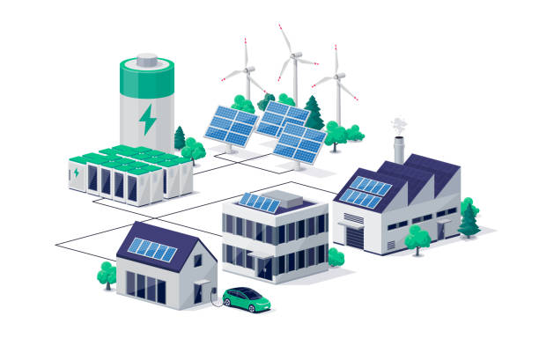
Electrical Networks
Distribution
Upgrades
Storage
Batteries
Smart grids
Hydro, CAES
Import / export
Interconnectors
Conversion
Hydrogen
Notes:
Distribution – Historic development of power networks have been from central large power plants with lines out to end users, Coastal wind development has challenged this with export limited by network capacity
Storage – flexibility, fast response – smart grid use of electric vehicle, data to manage supply and demand, CAES – compressed air energy storage
Import/export – key supply/demand management and renewable shortfall – interconnector with EU countries
Conversion – grid to hydrogen – hydrogen as an energy store

Slide 5
Transport hubs
Road transport
Varied products
Heavy load road transport
HGV, Buses and waste disposal
Ports
Low carbon bulk fuels
Shore to ship power
Deep water capabilities
Notes:
Road transport – likely to offer multiple options to support changing vehicle demand – see this in electrical and fossil fuel, potential for hydrogen to also become part of this mixture
HGV – greatest application for hydrogen in road users due to limited battery capacity, though technology is continuing to develop, hubs starting to be deployed with refilling station backbones on major cargo routes
Ports – Decabonisation of shipping, electrification, hydrogen, ammonia, Methanol – Offshore wind growth

Slide 6
Industry
Refineries & chemical processing
Alternative production
New feedstocks
Bulk storage sites
Demand and low carbon fuels
Process heat demand
Decarbonisation of industry
Supply Chain growth
Local content
New Technologies
DACS
Notes:
Refineries – Alternative fuel production across ammonia, liquid hydrogen and synthetic fuels – combination with carbon, built around existing processes, decarbonisation targets
Feedstock – increased renewable hydrogen, waste to fuel (SAF)
Bulk storage – lower energy density of future low carbon fuels increased demand for storage, new challenges and risks with ammonia or liquid hydrogen sites
Process heat – Electrification, industrial heat pumps, hydrogen fired, CCUS
Supply chains – Increased focus on local content in projects – growth and demand for fabrication capabilities
New Technology - Direct air capture and storage

Slide 7
Power
Abated gas fired generation
CCUS retrofit
Hydrogen fired generation
Bioenergy with CCS
Negative emissions
Nuclear
SMR, Fusion
Notes:
Abated gas fired – addition of CCUS on existing generation technologies – challenges in capture and stripping technologies
BECCS – Use of biomass with CCS as an offsetting mechanism
Nuclear – Small modular reactors, future fusion potential

Slide 8
Thank you
Adam Beardmore – Energy Transition Risk Engineer
Adam.Beardmore@aon.co.uk

