Slide 1
Downstream - volatility and inflation

Slide 2
Contents
Refining margins returning cash, allowing more investments
Crude prices are high, gas price high but distillate shortages drive margins
Geo-political events disrupting market and impacting prices
Impact of long-term investment decision in western refining
Engineering, construction capacity - can it meet high demand?
Disruption to global trade of material, specialist parts, rare metals
Impact of energy prices on base commodities from nickel to steel
Changing picture - makes investment decisions more difficult
Notes:
Two issues are top of the industry’s agenda, and the agenda of governments too:
Energy Transition part of which are moves to decarbonise refining. This includes the adoption of different feedstock from agricultural sources to waste oils. Bio-fuel and renewable diesel investments are increasing across Europe and the US.
Energy Security – the invasion of Ukraine has thrown into sharp relief the need for regions to control the inputs and outputs that give them security of energy supply. Supply at an affordable price.
The need for energy security is accelerating the pace of change in the energy transition. There is an opportunity for investments in refineries, both to increase capacity and invest in greener projects. These reduce the heavy carbon footprint by energy saving and by adapting the feedstocks that refineries use.
In the first part of this presentation, I’ll explore the current picture in refining and look at the current margins.
Then we’ll look at the impact of inflation and market volatility on the cost of projects currently planned, and the investment plans for the next few years.

Slide 3
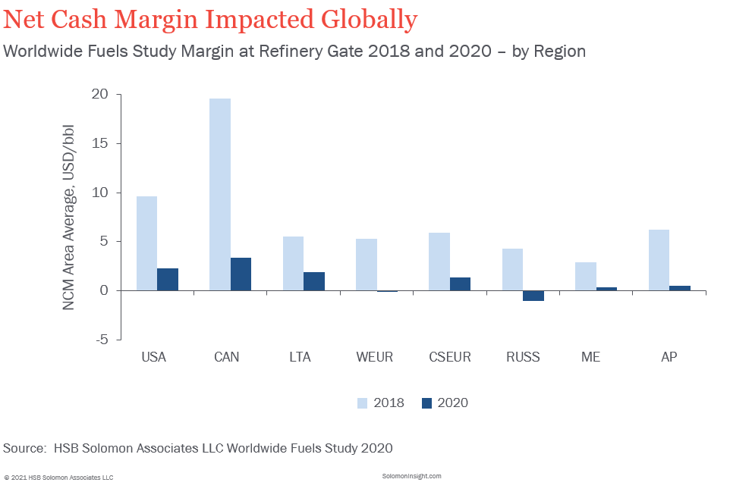
Refining - a low margin activity?
Refining tends to be low margin compared with the upstream O&G business
Historically in range of $2 to $10/bbl, depending on size, complexity and efficiency
Solomon Associates data based on global surveys over many years
Notes:
Refining has long been the problem child of the oil industry. Described recently as low margin, low drama, it is characterised by margins that allow most refineries to ‘just get by’. So the current boom is unusual. Typically these periods where refineries make hay don’t last very long.
2020 was a year when margin went very negative. Refineries lost their market as consumption of transportation fuels was extremely low due to restricted travel.
Crude and product storage tanks were full.
Refineries faced bankruptcy. Some Atlantic basin refineries closed.
Refineries were struggling, and have been heavily subsidised by the parent companies so current high margins are allowing them to make good those balance sheets
Refineries cut runs, elected to do maintenance, and in some cases closed for good.
Two of these refineries that shut were in the Atlantic basin and fed products into North-western Europe. These closures followed a gradual decrease in capacity over many years from the 90s.
So now as demands surges back, the capacity that was lost, coupled with upsets in normal product flows is having a major impact on the market.

Slide 4
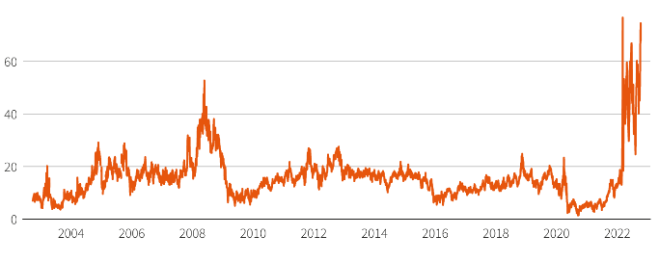
European diesel shortage – market impact
Benchmark European distillate crack hits a high of $77/bbl on 11th Oct.
(Reuters report on longer term market shortage, exacerbated by strikes in French refineries)
Distillate shortage in Europe in driving the higher margins
Notes:
Although the EU sanctions on Russian imported products don’t come into force until 5th February 2023, there are many countries and organisations already self sanctioning.
European refining capacity can’t supply the demand for distillates, which is driven by use in manufacturing, freight, mining, agriculture and forestry as well as vehicle use.
Russian refineries invested heavily in order to supply distillate into Europe to balance this structural diesel deficit that has existed for decades. That product flow from east to west has now largely stopped, leading to a significant imbalance in diesel and kerosene supplies.
You can see a spike on that distillate-crack which goes back to early summer. The supply was recovering a little by August. Since late September the distillate shortage has ramped back up as refineries owned by Exxon and TotalEnergies have been shut down by workers striking for higher wages.
With EU sanctions coming into force on Russian products in spring, Europe needs different sources of diesel import and kerosene from the US, Middle east or Asia to meet demand. Any increase in production from European refineries will find a hungry market.

Slide 5
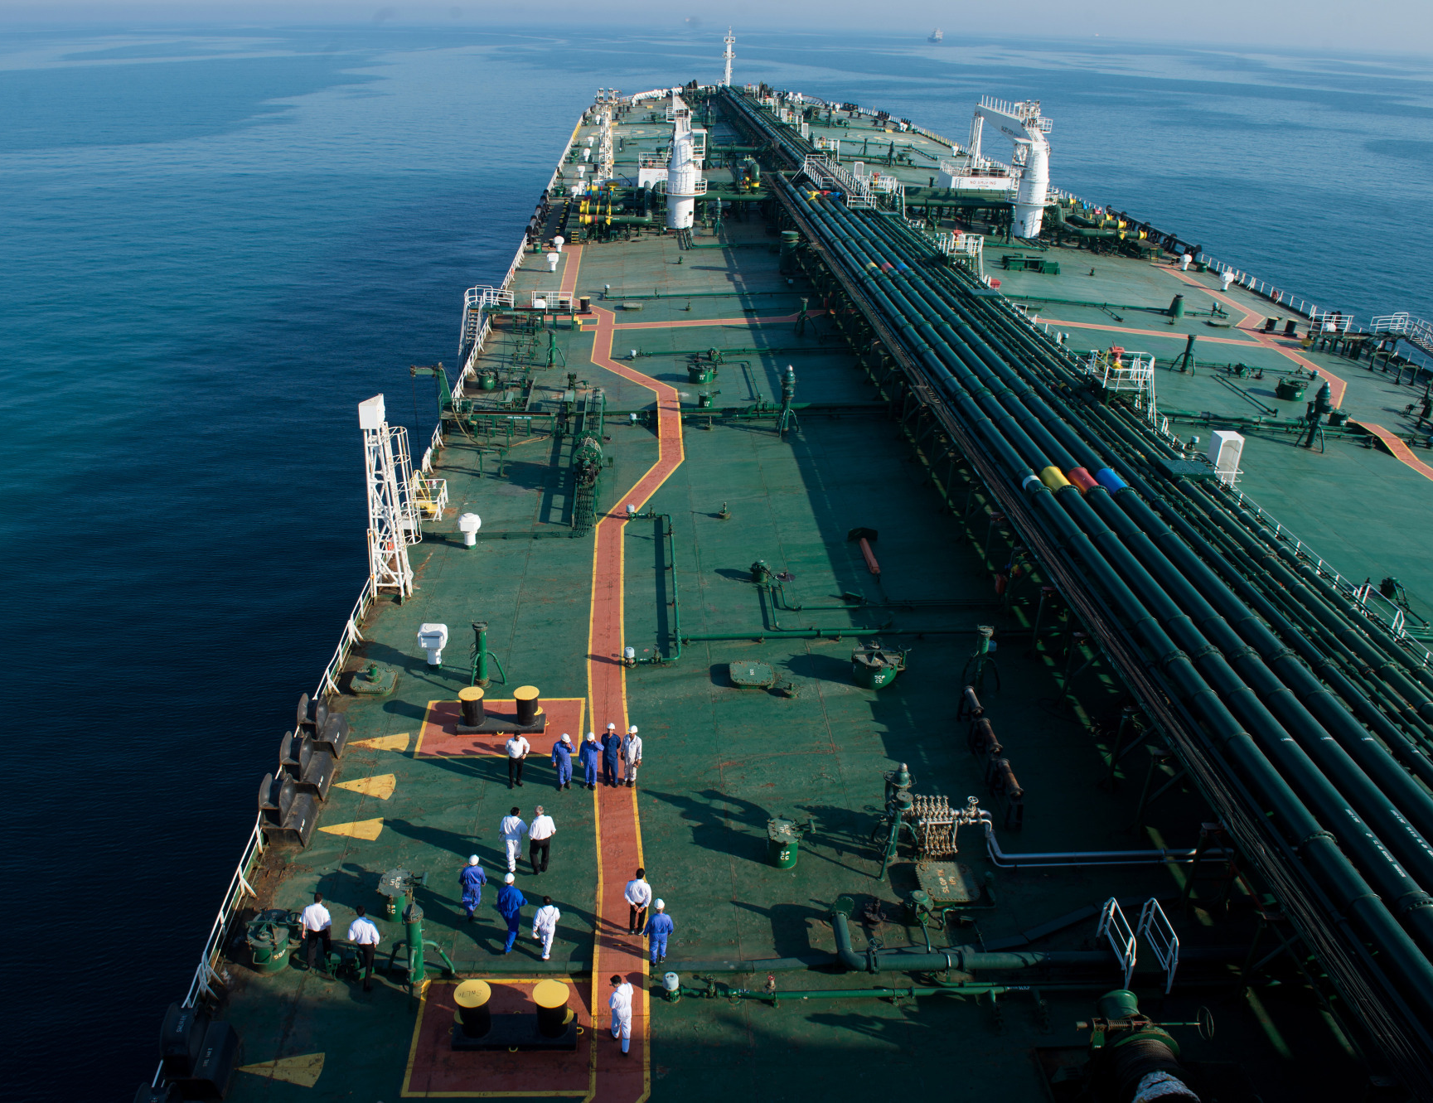
Refining Margin = Outputs - Inputs
Inputs:
Crude oil
Intermediate products
Natural gas
Electricity
Labour
Services
Materials
Equipment
Outputs:
Finished products
Petrochemical feed
Intermediate products
Electricity
Waste Heat (rarely)
Notes:
Refining margins - set by the difference between the price earned for finished products and the cost of the inputs.
The input costs are dominated by crude oil, and any intermediates it can upgrade and sell as finished product.
On the cost side of the equation prices are rising generally and a major component of that is energy.
Many refiners buy natural gas as fuel to supplement refinery produced fuels, but also to reform into hydrogen. Hydrogen is consumed in many processes and especially in those which produce distillate.

Slide 6
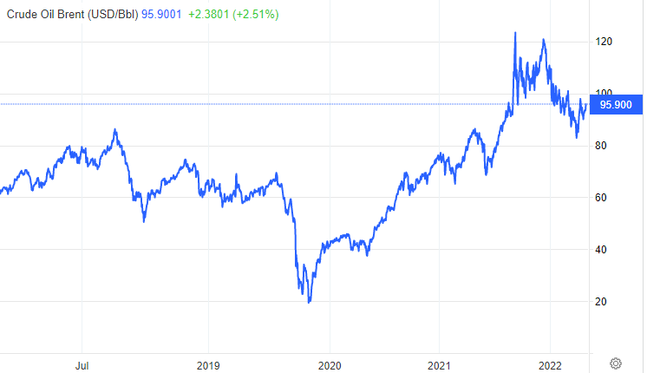
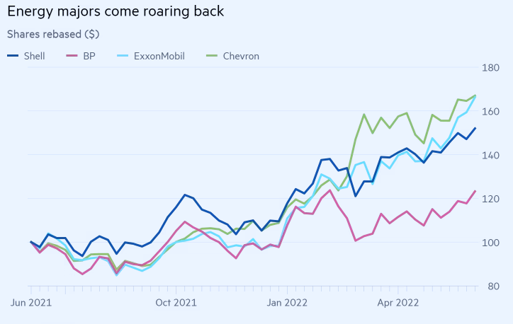
Crude price
Since January 2022
Brent price climbed by almost 60%
Boycott of Russian crude impacts supply
5th Dec no Russ crude import to EU by sea
Energy security back at top of the policy agenda
Share prices of oil majors recovering
Notes:
From January this year the price of Brent increased by 60%, with spikes up to 120 $/bbl. Crude prices remained at over $100 / bbl from March to July of 2022. With global crude flows disrupted the choices of crudes were different from those in a normal market, which in turn impacts how refineries can operate. Russia is exporting discounted crude to India and to Asia. As Saudi barrels make up more of the European refining diet, the impact of that sourer barell is felt in increased hydrogen consumption.
The EU has imposed sanction on Crude imports by sea, which constitutes 90% of the crude imported into the region from Russia. This comes into force on December 5th 2022, but with many traders and corporations self-sanctioning the effect is already being felt.
Energy security is at the top of government and industry’s agendas, fuelling a higher level of activity and investment in most forms of energy. The share prices of the Oil & Gas majors show that renewed interest and a recovery from low prices in 2020 and 2021.

Slide 7
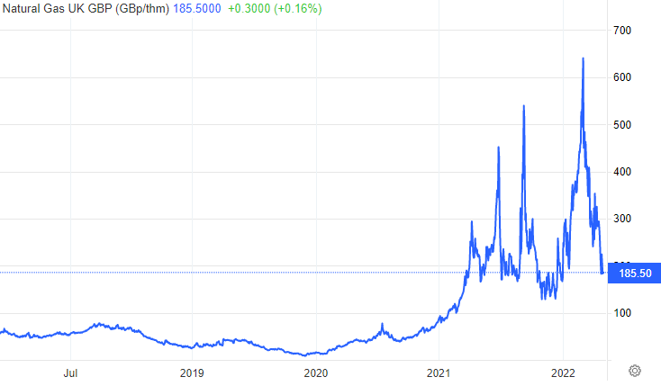
Natural gas - a strategy defining cost
Normal range of UK gas:
25-85 pence/ therm
August ‘22 peak price:
640 pence/ therm
Now at 185 pence/therm
Impact on refining margin around 3 $/bbl
Max vaporisation of LPG to offset nat gas
Makes H₂ cost high
Notes:
Even a decade ago energy costs represented more than 50% of a refinery operating cost.
The impact on the refinery margin is now at least $3/bbl which is normal margin times, would be enough to reduce the margin to a negative figure.
LPG is a saleable finished product, but refineries are vaporising LPG to offset the quantity of natural gas purchased.
Where a steam methane reformer is used to generate hydrogen then the cost of that hydrogen for desluphurising products is directly driven by the gas purchase price.

Slide 8
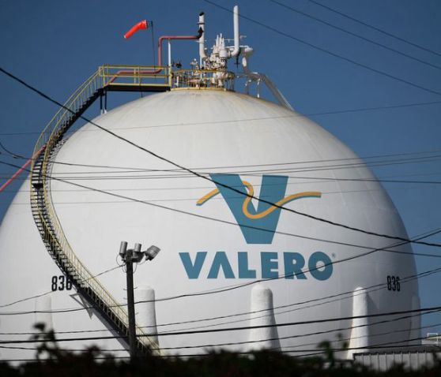
Despite high costs, margins are strong
Refiners making money even with rise in prices of crude and energy
US majors saw high margins further buoyed by recent unplanned outages
European margins reported as high as $60/bbl + for short periods in summer
Total’s refineries in Q2 earned 14 times as much as Q2 of 2021
Refining Margins | 2022 | 2021 | 2022 | 2021
 | Apr-May-Jun | Apr-May-Jun | Jan to Jun | Jan to Jun
Valero in U.S | 30 $/bbl | $7.95 $/bbl | 22 $/bbl | $7.54 $/bbl
Total Energies | 20.4 $/bbl | 1.4 $/bbl

Slide 9
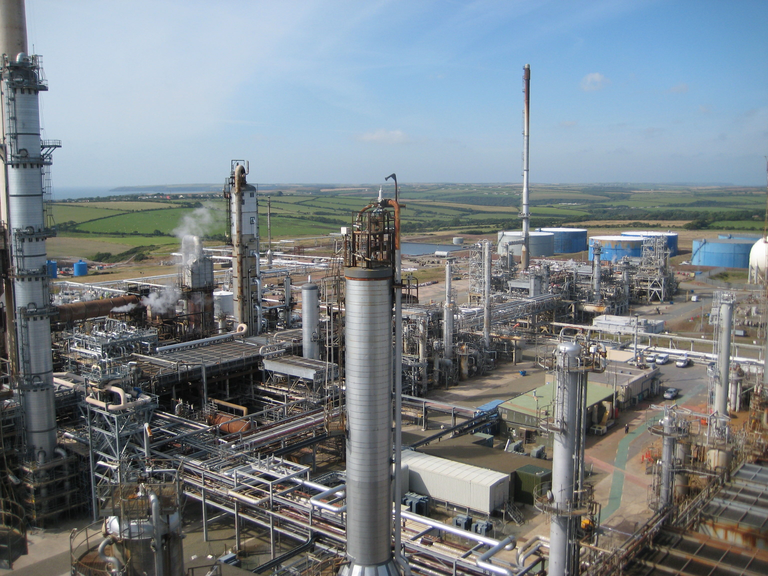
Why have margins increased?
Europe and US capacity reduced in recent years.
Boycott of Russian refined products and some crude imports.
Chinese export policies - change. Abnormal global crude & product flows.

Slide 10
The Economist - three key factors
First is long term decline in investment
Oil demand forecast to plunge over next decades; carbon cost pressure on refining
Capacity in the west has dropped by 3million bpd since pandemic
Second is China’s reducing export of refined products by 50% early 2022
Quota is increasing again. Russian crude going to India and to China.
China has 7% of global spare refining capacity
Third factor - sanctions on Russia due to invasion of Ukraine
UK and US ban on Russian imports is followed by EU ban on refined products
Source: The Economist, July 2022

Slide 11
Cost of investments
Notes:
While longer term investment in European refining capacity has been declining for many years, the current acute impact of threats to energy security is speeding up investments in refineries and in the energy infrastructure of western Europe generally.
Spoken over the model clip. Slide 13
The BCIS index for construction costs published by RICS shows an overall increase of 22.5% versus 2020 prices.
A source of data for predicting price rises in the downstream industry is the Chemical Engineers Price Cost Index (CEPCI) which is a good guide to the increases of various aspects of equipment and manpower. It is a compilation of data over the long- term tracking costs of all types of equipment used in downstream industries. These long-term trends help predict future prices, but how will the current instability impact those prices?

Slide 12
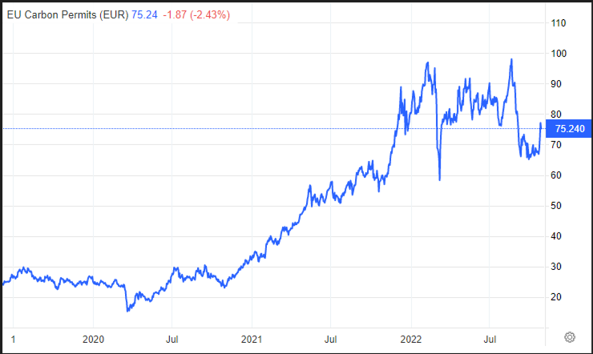
Steel price increases in UK
Energy intensive steel production hit by gas costs
EU emissions trading adds further cost
Energy prices hitting all economies
UK steel prices saw big jumps in 2022
Steel plate price rose by £250/te in March
Structural steel section up by £100/te August
British Steel hiked by £150 /te in September
Fluctuations make estimating project costs very difficult. Possible easing of price now?
Notes:
But the cost of those investments is rising, and the volatility of the market makes the job of the cost estimator a very difficult one. Prices and quotations that would normally be valid for months may now be valid for just a week or two.
Let’s take the example of steel, which is used in such a wide variety of applications. The UK market has seen three significant price hikes, which has driven up the cost of most projects.
In March the price of steel plate rose by £250/tonne
Later in the year the cost of structural steel sections was increased by £100/te
Then again in September, British Steel increased their price by £150/te citing energy costs as the underlying issue.
On top of the cost of gas or electricity purchases the manufacturers in Europe are hit again by the cost of carbon emission taxes. Given that EU carbon credits are traded the price of increasing production, and therefore CO2 emissions has to be factored in. This graph shows the cost of EU carbon credits which were trading at 30€ at the end of 2021, tripling in price by July this year, and now at a price of €75.

Slide 13
Inflation driving project costs up
European regional steel prices between Dec’21 and May ‘22 with increases typically around 50% but ranging from 15% to 79%
Price €/tonne Month | Hot Rolled Coil | Hot Rolled Plate | Cold Rolled Coil | Hot Dipped Galvanised Coil | Wire Rod | Sections & Beams | Rebar | Merchant Bar
Dec-21 | 921 | 947 | 1083 | 1190 | 794 | 981 | 766 | 855
Jan-22 | 892 | 935 | 1054 | 1170 | 823 | 1049 | 799 | 922
Feb-22 | 902 | 957 | 1057 | 1173 | 828 | 1053 | 803 | 920
Mar-22 | 1199 | 1466 | 1266 | 1408 | 1035 | 1250 | 997 | 1159
Apr-22 | 1346 | 1876 | 1446 | 1614 | 1224 | 1458 | 1185 | 1285
May-22 | 1135 | 1695 | 1247 | 1426 | 1184 | 1447 | 1159 | 1268
Change Dec-May | 23% | 79% | 15% | 20% | 49% | 48% | 51% | 48%
Notes:
This table shows the monthly cost of eight different steel products and how they increased from last December to May of this year.
Hot rolled plate, used throughout the downstream sector, is the most striking example with an increase in price of 79% over that six-month period. For a project which may have passed through the FEED and detailed design phases in those six months, any initial estimates of cost could now be very much on the low side.
Other products like wire rod, sections and beams, and rebar have also increased by 50%. Now that demand is high again and investments delayed by the impact of Covid are moving ahead, it may be that there will be a premium to pay to guarantee supply in line with a project’s schedule.
European refineries tend not to use Chinese steel, as the evidence of quality control is not always reliable. With market and supply disruption due to the war in Ukraine, the constraints on global supplies of materials are having an impact on project costs.
Project investment decisions are based on economics that quickly become out of date. And when feedstock and product prices are also in a state of flux, then the payback of a new project becomes very difficult to define accurately.

Slide 14
Engineered products - lead times
Equipment – Mechanical | Cost (£ million) | Lead Time
Shell & Tube Exchangers | £0.75 m | 30 weeks
Air Cooled Heat Exchangers | £3.2 m | 54-60 weeks
Electrical Heater Exchangers | £0.42 m | 36-40 weeks
Fans (Centrifugal) | £0.99-£2.6 m | 34-52 weeks
Centrifugal Circulation Pumps (API 610) | £1.2 - £1.9 m | 42 - 52 weeks
Manual Valves | £3.2 m | 16-30 weeks
Piping Bulks | £1.2 m | 14-18 weeks
Combination of longer lead times and costs rising in parallel makes for difficult decisions at early phase gates.
Equipment - Electrical | Cost (£ million) | Lead Time
Transformers | £1.6 | 26 weeks
LV Switchgear - 400V | £0.6 | 26 weeks
HV Switchgear - 33kV, 11k | £1,92 | 26 weeks
UPS | £0.81 | 22 weeks
Power Management System | £0.4 | 35 weeks
Equipment – Control & Instrumentation | Cost (£ million) | Lead Time
CCTV | £0.18 | 32 weeks
Integrated Control & Safety System | £0.59 | 25 weeks
Continuous Emissions Monitoring System | £1.03 | 16-18 weeks
Control Valves | £0.56 | 24-28 weeks
ESD Valves | £0.59 | 28 weeks
Notes:
Supplier’s prices are being held for shorter and shorter periods, and budget quotations are caveated to cover the supplier’s exposure to materials costs.
To exacerbate this, the lead times for engineering components or products is increasing. Lead times of over a year for bigger and more costly items are not unusual. This table shows examples from a recent downstream project with air cooled exchangers having lead times well over a year. The premium to reduce a delivery time on a centrifugal fan from 52 weeks to 34 weeks is equivalent to a doubling in cost.
This leads to a drive to place long lead items on order earlier in the projects life, with the inevitable risk that changes during the later design phases lead to re-work and increased costs due to changes in the design.
As a project passes through a phase gate the cost estimate of the previous phase may well be much too low, and costs need to be updated frequently. The changes have been so rapid and extreme that it may be worth phasing purchases on a project to avoid short term nature of price fluctuations

Slide 15
The competition for skills
Job market is very competitive
Engineering disciplines are often in demand; this changes with industry cycles
Large EPC companies re-hiring after big layoffs during 2020 (Covid)
With crude price suppressed by low demand, much investment halted 2020
Oil and gas projects competing with all forms of energy production
Competition from Nuclear: Hinkley Point mega project attracting huge numbers
New challenges from renewables, attractive due to sustainability
Notes:
The competition for engineering skills reflects the shortage in so many sectors where labour is in short supply. The impact of Brexit on the flow of European workers, is being felt and the cost of visas and travel is pushing up add-on costs.
Large EPC companies are re-hiring from the pool of people they laid off during 2020 amid Covid restrictions, when many projects were halted or cancelled.
But there are other mega- projects which need huge numbers of engineers, and skilled workers from welders to inspectors and scaffolders. Hinkley Point draws its workforce from all over the UK as well as other parts of the world. This well paid and long-term work is a competitor to the more short term Oil & Gas projects.
Although the impact of the increased labour costs is taking more time to be seen in the sector’s operating sites, the trend is another factor contributing to higher costs.

Slide 16
Refinery purchases - costs escalating
Exotic materials are much in demand, but in short supply
Exchanger bundle replacement in Inconel 625, nickel based superalloy
Sources in Europe are limited
Even worldwide availability is challenged
Price given by supplier in Feb = €1.1million
3 new channels and 2 new bundles
Price from same supplier in Oct = €1.5million
Refinery stores stocks - increased book value
Price of rare earths - impacts catalyst cost
Notes:
The example shown here is for a current project in western Europe. The material required for this application is Inconel 625, a nickel-based superalloy. It has always been at a premium price, but the restriction in materials supply are making it much more costly.
The price given by the chosen supplier for the same parts of three exchangers had increased from €1.1 million in February to €1.5 million in October. No changes to the spec of the design in that time – just the market effect on price.
The recent volatility of currency exchange rates hasn’t helped either. For example hot rolled plate priced in May-22 at €1,695/Tonnes would today be £1,464/Tonnes but priced at early October’s exchange rate was £1,661/Tonnes. That’s a cost difference of £197k for 1,000 tonnes of steel in the space of a fortnight.
For a cogen boiler estimated at a TIC f of $8.5million, if the pound had reached parity that boiler would have become a $10million project over a few days.
Refineries tend to run at minimum stock levels. But even with low stores stocks the value on the balance sheet is increased by the rise in process.

Slide 17
What’s the direction of investment?
Life extension for distillate producing units - the margin winners
Less complex refineries with a lower cost base have a window of opportunity to squeeze every last drop out of hydrotreaters and any distillate-making units
Cost of reducing sulphur to European diesel specs is high
Saudi crude contains more S, cost of H₂ to hydrotreat driven by cost of nat gas
Projects to conserve energy, projects to reduce carbon footprint
Investment in hydrogen for refinery use and for sale into other networks
Majors and smaller oil & gas are moving fast towards energy transition
Projects for increasing bio-fuels, waste oil and alternative fuels into distillates
Notes:
Anything that extends the lifetime of a distillate unit. Normally complex refineries with petrochemical links or specialist product like coke win out on margin. However, their cost base is high and they have been suffering for the past two years.
Simpler refineries have a window of opportunity to make the most of the margin on distillate and have lower energy cost. Those with high proportion of distillate capacity will maximise distillate production, and gain from their lower cost base. Squeeze the last drop out of any diesel making kit!
With Russian crudes now heading to India and China, there are more barrels of Saudi and ME crude in Europe, which tend to higher in sulphur content. The sulphur is removed by hydrotreating which consumes lots of hydrogen. Refineries use the SMR to generate more hydrogen from a natural gas feed, so each molecule of sulphur has a H₂ cost based on the price of natural gas.
Energy efficiency has never been of greater importance. Opportunities to create hydrogen from cleaner sources, and from neighbouring sites being explored.
The need for energy security is driving the traditional energy companies faster towards the energy transition. Tax incentives to invest in projects which move us towards net zero are following the declarations made by oil companies.

Slide 18
Future Energy
BP announced plan to become a net zero company by 2050
Includes net zero on carbon in oil & gas production
Measuring and reducing methane intensity of O&G sites
Total, in May 2022 - plan to be carbon neutral by 2050
Reduce emissions from industrial assets by 40% by 2030
Re-branded for move to renewables (e.g. FLOW in Celtic sea)
Varo investing $3.5 billion in next four years
Net zero by 2040; 40 % reduction of emissions by 2030
70% of investments in renewable; hydrogen; biofuels
Notes:
In 2020 BP announced five goals to transform the business to become a net zero company
it’s aim to make its operations achieve net zero by 2050,
including net zero on carbon in oil and gas production.
A reduction in carbon intensity of the product BP sells by 2050 or sooner.
Measure the methane intensity of all major oil and gas processing by 2023, and then and reduce that intensity by 50%
Increase the proportion of investment into non oil & gas business over time.
In May 2021, Total re-branded to become Total Energies to anchor itself as a broad based energy company, a world class player in the energy transition. They committed to
Reduce emissions from industrial facilities by over 40% by 2030
Reduce indirect emissions related to its products in the same period
They are an 80% investor in the first floating offshore wind project to go into construction around 2024/25 in the Celtic Sea off the Pembrokeshire coast
Varo Energy are investing $3.5 billion in the next 4 years with 70% of that committed to sustainable energy. Their strategy is to decarbonise but keep resilient their existing conventional sites, and use that to invest in a high growth sustainable energy business. They are investing in hydrogen production biofuels, biomethane and LNG, as well as carbon removal.

