Slide 1
The Real World of Energy Transition - Getting it done
ENERGY TRANSITION FROM THE PERSPECTIVE OF THE DEVELOPER
Suresh Bhaskar Managing Director for Renewables in UK & Ireland, ENGIE

Slide 2
The Real World of Energy Transition – Getting it done
01
Where do we stand now?
© ENGIE 2023 – LEADING THE ENERGY TRANSITION

Slide 3
Our Purpose
“
ENGIE’s purpose is to act to accelerate the transition towards a carbon-neutral economy, through reduced energy consumption and more environmentally-friendly solutions.
The purpose brings together the company, its employees, its clients and its shareholders, and reconciles economic performance with a positive impact on people and the planet.
ENGIE’s actions are assessed in their entirety and over time.
”
Notes:
The Real World of Energy Transition - Getting it done … this is exactly the purpose of ENGIE : ACT
ACT to accelerate the transition towards a carbon-neutral economy, through reduced energy consumption and more environmentally-friendly solutions.
Even if its still ongoing, this is our day-to-day reality because we work closely with all our counterparts to do it, and our actions are assessed over time.

Slide 4
ENGIE Decarbonization Trajectory
Engie abandons coal.
Asset sales are made and priority shifts to natural gas and renewables.
2015 - 2016
Aim for Net Zero by 2045 with interim emission cuts.
Commitments to 100% renewable electricity by 2030.
2019 - 2020
Net Zero by 2045
Leaders in the transition to low-carbon energy sources.
FUTURE
CO2
2013 – 2014
Decarbonisation journey begins.
Shift from fossil fuels to renewables.
2017 - 2018
Engie makes investments in renewables, energy storage and EV charging.
Active growth in green hydrogen production and distribution.
2021 - 2023
Shift to customer-focused decarbonisation strategy.
Renewable energy portfolio grows. More investment in advanced carbon reduction technologies.

Slide 5
Our Integrated Model
Distributed infrastructures to decarbonize our customers
01
RENEWABLES
Growing renewables capacity
ENERGY SOLUTIONS
Onshore Wind
Offshore Wind
Solar PV
Hydro
Local energy networks
On-site energy production
Energy
performance
and management
02
CUSTOMERS
04
Networks
Strong GEMS
Bring more flexibility to the system
Leveraging existing infrastructures to support growth
Flex Gen & retail
03
Pumped
Storage
CCGT
Storage
Networks
Biomethane, Hydrogen
Energy management expertise
Commercialising renewables
Optimising our fleet and monetising its flexibility
Notes:
The Group is leveraging the strength of its integrated model to accelerate its growth in the energy transition: the goal is to develop a balanced energy mix underpinned by the entire energy value chain:
Renewable energy platforms
Infrastructures to ensure security of supply in Europe
A wide range of flexible production assets, key to managing the intermittence of the electricity production
Distributed energy infrastructures, developed and operated by ENGIE, to help customers meet their decarbonization targets
Energy management, to valorize ENGIE’s business portfolio and to provide risk management services and custom-made energy supply contracts to its customers
Each of these elements makes a key contribution to enhancing ENGIE’s value proposition.

Slide 6
Accelerating Our Growth In Energy Transition
1st step of ENGIE strategic plan:
Refocus realized (2021-2023)
2nd step of ENGIE strategic plan:
Accelerating our growth towards energy transition
Simpler, Industrial, a leading role in faster energy transition
RAMP-UP
Growth
Secure & Flexible
NETWORKS
RENEWABLES
Growing renewables capacity
Gaining traction in renewable gases
Decarbonization
solutions for our customers
Networks supporting security of supply
Critical role of flexible assets in the energy transition: gas, batteries, pumped storage
ENERGY SOLUTIONS
FLEX GEN & RETAIL
Disposal program
Countries of operation
Supported by our integrated business model
complete
reduced
Notes:
1. NETWORKS
Gas
Historic record for our terminals in France with 95% utilisation rate
GRTgaz record high transit to Europe (~2x vs. 2021), including first-ever flows from France to Germany
Renewable Gas
520 GW of installed capacity at the end of 2022
Power Transmitions
In Latin America commissioning of Gralha Azul (1,000 KM) and Novo Estado (1,800 KM) on time and on budget
2. RENEWABLES
3.9 GW¹ added capacity in 12M vs 3 GW in 2021
37,9 GW¹ of installed capacity at the end of 2022
Signature of +2 GW
Green PPAs
Ocean Winds awarded 8 GW of offshore wind projects (Scotland, New York, California)
3. ENERGY SOLUTIONS
1 GW added in distributed energy infrastructure
On-site energy production contracts won for 250 MW of contracts in France, Spain, Italy and United Arab Emirates
EV charging: 12k charging points awarded
4. FLEX GEN & RETAIL
Flexible Generation
Strong performance in ancillary services ensuring system stability​
Acceleration of hydrogen projects ​
Development of battery storage, and of Hazelwood (150 MW)​
Building of 4 seawater desalination units​
Retail
Supporting customers on
affordability and making our portfolio more flexible (indexed offer, etc.)​

Slide 7
Business Cases - How Are We Helping Decarbonise Our Clients
Networks
ENGIE x Arkema in France
Renewables Karstädt Wind Farm (Germany)
300 GWH/year of renewable biomethane in France
10 year partnership
247 meter-high turbines
43.4 MW of electricity
Energy Solutions
ENGIE x L’ORÉAL in Brazil
Flexible Generation ENGIE x Microsoft in the US
100% RE electricity for production plants, distribution and research centres, head office
7,000 tons of CO2 avoided
24x7 Renewable energy
100% carbon-free energy on an hourly basis by 2030
Notes:
Karstädt wind farm (Germany)
The 20 end-of-life wind turbines, 99-meter-high have been replaced.
Contribution to accelerate the energy transition within ENGIE.
Provide energy to 26,000 four-person households.
ENGIEx Arkema in France
ENGIE will provide Arkema with 3TWh of biomethane to support the Group in its decarbonization journey and further reduce very significantly the carbon footprint of its biobased high performance Rilsan® polyamide 11 and Pebax® Rnew® elastomers.
ENGIE X L’ORÉAL in Brazil
L’Oréal Brazil’s goal was to reduce CO2 emissions by 60% by 2020, compared with 2005 levels. By 2018 they had beaten this target with a 68% reduction in their emissions! In Brazil, ENGIE supplies L’oréal with solutions to achieve carbon neutrality by 2025.
ENGIE x Microsoft in the US
Agreement to provide renewable energy to cover the consumption of select MS data centers in Texas.
Contribution to accelerate MS’s mission to transition to 100% carbon-free energy on an hourly basis by 2030.

Slide 8
The Real World of Energy Transition – Getting it done
02
What about ENGIE in the future?

Slide 9
Strong Ambitions for 2030
50GW in 2025
80GW in 2030
01
RENEWABLES
+8GW of distributed infrastructures by 2025 (vs. 2020)
ENERGY SOLUTIONS
02
CUSTOMERS
04
Networks
Strong GEMS
~4GW of hydrogen capacity by 2030
Flex Gen & retail
03
~10GW of batteries capacity by 2030
~10TWh of biomethane production per year in Europe by 2030

Slide 10
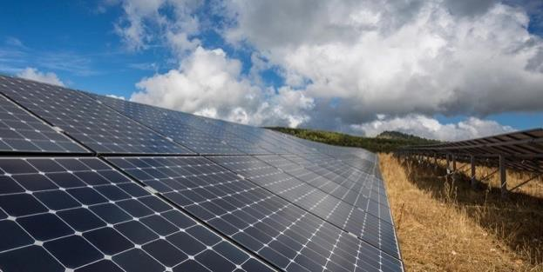
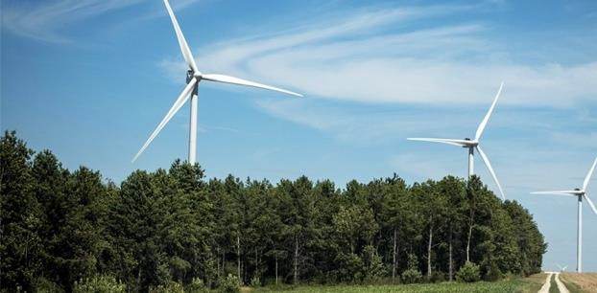
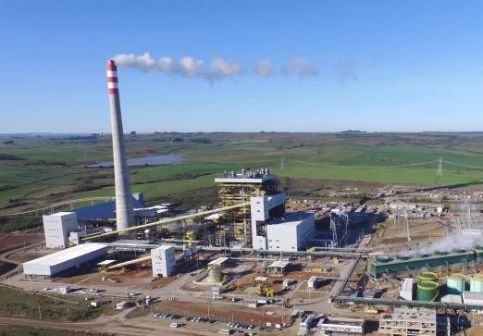
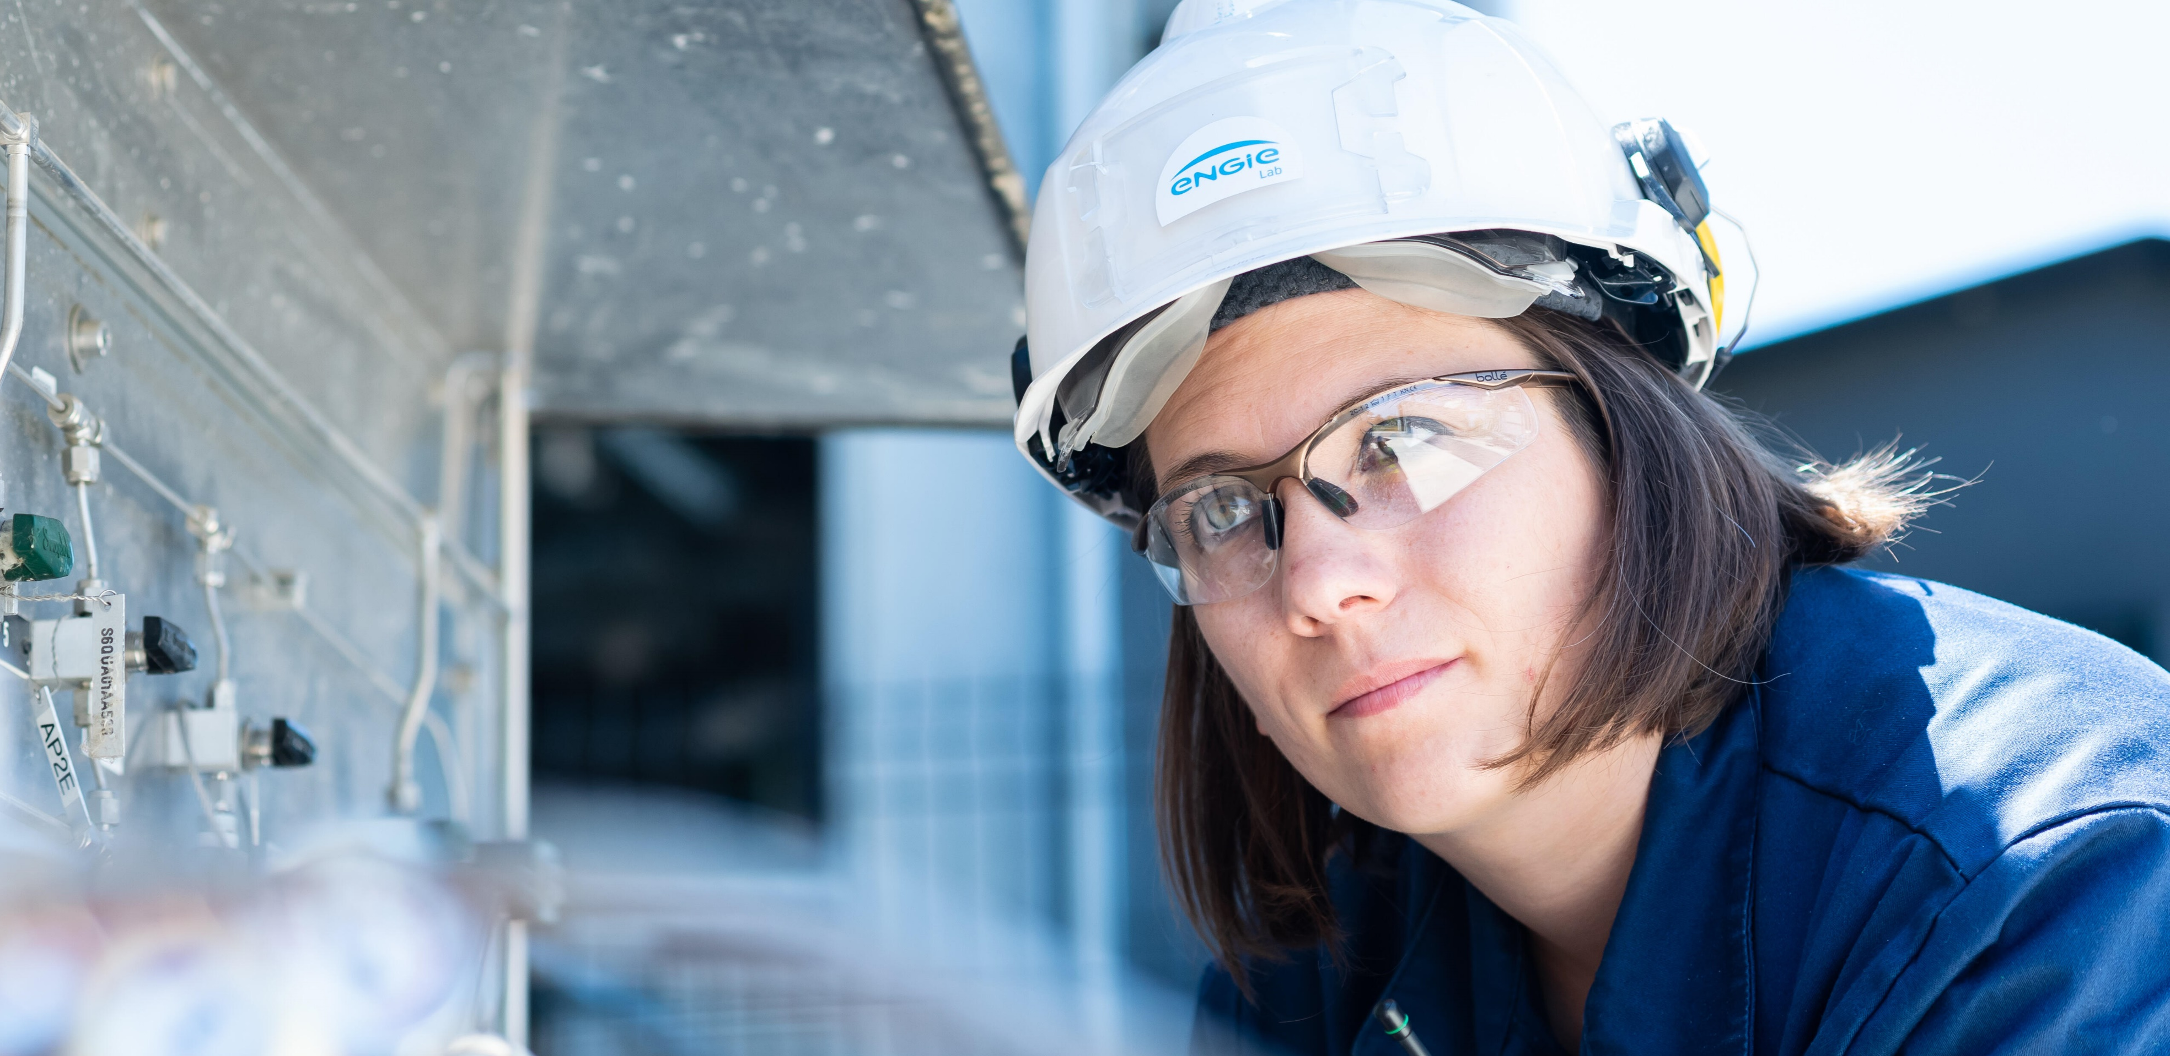
Progress on ESG
Share of renewables in total power generation capacity
Coal power generation
(GW@100%)
4 countries
in Group management
GHG¹ emissions
from energy production
Women in Group Management
107
Mt
Between 40% and 60% of women in group management by 2023
15.1
65
Mt
60
Mt
2030
TARGET
43 Mt
2030
TARGET
58 %
2027
no Coal
38%
39%
34%
30
26
Mt
28%
-86%
Mt
2.9
2.5
2.1
2017
H1 figures
2021 2022 H1
2023
2019
2021 2022 H1
2023
2015
2021 2022 H1
2023
1 Greenhouse gases, Scope1 and 3 (MtCO₂ eq)

Slide 11
Paving The Way To Achieve Our Net Zero Target By 2045
Well on track to phase out coal
by 2025 in Europe and 2027 globally
GHG³ emissions from energy production
NET ZERO by 2045
4 countries¹
Net zero by 2030
across all scopes
following a well below 2°C trajectory
Certified by SBTi
Carbon intensity of energy production and consumption down to
110g CO₂/kWh² by 2030
Coal phase out
Gas fleet reduction & decarbonization
1. Among which Brazil 2. Scope 1 and 2 3. Greenhouse gases, Scope1 and 3

Slide 12
The Real World of Energy Transition – Getting it done
03
How to accelerate? Focus on the European market
ENGIE’S SCENARIO FOR EUROPE

Slide 13
Our 5 Beliefs
1
Activate all possible levers for decarbonization
4% / annual reduction in emissions
To achieve « Net zero » carbon in less than 30 years
2
Combine electricity and molecules for a successful transition
450TWh of low-carbon gas by 2030
to meet “Fit for 55” objectives
3
Massive development of renewable power
80% increase
in electricity demand in Europe by 2050
x6
increase in power generation from solar and wind
4
Act now to anticipate flexibility needs
~x4
increase in flexibility needs by 2050
5
Energy efficiency is compatible with growth
34%
reduction in energy demand by 2050
ENGIE’S SCENARIO FOR EUROPE
Notes:
Extract from ENGIE presents its 2050 energy transition scenario for Europe
https://www.engie.com/sites/default/files/assets/documents/2023-06/WEB-Decarbonization pathways - EN v3-1.pdf

Slide 14
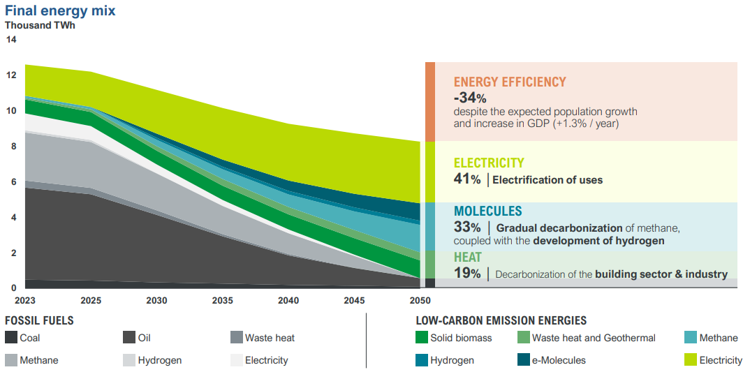
All Levers Are Required To Achieve Decarbonisation
ENGIE’S SCENARIO FOR EUROPE
Notes:
Extract from ENGIE presents its 2050 energy transition scenario for Europe
https://www.engie.com/sites/default/files/assets/documents/2023-06/WEB-Decarbonization pathways - EN v3-1.pdf

Slide 15
Some Concrete Barriers Must Be Addressed
ACCELERATION OF RENEWABLE POWER
AND GAS
Stabilize the investment framework
Facilitate and speed up network connections and permittingg
DEVELOPMENT OF HYDROGEN
by taking action throughout the value chain
Finalize the European regulatory framework
Ensure that appropriate public funding is granted quickly and that H₂ conversion of gas infrastructure is financed
MAXIMIZING BIOMETHANE POTENTIAL
by activating all levers
Ensure effective production support mechanisms (prices and inputs)
in France and in Europe
DEVELOPMENT OF FLEXIBILITY
TECHNOLOGIES
Develop suitable remuneration models (load management, batteries,
decarbonized CCGT, etc.)
Speed up permitting
Accelerate development of green heating networks, including geothermal
energy
Prioritize the use of biomethane for buildings and hybrid solutions
(heat pump, hybrid heat pump, boiler replacement, etc.)
Simplify access to housing aid with a one-stop shop grouping current mechanisms
DECARBONIZATION OF THE BUILDINGS SECTOR
by supporting all solutions
DECARBONIZATION OF INDUSTRY
Step up the use of waste energy (guarantee fund and threshold reduction)
Maintain funding over time (BCIAT fund in France)
Maintain local biomass as an RE
ENGIE’S SCENARIO FOR EUROPE
Notes:
Extract from ENGIE presents its 2050 energy transition scenario for Europe
https://www.engie.com/sites/default/files/assets/documents/2023-06/WEB-Decarbonization pathways - EN v3-1.pdf

