Slide 1
US Renewable Energy Changing Landscape and Lessons Learned Daniel Williams, CPA, CFF Senior Vice President, Forensic Accounting – Insurance Services Timothy Dowden Senior Vice President, Renewable Energy

Slide 2
23 Years of Forensic Accounting Experience
Regional Lead for West – Forensic Accounting – Insurance Services
Focus on Power Generation BI/ALOP Claims over last 12 years
Wind Farms
Solar Farms
Hydroelectric
Battery Energy Storage Systems
Traditional Power
Daniel Williams, CPA, CFF
Senior Vice President
Daniel.Williams@jsheld.com
Notes:
Danny to build out

Slide 3
Over 12 years of experience in the construction consulting industry
Renewable Energy U.S. Lead for J.S. Held technical services
Provided expert services on multiple large-scale renewable energy insurance and dispute related claims
Photovoltaic (PV) projects totaling more than 2 GWDC; more than $300 million in claims
Wind Turbine projects totaling more than 2 GWDC; more than $300 million in claims
Written and presented on topics such as severe weather, property loss and builder’s risk claims in the renewable energy sector.
Timothy Dowden
Senior Vice President
tdowden@jsheld.com

Slide 4
Outline
2022 Inflation Reduction Act (IRA) Overview
Retrospective, how did we get to where we are today?
What’s changed?
What are the challenges?
Why does this matter to insurers and claim professionals?
Lessons learned
Notes:
Need to update as other slides are completed

Slide 5
U.S. Inflation Reduction Act
“The renewables industry is at its most exciting time in the last 20 years.”
Western US Regional Bank, Head of Power & Project Finance
“The Inflation Reduction Act of 2022 (IRA) has created the greatest stimulus for renewables we have ever seen globally. It is causing a big focus on the US market. We need to see new capital come into the market.”
Canadian CleanTech Company, CEO
https://www.projectfinance.law/tax-equity-news/2023/march/the-solar-plus-wind-finance-and-investment-summit-soundbites-the-tax-equity-market-and-transferability/
Notes:
There is a lot that has yet to be determined with respect to the IRA and how this will all play out. We know there is guidance from Treasury, IRS pronouncements and simply how this will all shake out at the end of the day. There is a lot of dense and technical discussion on many of the matters involved in this so we took it upon ourselves to reach out to Industry Leaders throughout the US RE Space including, Developers, Construction, CEO of Insurer, Underwriter, Tax Equity Attorneys to get their perspectives on the IRA, outlooks and challenges.
Throughout this presentation I have added several anonymous quotes that have been collected by the law firm Norton Rose Fulbright, who has a group that specializes in RE Tax Equity Deals, they do a lot of thought leadership in the space that I found quite helpful

Slide 6
U.S. Inflation Reduction Act
Notes:
“Does everything BUT fight inflation” AMEN The Inflation Reduction Act is basically a scaled back version of the Green New Deal. While it does have some provisions that brought down prescription drug prices, healthcare funding, the lions share of the funds are set aside to clean energy and most specifically,
Much has changed in the U.S. Renewable Energy Industry in last Year, most notably the U.S. passed its most significant Climate Change legislation ever. The Inflation Reduction Act was signed in August 2022 and stands ready to inject approximately $369 Billion directly related to Climate over the next 10 years.

Slide 7
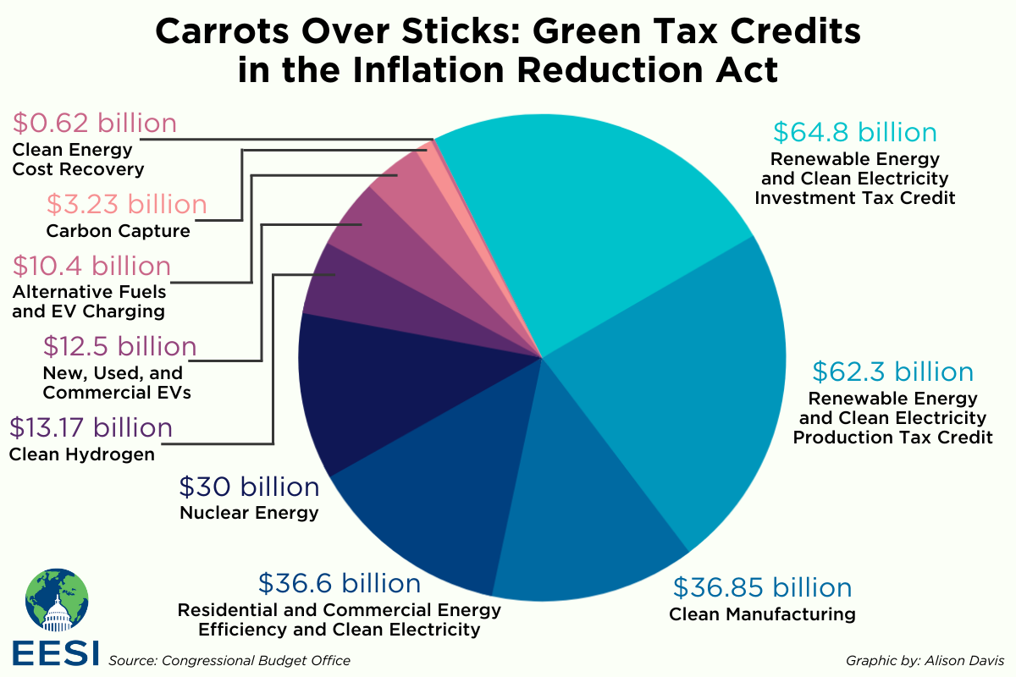
U.S. Inflation Reduction Act
Notes:
$129 B Drive down the cost of Installing Renewable Energy Projects – Majority of this is for Tax Credits for Wind, Solar and Storage
$37 B - Advanced Manufacturing – Tax Credits to increase US domestic production of Solar Panels, Inverters, Battery Storage, Wind Turbines, Blades, etc
$30 B – Protecting Clean Base Load Production - Existing Nuclear Power Plants Open and Operating
$22 B – Upgrade appliances to handle more electricity, heat pumps, heat pump water heater, induction stove tops, etc
$14 B – Home/business efficiency
$12 B – Electric Vehicle Tax Credits
$128 B – Everything else, including carbon sequestration, transmission line build out, buying debt from rural power co-ops to close fossil fuel plants if they agree to replace with CE, etc
These expenditures are only estimates and are Uncapped, meaning there is no limit on how much higher these figures can go

Slide 8
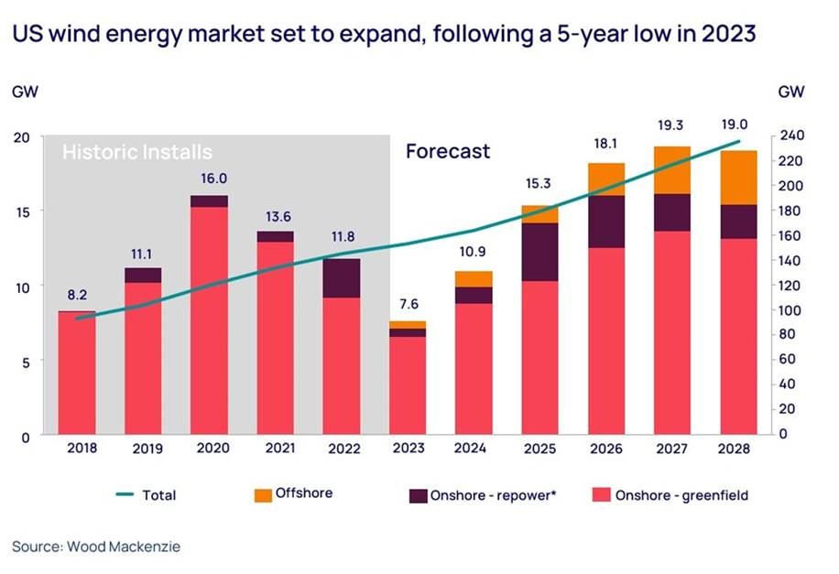
U.S. Inflation Reduction Act - Forecast
Notes:
2020 High due to the anticipation of expiring PTCs
US Wind generation capacity has grown more than 77x since 2000

Slide 9
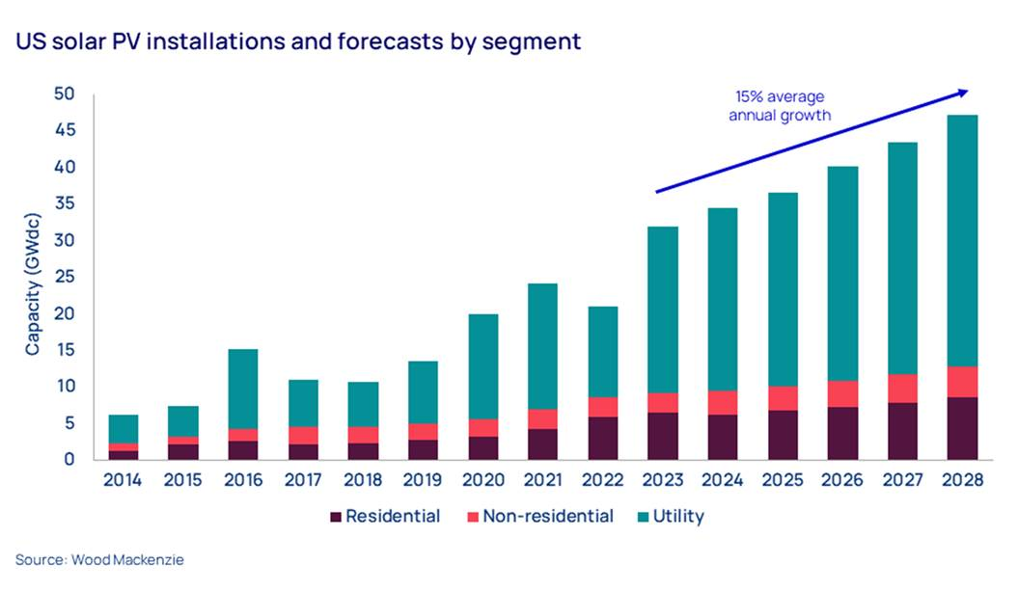
U.S. Inflation Reduction Act - Forecast
Notes:
2016 was the first expected final year of full ITCs
US Solar capacity has grown more than 200x since the ITC program was implemented in 2006

Slide 10
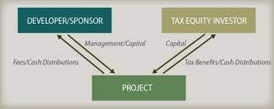
Retrospective, how did we get to where we are today?
Wind – 1992 Energy Policy Act of 1992 enacted the Production Tax Credit (PTC) which provides a tax credit for each MWh of Generation for the first 10 years of the project, the current inflation adjusted PTC is $27.50/MWh
Solar – 2005 Energy Policy Act of 2005 initially created the U.S. Federal Solar Investment Tax Credit or ITC (subsequently extended multiple times) which generated tax credits equal to 30% of the total Cost of Project over a 5-Year Period
Tax Credits, these sound great, but what if I don’t pay that much in tax?

Slide 11
Rise of the Tax Equity Investor

Slide 12
Rise of the Tax Equity Investor
Notes:
How do these work in reality
Dominated by two companies JPMorgan and Bank of American, in 2021 they provided approximately 50% of the $22 B
Example - Renewable Company X wants to develop a 100 MW project, Goes the JUMBO Bank, JUMBO agrees to put in 35% Company X puts in $65% via debt or other funds
For the First 5 or 6 Years (Solar) or 10-12 Year (Wind) Company X gets 100% of the revenue associated with the sale of Generation and JUMBO Bank receives 100% of the PTC or ITC, as it is an efficient tax payer, those are more valuable than they are to Company X. JUMBO also receives the tax losses, interest deductions and Accelerated depreciation deductions. Once JUMBO has exhausted all of the Tax Credits and Losses it can use, the partnership is concluded and Company X is now the owner of a wind or solar farm free and clear.

Slide 13
Tax Credits and Tax Equity, why does this matter?
The Inflation Reduction Act doubles down on the Production Tax Credit Programs (PTC/ITC) and has “sweetened the pot”
Acknowledging the limitations or appetite for Tax Equity Investment, the IRA also attempts to make it easier for more capital and corporate market participants to take advantage of these Tax Benefits

Slide 14
Inflation Reduction Act – What’s Changed?
Key Changes
Elections - Wind and Solar are now both eligible for EITHER Production Tax Credit or Investment Tax Credit, previously most wind was only eligible for PTC and Solar was limited to ITC.
“PTCs have been better from a return-on-investment perspective rather than the ITC. Also, the PTC is a less lumpy use of tax appetite.”
Money Center Bank, Managing Director
“More than likely new solar projects in Texas and California will opt for the PTC. How is that going to work when you have existing ITC solar projects, that won’t sell power for zero negative prices, and new PTC solar projects that will sell power at zero or negative prices.”
Sustainable Energy Investment Firm, Country Head
Stand Alone Energy Storage Systems (ESS) now eligible ITC for any type of generation stored, previously to be ITC eligible ESS had to be built in conjunction with a solar facility and it was required to charge 80% renewable power to qualify.

Slide 15
Inflation Reduction Act – What’s Changed?
Key Changes (Cont’d)
Transferability of ITC/PTC – Now, companies generating electricity have the option to sell their PTCs and ITCs to third parties, previously had to be used by the entity generating them “rise of tax equity” this opens the door to potentially increasing the pool of investors in RE projects
“Transferability brings to the table the ability of developers to try their own thing. You no longer have to listen to what the top four tax equity investors tell you about how to manage your project.”
Energy Transition Investment Firm, Partner
Rate Structure and Bonus Potential

Slide 16
Inflation Reduction Act – ITC Changes
Notes:
Walk through of rate changes and adders
ITC Base Rate x 5 (Apprenticeship/Prevailing Wage)
ITC – 6% Base x 5 (A/PW) = 30%
Domestic Content +10%
“Energy Community Bonus” (i.e, Brownfield Sites) + 10%
Total Possible – 50%
Similarly PTC
PTC - $5.50 Base x 5 (A/PW) = $27.50/MWh
Domestic Content + $3/MWh
Energy Community Bonus +$3/MWh
Discuss Gross Ups
Show PTC Example on 1,000,000 MWh Before and After and Gross Ups

Slide 17
Inflation Reduction Act – PTC Changes
Notes:
Walk through of rate changes and adders
Similarly PTC
PTC - $5.50 Base x 5 (A/PW) = $27.50/MWh
Domestic Content + $3/MWh
Energy Community Bonus +$3/MWh
Total Possible - $33.50/MWh
Discuss Gross Ups
Show PTC Example on 1,000,000 MWh Before and After and Gross Ups
Important to note that these changes are NOT retroactive, so these changes will not be impacting any of the sites placed in service before 2023, and many of those placed in service AFTER until the new construction starts ramp up

Slide 18
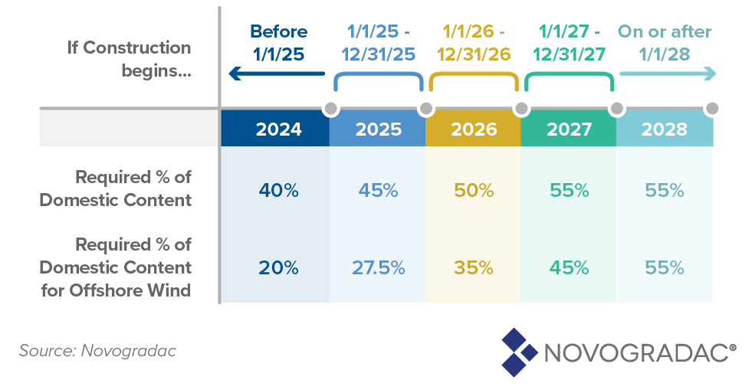
IRA – Domestic Content Bonus
The Inflation Reduction Act creates a 10% tax credit adder to encourage the use of “domestic content” in renewable projects that qualify for the production tax credit (PTC) and investment tax credit (ITC). Only projects built using the required amounts of U.S.-produced steel, iron and manufactured products can receive this credit increase.
To meet the domestic content bonus criteria, taxpayers must construct a project with:
100% U.S. content steel and iron*
Incorporate the appropriate “adjusted percentage” of domestically manufactured products**.
Tax exempt entities receiving direct pay, with projects +1MW, are required to meet Domestic Content or receive reductions in tax credits, but still receive adder credit for compliance.
*Only structural construction materials made primarily of steel or iron (racking, rebar, etc.) must meet the domestic content requirement, and not steel or iron parts of other components.
**Manufactured product is considered to be produced in the United States only if (1) all the manufacturing processes for the product take place in the United States and (2) all the components of the product are of U.S. origin.
The IRS has specific requirements for certification/record keeping which are outlined in Notice 2023-38.

Slide 19
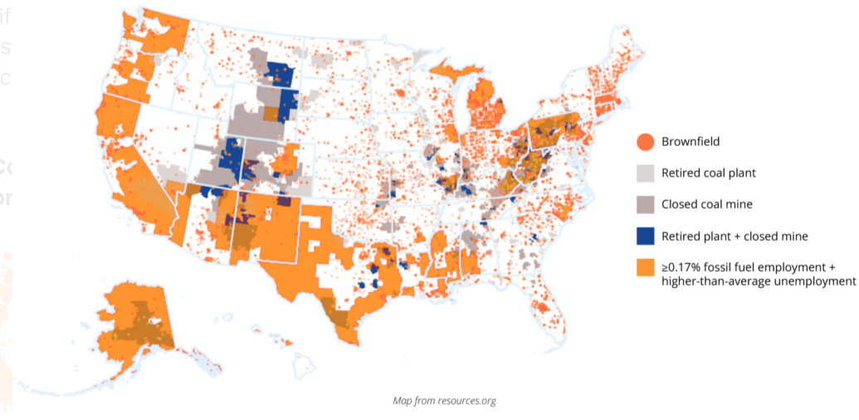
IRA – Brownfield Redevelopment
Energy Community: The Inflation Reduction Act creates a 10% tax credit adder available if a project is located in an “energy community.” Energy communities include “brownfield sites,” which is defined by referencing the Comprehensive Environmental Response, Compensation, and Liability Act (CERCLA).
The CERCLA definition is broad with a long list of exceptions. However, the consensus is that a brownfield site is “complicated by the presence or potential release of hazardous substances, pollutants, or contaminants”.
Additionally, under the same provision other notable tax deductions and credits available are:
Energy-Efficient Commercial Buildings, Energy Investment, Renewable Electricity Production, etc.
The New Markets Tax Credit program
Low-Income Housing Tax Credits
Notes:
The New Markets Tax Credit program is designed to stimulate the economies of distressed urban and rural communities and create jobs in low-income communities.
Low-Income Housing Tax Credits provide incentives for the use of private equity in the development of affordable housing for low-income Americans.

Slide 20
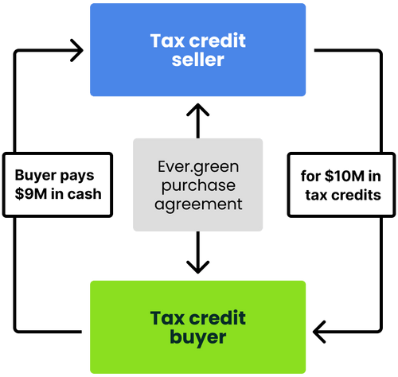
What are the Challenges?
Tax Equity Markets
Not Enough Capacity
“Twenty billion or so is the maximum capacity the market will see from the base of traditional tax equity investors. The traditional tax equity investors are maxed out, so the path forward is transferability and new entrants.”
Corporate & Investment Bank, Head of Tax Equity
Additionally, Tax Equity markets are facing issues with the proposed BASEL III guidance for central banks
Potential Solution – Tax Credit Exchanges
Notes:
There are currently at least 4 tax credit exchanges that have popped up recently looking to match sellers to buyers of Tax Credits, seen pricing anywhere between 80-92% of face value depending on the type and vintage of credits

Slide 21
What are the Challenges?
Other Challenges
Capacity for Insurance, both Construction and Operational
Interconnection/PPA Capacity
New, less experienced developers, BOP Contractors, will likely have to step in
More Challenging Site Locations
High Voltage Transmission Line Capacity
Notes:
There are currently at least 4 tax credit exchanges that have popped up recently looking to match sellers to buyers of Tax Credits, seen pricing anywhere between 80-92% of face value depending on the type and vintage of credits

Slide 22
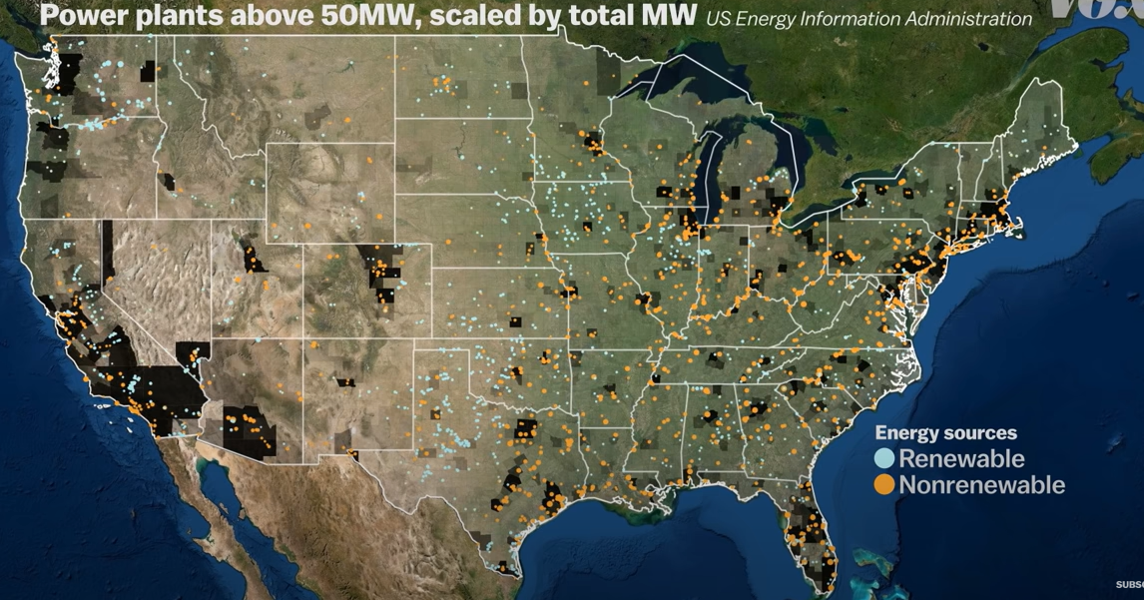
High Voltage Transmission Issues
Notes:
All the large-scale power plants are located near heavily populated areas.

Slide 23
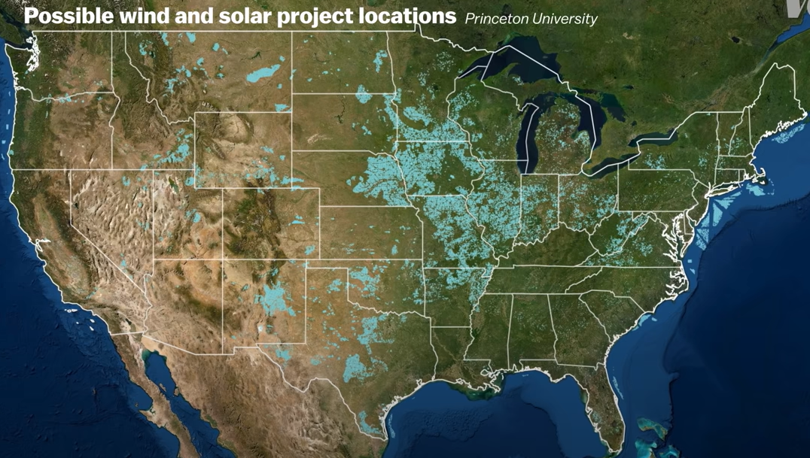
High Voltage Transmission Issues
Notes:
All the large-scale power plants are located near heavily populated areas.

Slide 24
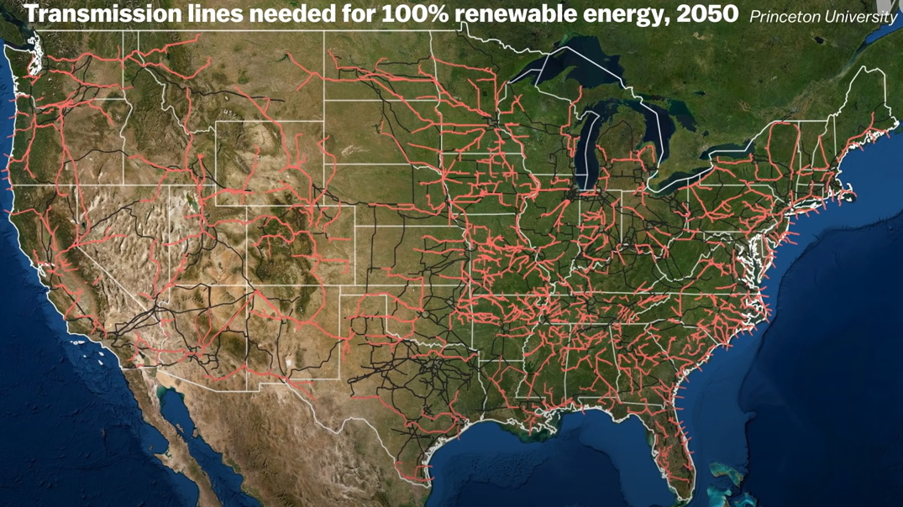
High Voltage Transmission Issues
Why So Difficult??
Building transmission lines in the U.S. requires all the stakeholders in the construction of a new line (utility companies, regulators, landowners) must agree, and there are usually competing interests.
In the end, electricity customers foot the bill for new transmission lines via additional charges in their electric bill. This amount must be approved by regulators.
Delays in the transmission planning and construction is currently an obstacle for deploying clean energy and the rate of construction has to more than double in order for the U.S. to meet its climate goals.
All of the difficulties will continue to compound as renewable power construction ramps up.
The “grey” is current transmission lines, and the “orange” is what is needed to reach 100% RE power by 2050.
Requiring ~$320 Billion in investment to meet this goal.
Notes:
99% can be in on board and that last 1% can stop a project from moving forward.

Slide 25
Why does this matter to Insurers and Claims Professional?

Slide 26
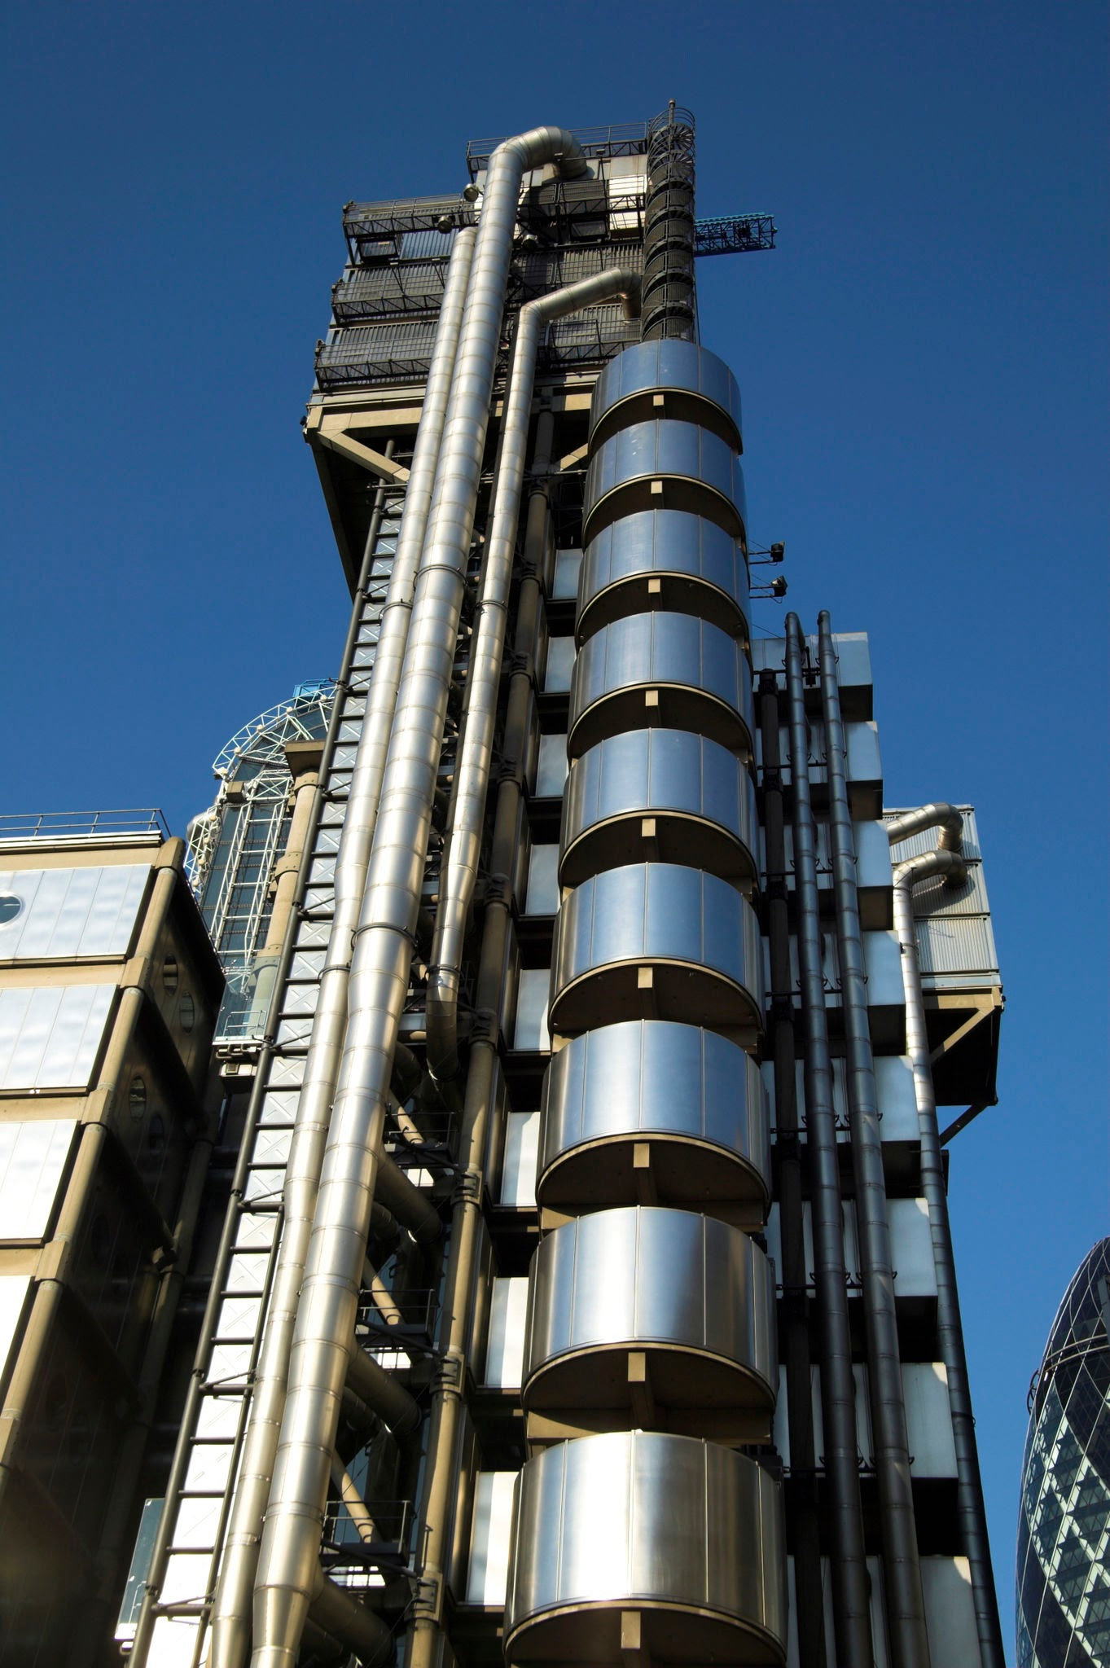
Why does this matter to you?
Insurance Capacity
Not Enough – 2021 was the Previous Record for RE Growth, forecasted to essentially double that amount for the next 10 years
Solar Farm with PTC Elections will increase TIV’s 30-40%
Accurate Statement of Value Reporting
Tax Credit Selection, and Bonus Adders if any
Increasing Costs
Construction – Prevailing Wage/Apprenticeship (10% Solar/5% Wind)
Domestic Content Provisions – Increase Costs? Slower lead times?
New (Less Seasoned) Entrants to the US RE Market
Developers, BOP, OEM
Notes:
There are currently at least 4 tax credit exchanges that have popped up recently looking to match sellers to buyers of Tax Credits, seen pricing anywhere between 80-92% of face value depending on the type and vintage of credits

Slide 27
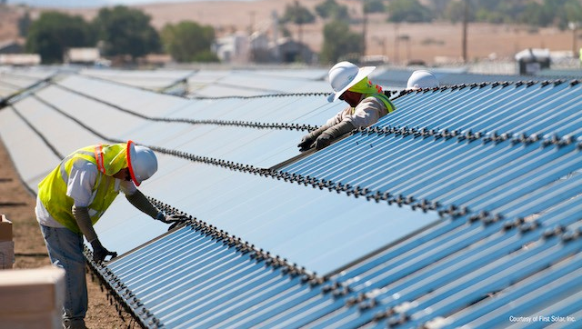
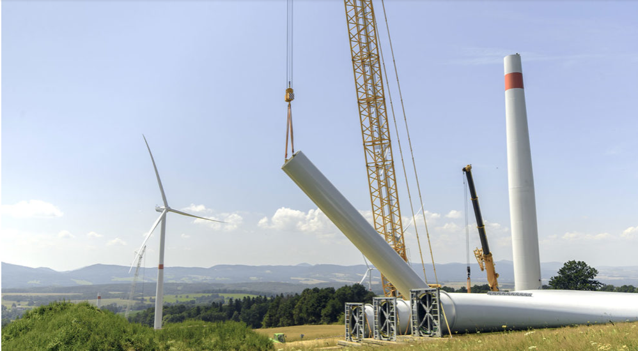
Construction Cost Implications
Labor Implications
Prevailing Wage & Apprenticeship
Increased construction costs: New wage requirements are likely to have a more notable impact on construction costs for Solar (potentially ~+10%) than with Wind (potentially ~+3%):
Labor is a larger percentage of the overall construction costs for solar.
Contractors have historically relied on lower labor rates for construction for solar than in wind, as solar construction activities are far less specialized.
“Open Shop” portability issues, as crews will potentially become more regionalized (as opposed to nationalized) due to regional disparity in prevailing wage rates, this will likely cause widening disparity between average regional construction costs.
Apprenticeship percentage requirements will likely result in better employee retention as it cannot be transferred from one company to another. However, it will also likely result in higher overhead costs for training, compliance, etc.
Compliance monitoring will likely be driven by Tax Equity and Engineers, requiring substantial audit documentation (i.e., certified payroll, etc.). This will intern require a more robust back-office for contractors and developers. Compliance failure could result in additional liquidated damages exposure, though it is more likely to result in more “make right” options.
Notes:
Tim

Slide 28
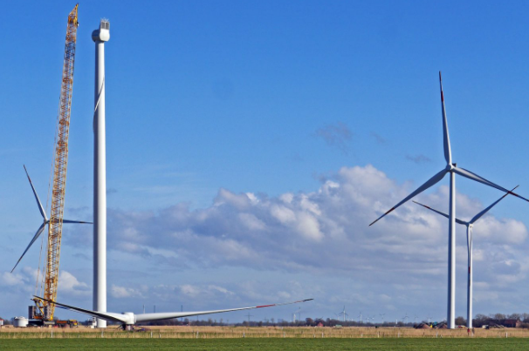
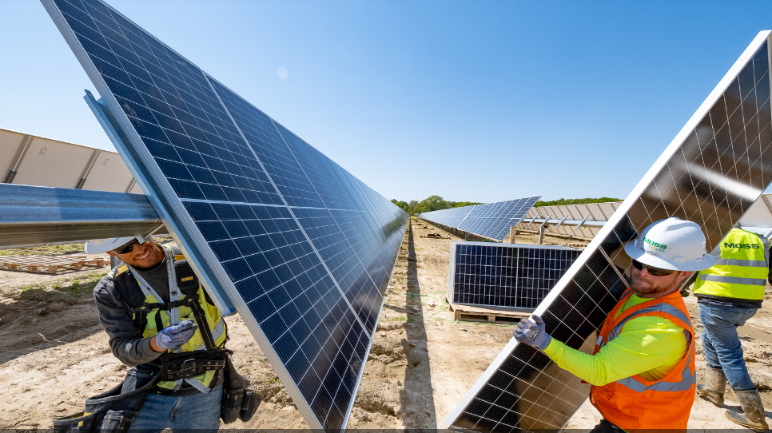
Market Impact - Points
Market growth IRA impacts:
IRA Potential Impacts
Due to additional tax credit incentives, Community and Distributed Solar, along with construction on or near “Dirty Energy” sites may see the largest growth in the immediate future.
“Dirty Energy” sites have the added benefit of localized access to interconnection.
However, the domestic module supply chain will likely result in a bottle neck for solar and may not be able to hold up with demand.
IRA lowers barriers to entry for financing access, mainly for less capital-intensive projects (i.e., Community and Distributed Solar).
However, lowering barriers for financing could result in an influx of uninformed Insureds and Insurers, unaware of risks and pitfalls unique to renewable energy construction, potentially impacting the market premiums and impactful losses.
With the solar domestic module production issues, some industry professionals feel wind is poised to ramp up faster due to evening and night generation availability.
Existing Issues
Insurance costs in the Renewable Energy sector have moved from a top-10 spend item for companies to a top-3 spend item.
Natural Perils (Flood, Fire, Wind and Hail) are still driving a “Hard Market” in Insurance. Increase of 30%-50% are being reported.
Carriers are looking for better risk sharing (i.e., higher deductibles, lower limits, etc.). Insureds are having to go to excess markets for perils like hail.
Notes:
Tim

Slide 29
Backward Look: Lessons (Hopefully) Learned

Slide 30
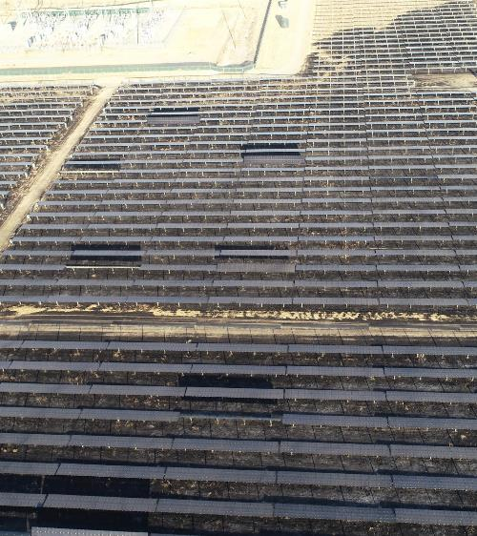
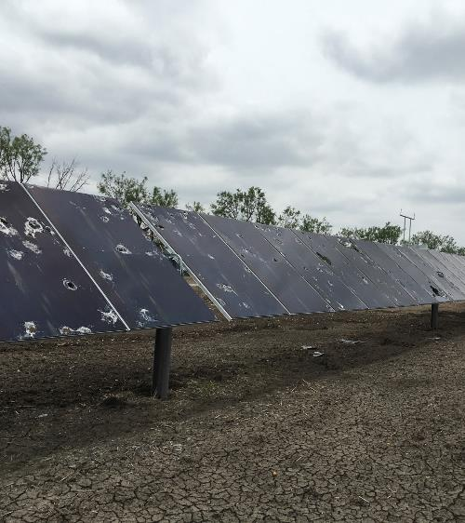
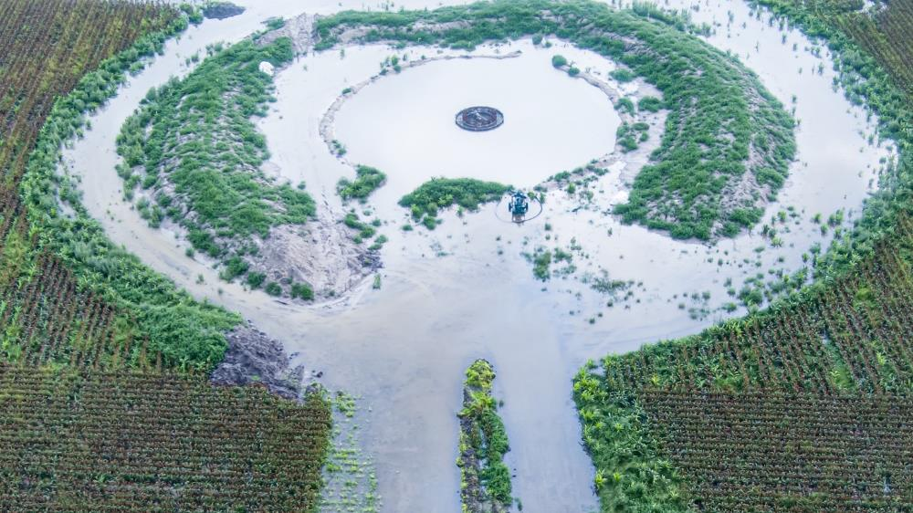
Project Locations & Risks
In addition to traditional NAT CAT, the renewable energy sector faces natural risks, which are generally much more localized, such as hail, severe weather, heavy rainfall, and brush fires.
Because these perils do not fall under the traditional definitions of natural disasters, and because renewable energy projects are still more common in less favorable and more remote locations, these events are less reported and risk staying under the radar, being as big of a threat as traditional natural disasters for renewable energy projects.
“Insured losses from severe convective storms (SCS also known as secondary perils) in the United States continued to increase during the third quarter [of 2023], surpassing the $50 billion mark for the first time on record and accounting for roughly 60% of all global insured losses.
Wildfire and severe convective storm were once again highly prominent… both are becoming increasingly costs to insurers, communities and governments. In the U.S., around 80% of SCS loss growth can be explained by exposure change – highlighting the need for insurers to understand underlying exposures in their portfolios.¹”
¹Howard, L.S. “Insured Losses from Severe Convective Storms in US Top $50B for 1st Time: AON.” Insurance Journal, 20 Oct. 2023, www.insurancejournal.com/news/international/2023/10/20/745036.htm.
Notes:
Tim

Slide 31
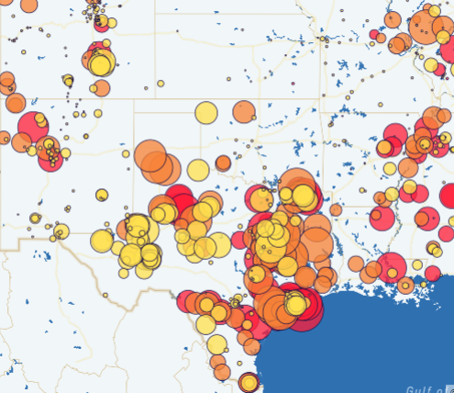
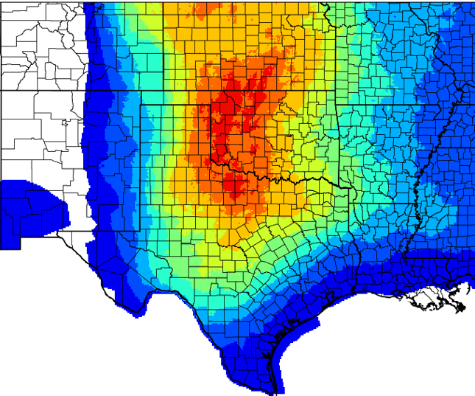
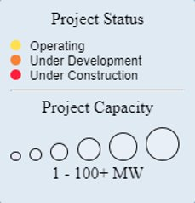
Hail/Severe Weather – Solar Risks
SEIA – Solar Project Location Map​ with Southern Plains +2” Hail Outlook Map Overlay
This data suggests a fair number of sites / projects where (2 – 5) times per year conditions historically exist conducive for +2” hail
Notes:
Tim

Slide 32
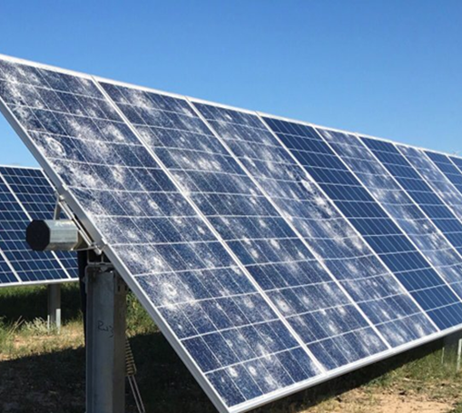
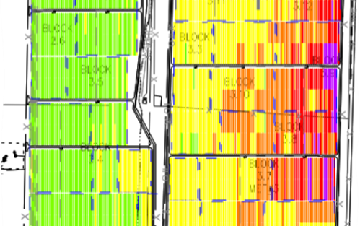
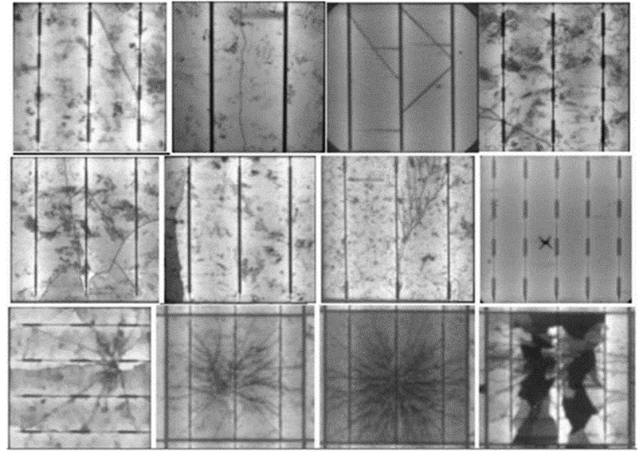
Hail/Severe Weather – Solar
Hail and Severe Weather has been a historically catastrophic peril for solar energy projects. It is important to get to the impacted site quickly to ensure the most accurate site documentation.
What time of day did the storm occur, what direction did it come from, what size of hail was observed, and was the storm warned (NWS)?
It is critical to accurately identify & document damage scope. Aerial and ground level inspections to document visible site conditions. Some impacts can be HARD TO SEE!!
What severe weather mitigation technologies (if any) were in place and were they enacted?
What (if any) non-visible damage concerns are there?
Notes:
Tim

Slide 33
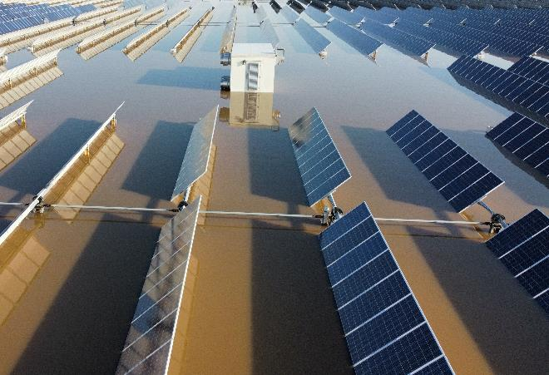
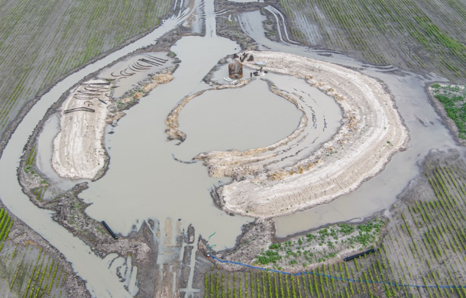
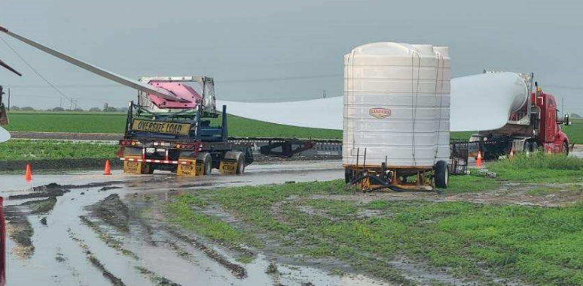
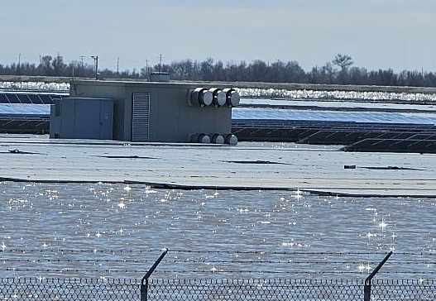
Flooding / Heavy Rain - Wind and Solar
Flooding from heavy rains can result in significant impacts to construction progress, particularly when large equipment and components are involved, as in the case of a wind turbine project.
Flooding and Ground Saturation
Labor & Equipment Standby Costs
Multiple Rain Events
Stormwater Management
Construction Schedule Impacts
Component Delivery Delays
Component Damages
Equipment Heights & Position
Repair Activities
Erosion project rework (proof rolls, etc.)
Notes:
Tim
Flooding & Ground Saturation
Is it better for the contractor to halt work for a short period of time to allow for possible site recovery, and/or when is the right time to start mitigation efforts? Paying standby for labor crews & equipment to remain at site vs. placing project on hold. ADD MORE DETAIL ON MITIGATION ACTIVITIES.
What are the specific soil conditions at the site, what do the geotechnical and hydrology documents state? What are the impacts from potential subsequent rain events?
Multiple Events: Monitoring inspections, regular status reporting from contractor, meteorological review and soil monitoring to understand potential number of events.
Construction Schedule Impacts
What is the current stage of the project, and what are the potential impacts to the critical path of the construction schedule?
Construction schedules in native software format. Native format is required to review details necessary to evaluate delay (i.e., critical path, logic, and constraints, etc.)
What if any non-event related delays exist? (i.e., component delivery delays, civil considerations, etc.)
Truck Detention / Component Demurrage
Repair Activities
Erosion / Rutting at access roads from run-off and equipment.
Component laydown and crane pad repairs / rework / addl’ proof rolling

Slide 34
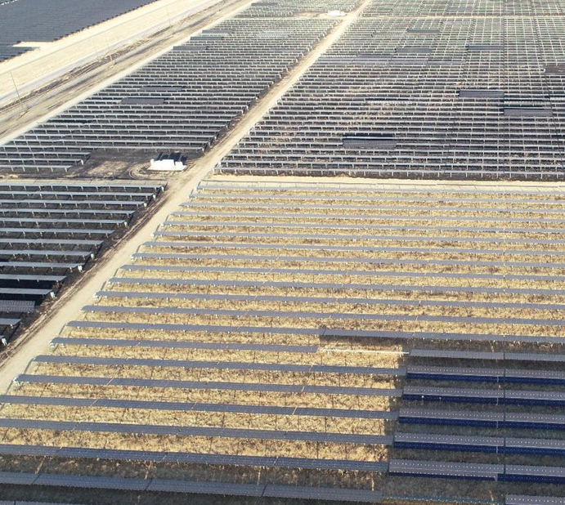
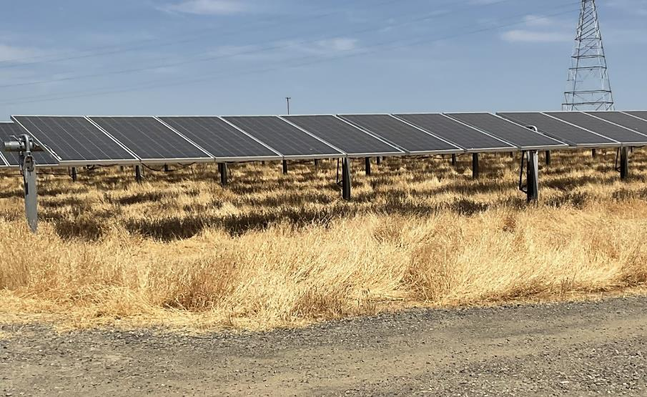
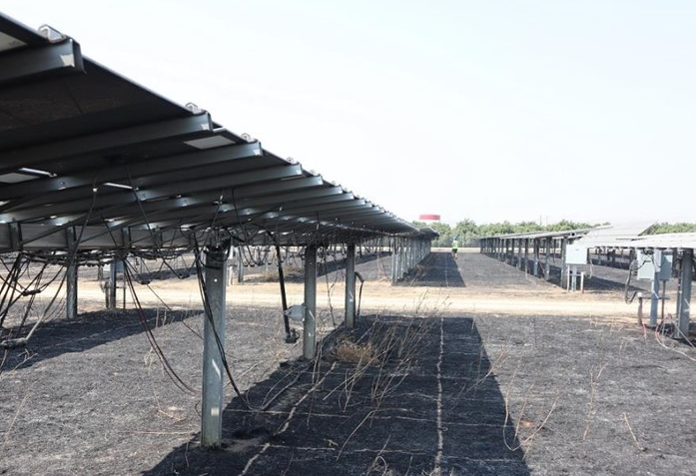
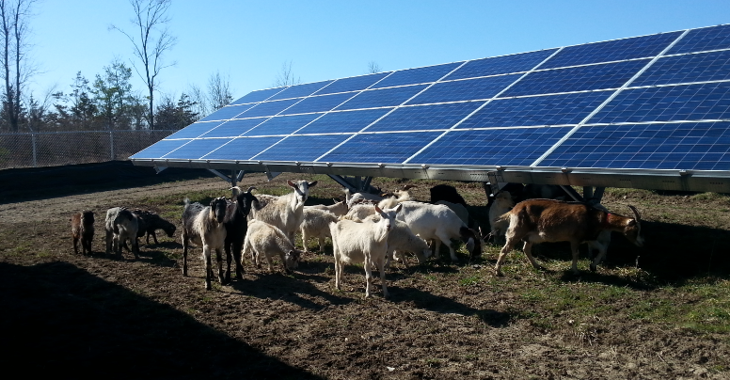
Fire (Wild/Brush) – Solar
Wildfires / brush fires and inverter fires are another notable peril faced by solar energy projects. It is important to get to the impacted site quickly to ensure the most accurate site documentation.
How and from where did the fire originate, and what (if any) are the boundaries? (Drone imagery helpful)
It is critical to accurately identify & document damage scope. Aerial and ground level inspections to document visible site conditions. Some impacts can be HARD TO SEE!!
Documenting vegetation management conditions and activities. Effective vegetation management can drastically reduce equipment exposure.
Notes:
Tim
Review slide notes and add color as needed.

Slide 35
Underwriting “BI-tes”
2022 Merchant Revenue Exposed Sites blew SOVs apart
SOV Reporting Related to Production Tax Credits
Limits – Sitewide vs. Operating Unit
Documentation Requirements
Resource Potential – Irradiance/Wind Speed tracking while site is off-line

